Slide 1

Chapter 4:
Access Control
Brian E. Brzezicki

Slide 2
Access Controls
Access controls are security features that control how people can interact with systems, and resources.

Slide 3
Access*
Access is the data flow between an subject and an object.
  Subject is a person, process or program
  Object is a resource (file, printer etc)
  Access controls should support the CIA triad!

Slide 4
Access*
What is the CIA triad?

Slide 5
Access*
Seriously, you need to know this.

Slide 6
Access*
If you don’t you will not pass the CISSP exam.

Slide 7
Components of Access Control (156)
The component of Access Control that we are about to discuss are:
  Identification:
    Who are you? (userid etc)
  Authentication:
    Prove you really are who you say you are
  Authorization:
    What are you allowed to access.
  Auditing:
    Your access is logged and reviewed.

Slide 8
Components of Access Control (156)
That was a lot of As, remember them.

Slide 9
Identification
Identifies a user uniquely
  Identification must be unique for accountability
  Standard naming schemes should be used
  Identifier should not indicate extra information about user (like job position)

Slide 10
Authentication (160)
Proving who you say you are, usually one of these 3
  Something you know
  Something you have
  Something you are

Slide 11
Authentication (160)
What is wrong with just using one of these methods?
Any single method is weak by itself.

Slide 12
Strong Authentication (159)
Strong Authentication is the combination of 2 or more of these and is encouraged!
  Strong Authentication provides a higher level of assurance*
  Strong Authentication is also called multi-factor authentication*

Slide 13
Authorization
The concept of ensuring that someone who is authenticated is allowed access to a resource.
  Authorization is a preventative control*

Slide 14
Auditing
Logging and reviewing accesses to objects.
  What is the purpose of auditing?
  Auditing is a detective control*

Slide 15
WARNING: CISSP buzzword on the next slide.

Slide 16
CISSP BUZZWORD
Logical (technical) access controls are used to provide Identification, Authentication, Authorization and Auditing.
  Things like smart cards,biometrics, passwords, and audit systems are all logical access controls.

Slide 17
Identity Management

Slide 18
Identity Management (160)
Identity management products are used to identify, authenticate and authorize users in an automated means.

Slide 19
Identity Management (160)
  It’s a broad term.

Slide 20
Identity Management (160)
These products may include
  Directories
  User account management
  Profiles
  Access controls
  Password management
  Single Sign on
  Permissions

Slide 21
Directories (163)
Information about the users and resources
  LDAP / Active Directory
  Legacy NT
  NIS/YP
  Novell Netware

Slide 22
Account Management Software
Attempts to centrally manage user accounts in a centralized and scalable method.
  Often include workflow processes that allow distributed authorization. I.e.. A manager can put in a user request or authorize a request, tickets might be generated for a Key card system for their locations, Permissions might be created for their specific needs etc.
  Automates processes
  Can includes records keeping/auditing functions
  Can ensure all accesses/accounts are cleaned up with users leave.

Slide 23
Directories Role in ID management
Directories are specialized database optimized for reading and searching operations
  Important because all resource info, users attributes, authorization info, roles, policies etc can be stored in this single place.
  Directories allow for centralized management!
  However these can be broken up and delegated. (trees in a forest)

Slide 24
Password Management In ID systems (169)
Allows for users to change their passwords,
May allow users to retrieve/reset password automatically using special information (challenge questions) or processes
Helpdesk assisted resets/retrievals
May handle password synchronization

Slide 25

Federation (175)

Slide 26
Federation (175)
Anyone know what a federation is?

Slide 27
Federation (175)
A Federation is multiple computing and/or network providers agreeing upon standards of operation in a collective fashion. (self governing entities that agree on common grounds to easy access between them)

Slide 28
Federated Identity (175)
A federated Identity is an identity and entitlements that can be used across business boundaries.
Examples:
  MS passport
  Google

Slide 29
Authentication

Slide 30
Biometrics (179)
Bio -life
Metrics - measure
  Biometrics verifies (authenticates) an individuals identity by analyzing unique personal attribute
  Require enrollment before being used*
  EXPENSIVE
  COMPLEX

Slide 31
Biometrics
Can be based on
  behavior (signature dynamics) – might change over time
  Physical attribute (fingerprints, iris, retina scans)
  We will talk about the different types of biometrics later

Slide 32
Biometrics
Can give incorrect results*
    False negative – Type 1 error* (annoying)
    False positive – Type 2 error* (very bad)

Slide 33
CER (180)
Crossover Error Rate (CER)* is an important metric that is stated as a percentage that represents the point at which the false rejection rate equals the false positive rate.
  Also called Equal Error Rate
  Use CER to compare vendors products objectively
  Lower number CER provides more assurance*. (3 is better than an 4)

Slide 34
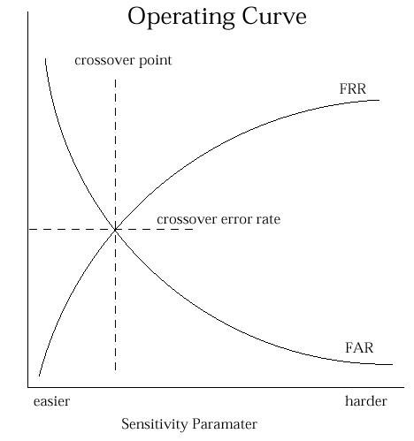
CER

Slide 35
Biometric problems?
Expensive
Unwieldy
Intrusive
Can be slow (should not take more than 5-10 seconds)*
Complex (enrollment)
Privacy Issues

Slide 36
Biometric Types Overview
We will talk in more depth of each in the next couple slides
  Fingerprint
  Hand Geometry
  Retina Scan
  Iris Scan
  Keyboard Dynamics
  Keyboard Dynamics
  Voice Print
  Facial Scan

Slide 37

Finger Print

Slide 38
Fingerprint
Measures ridge endings an bifurcations (changes in the qualitative or topological structure) and other details called “minutiae”
Full fingerprint is stored, the scanners just compute specific features and values and sends those for verification against the real fingerprint.

Slide 39
Hand Geometry
Measures:
  Overall shape of hand
  Length and width of fingers

Slide 40
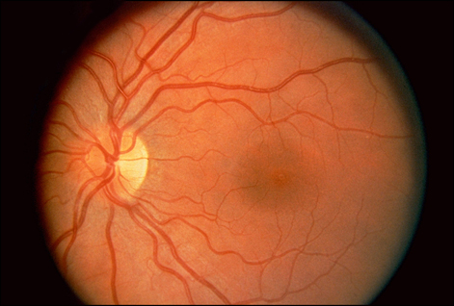
Retina Scan

Slide 41
Retina Scan
Reads blood vessel patterns on the back of the eye.
  Patterns are extremely unique
  Retina patters can change
  Can possibly be a privacy issue
  Place scanner so sun does NOT shine through aperture*

Slide 42
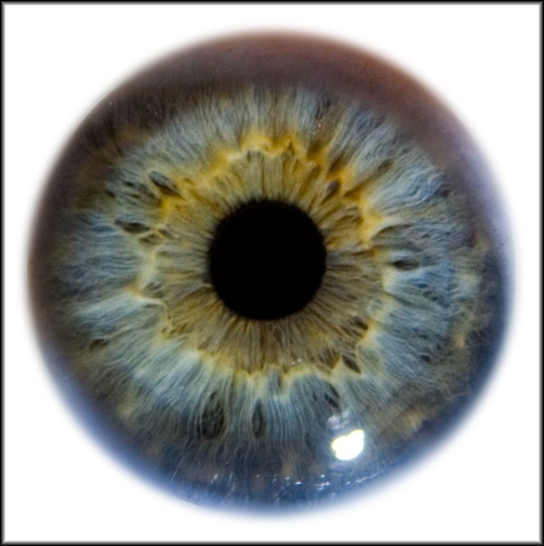
Iris Scan

Slide 43
Iris Scan
Measures
  Colors
  Rifts
  Rings
  Furrows (wrinkle, rut or groove)
Has the most assurance of all biometric systems*
IRIS remains constant through adulthood
Place scanner so sun does NOT shine through aperture*

Slide 44
Signature Dynamics
Work on the fact that most people sign in the same manner, and this is hard to reproduce
Monitor the motions and the pressure while moving (as opposed to a static signature)
Type I error rate is high
Type II error rate is low

Slide 45
Keyboard dynamics
Measure the speeds and motions as you type, including timed difference between characters typed. For a given phrase
This is more effective than a password
  it is hard to repeats someone's typing style, where as it’s easy to get someone's password.

Slide 46
Voice Print
Measures speech patterns, inflection and intonation (i.e.. pitch and tone)
For enrollment, you say several different phrases.
For authentication words are jumbled.

Slide 47
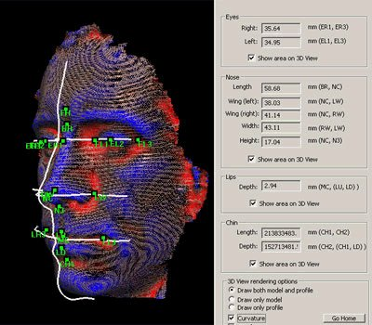
Facial Scan

Slide 48
Facial Scan
Geometric measurements of
  Bone structure
  Nose ridges
  Eye width
  Chin shape
  Forehead size

Slide 49
Hand Topography
Peaks and valleys of hand along with overall shape and curvature
This is opposed to size and width of the fingers (hand geometry)
Camera on the side at an angle snaps a pictures
Not unique enough to stand on it’s own, but can be used with hand geometry to add assurance

Slide 50
Biometrics wrap up
We covered a bunch of different biometrics
Understand some are behavioral* based
  Voice print
  Keyboard dynamics
  Can change over time
Some are physically based
  Fingerprint
  Iris scan

Slide 51
Biometrics wrap Up
Fingerprints are probably the most commonly used and cheapest*
Iris scanning provides the most “assurance”*
Some methods are intrusive*
Biometrics do cause privacy issues*

Slide 52
Biometrics Wrap up
Understand Type I and Type II errors
Be able to define CER, is a lower CER value better or worse?

Slide 53
Passwords

Slide 54
Passwords (184)
  Password – A protected string of characters that one uses to authenticate themselves.
  Password authentication is:
    Something you know

Slide 55
Passwords (184)
Password traits
  Simplest form of authentication*
  Cheapest form of authentication*
  Oldest form of authentication
  Most commonly used form of authentication*
  Weakest form of authentication*

Slide 56
Problems with Passwords
People write down passwords
People use weak passwords
People re-use passwords
If you make passwords to hard to remember then people write them down
If you make them too easy then they are easily cracked

Slide 57
Password Management
Proper Password Management, including password policies can help mitigate some of the problems with passwords.
First choose a strong password!
  Minimum password lengths - 8
  Case changes, number and special characters
    1 or more A-Z
    1 or more a-z
    1 or more 0-9
    1 or more special character
  No personal information (usernames, real name, children's names, birthdates)

Slide 58
Password Management
Use a password checker before accepting a new password
The OS should enforce password requirements
  Aging –when a password expires
    Minimum password age: days to weeks
    Maximum password age : 60-90 days
  Reuse of old passwords (password history)
  Minimum number of characters
  Limit login attempts – disable logins after a certain number of failed attempts
(more)

Slide 59
Password Management
System should NOT store passwords in plaintext, hash them instead.
Use passwords salts
  random values added to the encryption/hash process to make it harder to brute force (one password may hash/encrypt to multiple different results)
You can encrypt hashes… (Windows SYSKEY)… but…

Slide 60
Passphrases (190)
I like to use a “passphrase” to generate a password
I Like Iced Tea and Cranberry with Lemon
I L I T A C W L
1 L 1 t @ c w l

Slide 61
Attacks on Password
Sniffing (Electronic Monitoring)
Dictionary Attack
Brute force attacks
Social Engineering
Rainbow tables

Slide 62
Virtual Password
Simply a phrase, application will probably make a “virtual password” from the passphrase (etc a hash)
Generally more secure than a password
  Longer
  Yet easier to remember

Slide 63
Cognitive passwords (187)
Facts that only a user should know.
  Can be used by helpdesk authenticate a user without revealing the password.
  Often used for password reset challenges

Slide 64
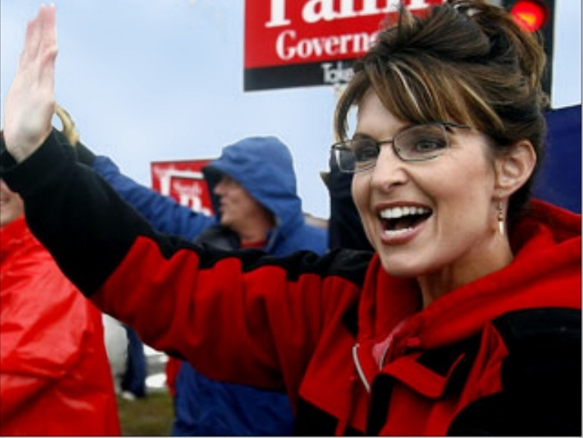
Problems with cognitive passwords
Not really secure. I’m not a big fan.

Slide 65
Cognitive Passwords (187)
“As detailed in the postings, the Palin hack didn’t require any real skill. Instead, the hacker simply reset Palin’s password using her birthdate, ZIP code and information about where she met her spouse — the security question on her Yahoo account, which was answered (Wasilla High) by a simple Google search.”
http://www.wired.com/threatlevel/2008/09/palin-e-mail-ha/

Slide 66
One Time Password
Password that is used only once then no longer valid
  Used in high security environments
  VERY secure
  Not vulnerable to electronic eavesdropping, but vulnerable to loss of token.
  Require a token device to generate passwords. (RSA SecureID key is an example)

Slide 67
One Time Password Token Type
One time passwords are one of two types that we are about to discuss.
  Synchronous
  Asynchronous

Slide 68
Synchronous One Time Password
Synchronous – uses time to synchronize between token and authentication server
  Clocks must be synchronized!
  Can also use counter-sync which a button is pushed that increments values on the token and the server

Slide 69
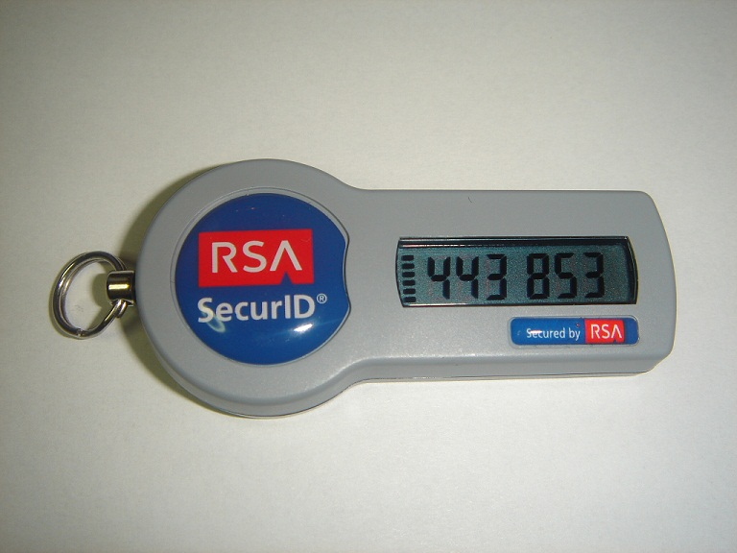
Synchronous One Time Password

Slide 70
OTP Token Types (187)
Asynchronous
  Challenge response
    Auth sends a challenge (a random value called a nonce)*
    User enters nonce into token, along with PIN
    Token encrypts nonce and returns value
    Users inputs value into workstation
    If server can decrypt then you are good.

Slide 71
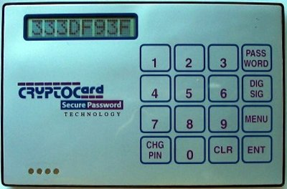
Challenge OTP

Slide 72
Other Types of Authentication ()
Other types of Authentication that we are about to discuss are
Digital Signatures
Memory Cards
Smart Cards

Slide 73
Digital Signatures
Digital Signature (talk about in more depth in chapter 8).
  Take a hash value of a message, encrypt hash with your private key
  Anyone with your public key can decrypt and verify message is from you.

Slide 74
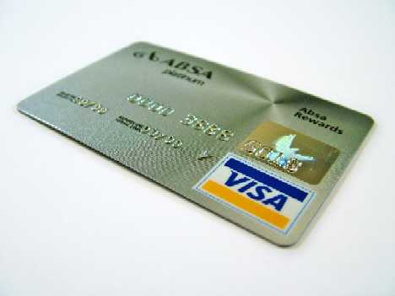
Memory Cards

Slide 75
Memory Cards (190)
NOT a smart card
Holds information, does NOT process
A memory card holds authentication info, usually you’ll want to pair this with a PIN… WHY?
A credit card or ATM card is a type of memory card, so is a key/swipe card
Usually insecure, easily copied.*

Slide 76
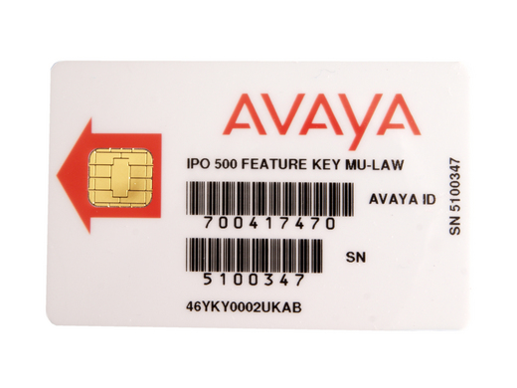
Smart Card

Slide 77
Smart Card (191)
Much more secure than memory cards
Can actually process information
Includes a microprocessor and ICs
Can provide two factor authentication, as you the card can store authentication protected by a pin. (so you need the card, and you need to know something)
Two types
  Contact
  contactless

Slide 78
Smart Card Attacks (193)
There are attacks against smart cards
1. Fault generation – manipulate environmental controls and measure errors in order to reverse engineer logic etc.
(more)

Slide 79
Smart Card Attacks
2. Side Channel Attacks – Measure the cards while they work
  Differential power analysis – measure power emissions
  Electromagnetic analysis – example frequencies emitted
(more)

Slide 80
Smart Card Attacks
3. Micro probing* - using needles to vibrations to remove the outer protection on the cards circuits. Then tap into ROMS if possible or “die” ROMS to read data.

Slide 81
Authorization

Slide 82
Authorization
Now that I proved I am who I say I am, what can I do?
  Both OSes and Applications can provide this functionality.
  Authorization can be provided based on user, groups, roles, rules, physical location, time of day (temporal isolation)* or transaction type (example a teller may be able to withdrawal small amounts, but require manager for large withdrawals)

Slide 83
Authorization principals (196)
Default NO access (implicit deny)* - Unless a subject is explicitly given access to an object, then they are implicitly denied access.
  very important principal you must understand this.

Slide 84
Authorization Creep* (197)
As a subject stays in an environment over time, their permissions accumulate even after they are no longer needed.
  Auditing authorization can help mitigate this. SOX requires yearly auditing.

Slide 85
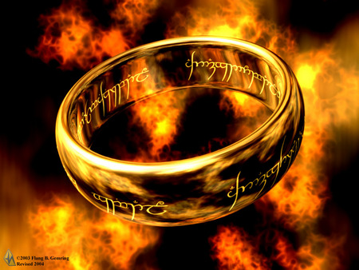
The Golden Ring of Network Authentication

Slide 86
Single Sign On (198)
As environments get larger and more complex it becomes harder and harder to manage users accounts securely.
  Multiple users to create/disable
  Passwords to remember, leads to passwords security issues
  Reduces user frustration as well as IT frustration!
  Wastes your IT budget trying to manage disparate accounts.

Slide 87
Single Sign On (198)
Single sign on systems try to mitigate this problem. Some SSO systems are.
Sun NIS/YP
Kerberos
LDAP
Microsoft Active Directory*

Slide 88
SSO downsides
Centralized point of failure*
Can cause bottlenecks*
All vendors have to play nicely (good luck)
Often very difficult to accomplish*
One ring to bind them all!...If you can access once, you can access ALL!

Slide 89
SSO technologies
Sun NIS/YP
Kerberos
SESAME
LDAP
Microsoft Active Directory*

Slide 90
NIS/YP
Sun NIS/YP – The first attempt at centralizing user accounts on a network.
Flat files distributed
Old technology
Extremely insecure

Slide 91
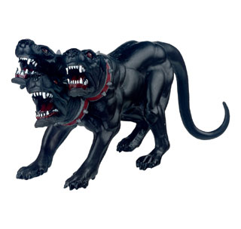
Kerberos

Slide 92
Kerberos (200)
A network authentication protocol designed from MITs project Athena. Kerberos tries to ensure authentication security in an insecure environment
Used in Windows2000+ and some Unix
Allows for single sign on
Never transfers passwords
Uses PRIVATE key encryption to verify Identifications
Avoids replay attacks

Slide 93
Kerberos Components
Principals – users or network services
KDC – Key Distribution Center, stores secret keys (passwords) for principals
Tickets
  Ticket Granting Ticket (TGT) gets you more tickets
  Service Tickets – access to specific network services (ex. File sharing)
Realms – a grouping of principals that a KDC provides service for, looks like a domain name
  Example: somedepartment.mycompany.com

Slide 94
Kerberos Concerns
Computers must have clocks synchronized within 5 minutes of each other
Tickets are stored on the workstation. If the workstation is compromised your identity can be forged.
If your KDC is hacked, security is lost
A single KDC is a single point of failure and performance bottleneck*
Still vulnerable to password guessing attacks

Slide 95
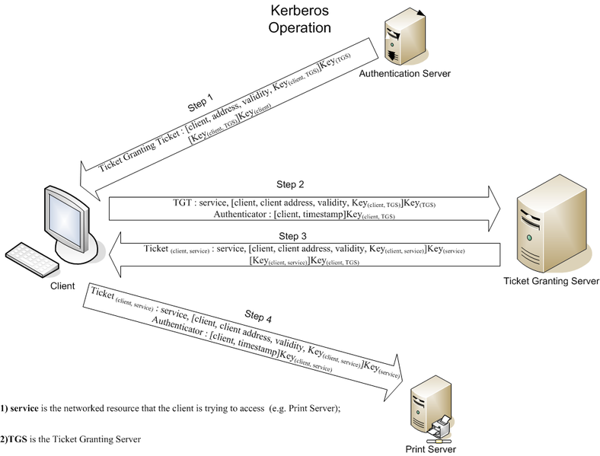
How Kerberos Works (202)
Image - http://upload.wikimedia.org/wikipedia/en/thumb/c/c3/Kerberos.png/788px-Kerberos.png

Slide 96
SESAME
European technology, developed to extend Kerberos and improve on it’s weaknesses
  Sesame uses both symmetric and asymmetric cryptography.
  Uses “Privileged Attribute Certificates” rather than tickets, PACS are digitally signed and contain the subjects identity, access capabilities for the object, access time period and lifetime of the PAC.
  PACS come from the Privileged Attribute Server.

Slide 97
Access Control Models

Slide 98
Access Control Models (210)
A framework that dictates how subjects access objects.
Uses access control technologies and security mechanisms to enforce the rules
Business goals and culture of the organization will prescribe which model is used
Every OS has a security kernel/reference monitor (talk about in another chapter) that enforces the access control model.

Slide 99
Access Control Models
The models we are about to discuss are
  DAC
  MAC
  Roles based

Slide 100
DAC
Discretionary Access Control*
  Owner or creator of resource specifies which subjects have which access to a resource. Based on the Discretion of the data owner*
  Common example is an ACL (what is an ACL?)
  Commonly implemented in commercial products (Windows, Linux, MacOS)

Slide 101
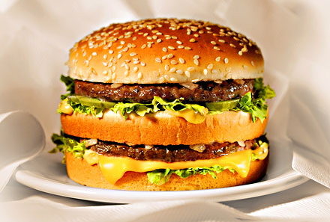
MAC

Slide 102
MAC
Mandatory Access Control*
Data owners cannot grant access!*
OS makes the decision based on a security label system*
Users and Data are given a clearance level (confidential, secret, top secret etc)*
Rules for access are configured by the security officer and enforced by the OS.

Slide 103
MAC (211)
MAC is used where classification and confidentiality is of utmost importance… military.
Generally you have to buy a specific MAC system, DAC systems don’t do MAC
  SELinux
  Trusted Solaris

Slide 104
MAC sensitivity labels
All objects in a MAC system have a security label*
Security labels can be defined the organization.
They also have categories to support “need to know” @ a certain level.
Categories can be defined by the organization
If I have “top secret” clearance can I see all projects in the “secret” level???

Slide 105
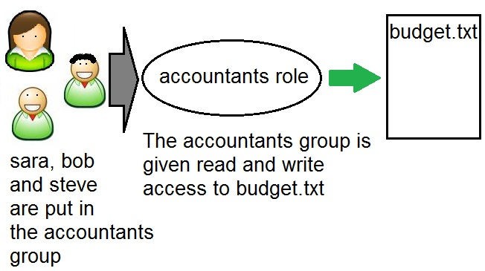
Role Based Access Control

Slide 106
Role Based Access Control (213)
Also called non-discretionary.
Uses a set of controls to determine how subjects and objects interact.
Don’t give rights to users directly. Instead create “roles” which are given rights. Assign users to roles rather than providing users directly with privileges.
Advantages:
  This scales better than DAC methods
  Fights “authorization creep”*

Slide 107
Role based Access control
When to use*
If you need centralized access*
If you DON’T need MAC ;)
If you have high turnover*

Slide 108
Access Control technologies that support access control models ()
We will talk more in depth of each in the next few slides.
Rule-based Access Control
Constrained User Interfaces
Access Control Matrix
Access Control Lists
Content-Dependant Access Control
Context-Dependant Access Control

Slide 109
Rule Based Access Control (216)
Uses specific rules that indicate what can and cannot transpire between subject and object.
“if x then y” logic
Before a subject can access and object it must meet a set of predefined rules.
  ex. If a user has proper clearance, and it’s between 9AM -5PM then allow access
However it does NOT have to deal specifically with identity/authorization
  Ex. May only accept email attachments 5M or less

Slide 110
Rules Based Access Control
Is considered a “compulsory control” because the rules are strictly enforced and not modifiable by users.
Routers and firewalls use Rule Based access control*

Slide 111
Constrained User Interfaces (218)
Restrict user access by not allowing them see certain data or have certain functionality (see slides)
Views – only allow access to certain data (canned interfaces)
Restricted shell – like a real shell but only with certain commands. (like Cisco's non-enable mode)
Menu – similar but more “gui”
Physically constrained interface – show only certain keys on a keypad/touch screen. – like an ATM. (a modern type of menu) Difference is you are physically constrained from accessing them.

Slide 112
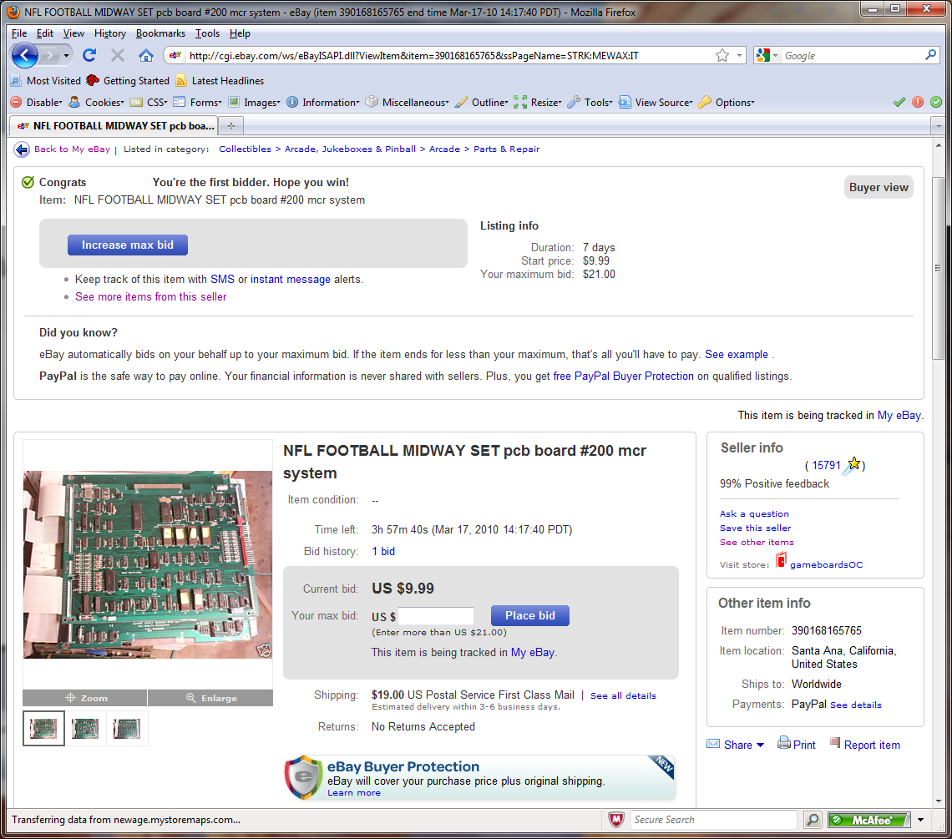
View

Slide 113
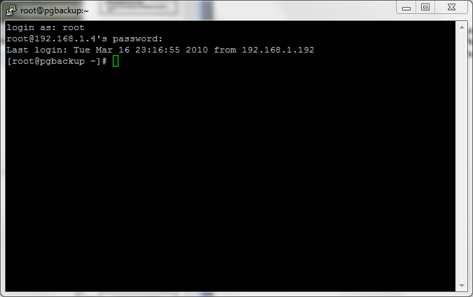
Shell

Slide 114
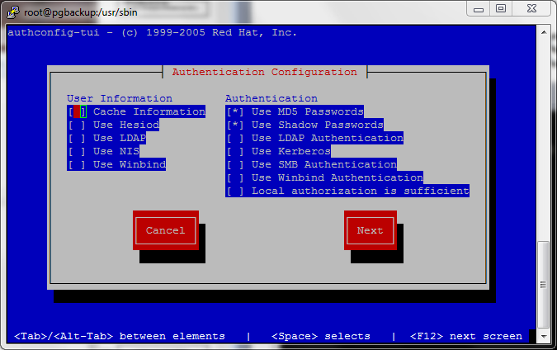
Menu

Slide 115
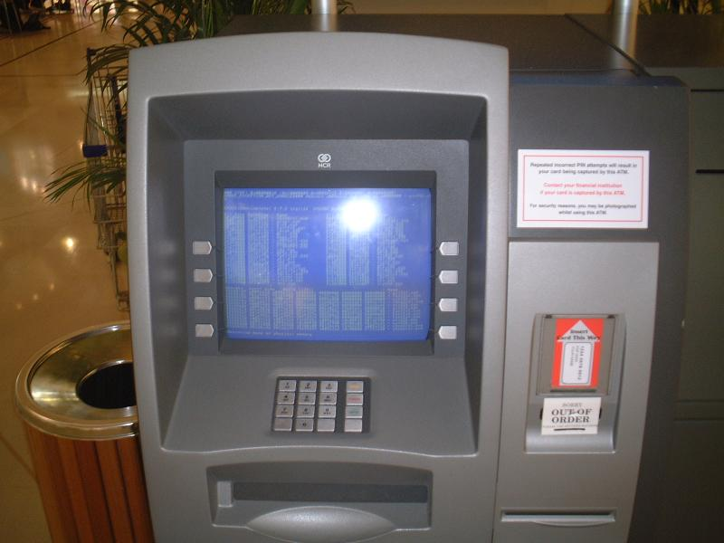
Physically Constrained UI

Slide 116
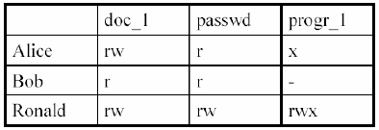
Access Control Matrix* (218)
Table of subjects and objects indicating what actions individuals subjects can take on individual objects*

Slide 117
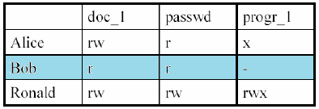
Capability Table*
Bound to subjects, lists what permissions a subject has to each object
This is a row in the access matrix
NOT an ACL.. In fact the opposite

Slide 118
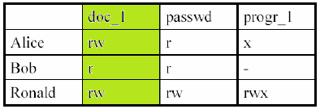
ACL*
Lists what (and how) subjects may access a certain object.
It’s a column of an access matrix

Slide 119
Content Dependant Access Controls (220)
Access is determined by the type of data.
  Example, email filters that look for specific things like “confidential”, “SSN”, images.
  Web Proxy servers may be content based.

Slide 120
Context Dependant Access Control (221)
System reviews a Situation then makes a decision on access.
  A firewall is a great example of this, if session is established, then allow traffic to proceed.
  In a web proxy, allow access to certain body imagery if previous web sessions are referencing medical data otherwise deny access.

Slide 121
Review of Access Control Technology / Techniques
Constrained User Interfaces*
  view, shell, menu, physical
Access Control Matrix*
Capability Tables*
ACL*
Content Dependant Access Control
Context Dependant Access Control
You should really know ALL of these and be able to differential between similar types!

Slide 122
Access Control Administration

Slide 123
Centralized Access Control Administration (223)
What is it?
A centralized place for configuring and managing access control
All the ones we will talk about (next) are “AAA” protocols*
  Authentication
  Authorization
  Auditing

Slide 124
Centralized Access Control Technologies
We will talk about each of these in the upcoming slides
Radius
TACACS, TACACS+
Diameter

Slide 125

Radius

Slide 126
Radius* (223)
Initially developed by Livingston to authenticate modem users
Access Server sends credentials to Radius server. Which sends back authorization and connection parameters (IP address etc) (see slide)
Can use multiple authentication type (PAP, CHAP, EAP)
Uses UDP port 1812 , and auditing 1813*
Sends Attribute Value Pair (Ex. IP=192.168.1.1)
Access server notifies Radius server on disconnect (for auditing)

Slide 127
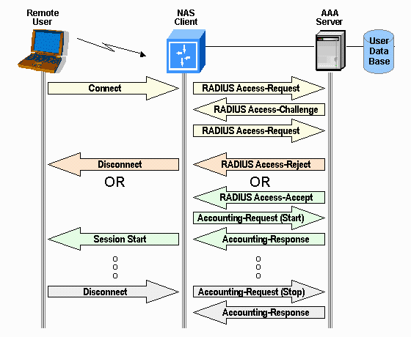
Radius

Slide 128
What is radius used for
Network access
  Dial up
  VLAN provisioning
  IP address assignment
  801.x access control

Slide 129
Radius Pros/Cons
Radius Pros
  It’s been around, a lot of vendor support
Radius Cons
  Radius can share symmetric key between NAS and Radius server, but does not encrypt attribute value pairs, only user info. This could provide info to people doing reconnaissance
  PAP password go clear text from dial up user to NAS

Slide 130
TACACS+ (223)
Provides the same functionality of Radius
TACACS+ uses TCP port 49
TACACS+ can support one time passwords
Encrypts ALL traffic data
TACACS+ separates each AAA function.
  For example can use an AD for authentication, and an SQL server for accounting.
Has more AVP pairs than Radius… more flexible

Slide 131
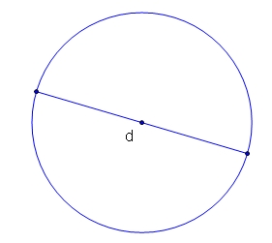
Diameter
Twice as good as Radius ;)

Slide 132
Diameter (226)
Builds upon Radius
Similar functionality to Radius and TACACS+
NOT Backwards compatible with Radius (book is wrong) but is similar and an upgrade path
Uses TCP on port 3868
With Diameter the DS can connect to the NAS (i.e.. Could say kick user off now). Radius servers only respond to client requests.
Has a lot more AVP pairs (2^32 rather than 2^8)

Slide 133
Centralized Access Controls overview
Idea centralize access control
Radius, TACACS+, diameter
Decentralized is simply maintaining access control on all nodes separately.

Slide 134
Access Control Methods

Slide 135
Controls and Control Types* (NIB)
There are Controls and Control types, need to understand these.
Controls:
  Administrative
  Physical
  Technical

Slide 136
Administrative Controls (238)
HR practices
Management practices (supervisor, corrective actions)
Training
Testing – not technical, and management’* responsibility to ensure it happens

Slide 137
Physical Controls (238)
Physical Network Segregation (not logical) – ensure certain networks segments are physically restricted
Perimeter Security – CCTV, fences, security guards, badges
Computer Controls – physical locks on computer equipment, restrict USB access etc.
(more)

Slide 138
Physical Controls continued
Work Area Separation – keep accountants out of R&D areas
Cabling – shielding, Fiber
Control Zone – break up office into logical areas (lobby – public, R&D- Top Secret, Offices – secret)

Slide 139
Technical or Logical controls (239)
Using technology to protect
System Access – Kerberos, PKI, radius (specifically access to a system)
Network Architecture – IP subnets, VLANS , DMZ
Network Access – Routers, Switches and Firewalls that control access
Encryption – protect confidentiality, integrity
Auditing – logging and notification systems.

Slide 140
Control types (237)
Types (can occur in each “control” category, expanding on last chapters types)
  Deterrent – intended to discourage attacks
  Preventative – intended to prevent incidents
  Detective – intended to detect incidents
  Corrective – intended to correct incidents
  Recovery – intended to bring controls back up to normal operation (how is this different?)
  Compensative – provides alternative controls to other controls
  Directive controls – controls etc that are required due to regulation, policies or legal reasons.

Slide 141
Unauthorized Disclosure of Information

Slide 142
Unauthorized Disclosure of Information
Sometimes data is un-intentionally released.
Examples:
Object reuse
  Countermeasures
    Destruction
    Degaussing
    overwriting
Emanations Security (next)

Slide 143
Emanation Security (247)
All devices give off electrical / magnetic signals.
A non-obvious example is reading info from a CRT bouncing off something like a pair of sunglasses.
Tempest* is a standard to develop countermeasures to protect against this.

Slide 144
Emanation Countermeasures
Faraday cage – a metal mesh cage around an object, it negates a lot of electrical/magnetic fields.
White Noise – a device that emits uniform spectrum of random electronics signals. You can buy sounds frequency white noise machines. (call centers, doctors)
Control Zones – protect sensitive devices in special areas with special walls etc.

Slide 145
Access Control Monitoring

Slide 146
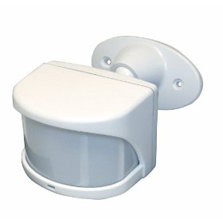
Intrusion Detection Systems
No… the other kind

Slide 147
IDS (249)
IDS are a tool in a layered security model. The purpose of an IDS is to
identify suspicious activity
log activity
Respond (alert people)

Slide 148
IDS categories
IDS systems we are about to discuss.
HIDS – Host Based Intrusion Detection System
NIDS – Network Intrusion Detection System

Slide 149
IDS Components
Both type of IDS have several components that make up the product
Sensor – Data Collector
  On network segments (NIDS)
  Or on Hosts (HIDS)
Analysis Engine – Analyzes data collected by the sensor, determines if there is suspicious activity
Signature Database – Used by the AE, defines signatures of previously known attacks
User Interface and Reporting – the way the system interacts with users
(visualization next)

Slide 150
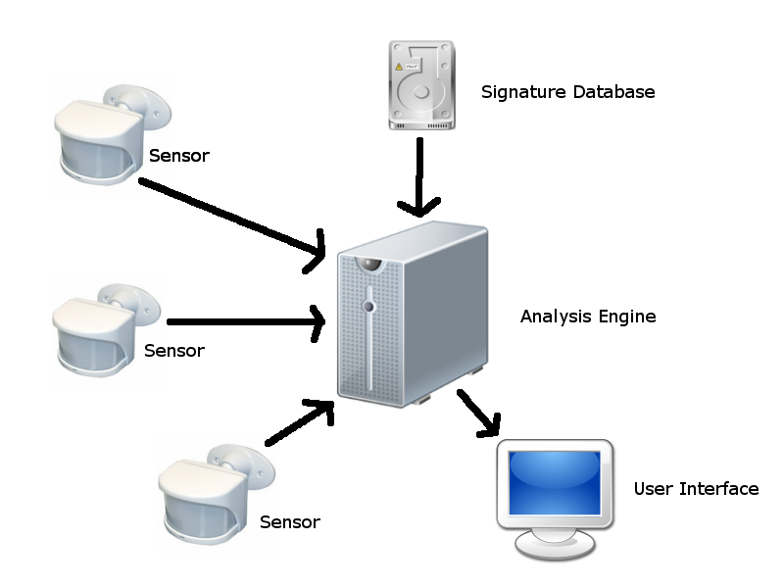
IDS Components

Slide 151
HIDS
Hosts Based Intrusion Detection Systems – Examine the operation of a SINGLE system independently to determine of anything “of note” is going on.
Some things a HIDS will looks at
Logins
System Log files / audit files
Application Log Files / audit files
File Activity / Changes to software
Configuration Files changes
Processes being launched or stopped
Use of certain programs
CPU usage
Network Traffic to/from Computer

Slide 152
Advantages of HIDS
Can be operating system and application specific – might understand the latest attack against a certain service on a host.
They can look at data after it’s been decrypted (network traffic is often encrypted)*

Slide 153
Disadvantages of HIDS
Only protect one machine (or must be loaded on every machine you want to protect)
Use local system resources (CPU/memory)
They don’t see what’s going on, on other machines.
Scalability
The HIDS could be disabled if machine is hacked

Slide 154
HIDS side note
Logs in Unix are generally sent via the syslog mechanism to a series of files.
In Unix you also have a kernel ring buffer
In Windows you have the event viewer which you can view logs by Application, System, and Security other categories may be added.

Slide 155
Network Based IDS
A concept focused on watching an entire network and all associated machines. Focuses specifically on network traffic, in this case the “sensor” is sometimes called a “traffic collector”
Looks at
SRC IP
DEST IP
Protocol
Port Numbers
Data Content

Slide 156
Network Based IDS
A NIDS system will often look for
DoS Attacks
Port Scans
Malicious content
Vulnerability tests
Tunneling
Brute Force Attacks

Slide 157
Network Based IDS
In Addition to looking for attacks a NIDS can watch the internal network for policy violations.
Example:
Detecting Instant Messaging, or streaming video.

Slide 158
NIDS Advantages
A single NIDS sensor can cover a whole network. What happens if I want to cover multiple networks?
Deployment is usually easier
A NIDS can see things that are happening on multiple machine, it gets a bigger picture and may see distributed attacks that a HIDS would miss

Slide 159
NIDS problems
Data must be UNENCRYPTED for a NIDS to analyze. So many protocols are now encrypted, it’s hard for the NIDS to see what’s going on.*
Switches cause problems for NIDS.
If only on the perimeter, it can miss things on the inside.
It must be able to handle LOTS of data to be effective! (should be able to handle wire speed+)
It does not see what’s going on a server directly

Slide 160
IDS vs. IPS
An IDS is generally a passive device.
An IPS is an IDS that takes an active aproach.
Examples:
  Activate Firewall rules dynamically
  Shuts down TCP traffic

Slide 161
Signature Based
Most network attacks have distinct “signatures” that is data that is passed between attacker and victim. A Signature Based NIDS has a database of known attack signatures, and compares network traffic against this database.
Concerns for Singature Based systems.
  Pay for a signature subscription from vendor*
  Keep signatures updated*
  Does not protect against 0day attacks!

Slide 162
Anomaly based IDS
Example.
You have a 15 year old son. Everyday he normally comes home at 3:30 does his homework watches TV. All of a sudden he starts “hanging out at school” till 5PM, comes home, does homework, then disappears into his room and talks on the phone till 9:30PM

Slide 163
Anomaly
Anomaly based system, look for changes in “normal” behavior. To do this generally you let a anomaly based system learn what normal behavior is over a few days or weeks, creating a baseline. The anomaly based system will then look for traffic types and volume that is outside of the normal behavior.

Slide 164
Anomaly
Advantages
  Can possibly detect 0days*
  Can detect behavioral changes that might not be technical attacks (like employees preparing to commit fraud)*
Disadvantages
  Lots of false positives*
  Often ignored due to reason above
  Requires a much more skilled analyst

Slide 165
Rules Based
Uses expert system/knowledge based systems.
These use a database of knowledge and an “inference engine”) to try to mimic human knowledge. It’s like of a person was watching data in real time and had knowledge of how attacks work.

Slide 166
Random Term #1
Promiscuous Mode …

Slide 167
Random Term #1
… Get your mind out of the gutter…

Slide 168
Random Term #1
Promiscuous mode
Network interfaces generally only look at packets specifically intended for their MAC address. TO accomplish sniffing, network analysis, or IDS functionality, you have to put network interfaces into promiscuous mode

Slide 169
Random Term #2
Network Tap – a piece of hardware that lets a device ONLY see what’s going on in the network, it doesn’t allow for outgoing traffic.
In the case of an IDS, you might put a TAP on the IDS to stop someone from hacking the IDS.

Slide 170
Random Term #3
Switched Port Analyzer (SPAN) or (Mirror port) – to get around the problem IDS system in a switched network.
  Configure your switch to copy all traffic down to the SPAN port where your IDS system sits.

Slide 171
Random Term #4
Network Mapper – a tool used to discover devices and Operating Systems that are on a network.

Slide 172
Threats to Access Control

Slide 173
Threats to Access Control (260)
Let’s review these now
Dictionary attacks
Sniffers
Dictionary attack.
Brute force attacks
Spoofing login/trusted path
Phishing
Identity theft

Slide 174
Chapter 4 - Review
Q. What is a type 1 error (biometrics)
Q. What is a type 2 error (biometrics)
Q. Which is generally less desirable.
Q. What is CER?
Q. What is derived from a passphrase

Slide 175
Chapter 4 - Review
Q. Does Kerberos use
  Tickets?
  Public keys?
  Private keys?
  Digital certificates?
Q. Does Kerberos ever send a password over the network?
Q. What is the most commonly used method of authentication
Q. what is strong authentication?

Slide 176
Chapter 4 - Review
Q. If a company has a high turnover rate, which access control system is the best.
  DAC
  Role-Based
  Rule-Based
Q. What is mutual authentication?
Q. Reviewing audit logs is what type of control
  Preventative
  Detective
  corrective?
Q. What is the concept of least privilege?

