Slide 1
Chapter 5: Security Architecture
Brian E. Brzezicki

Slide 2
Architecture (283)
Architecture encompasses all of the components of a computer, including
Operating System (Windows, Linux, Solaris etc)
Memory (next)
CPU
Storage (Hard Drives, IDE/ATA, SCSI, Fibre Channel)
I/O devices
Security components
Networking

Slide 3
Memory
Address | Data (1 byte usually)
0000 | 00100000
0001 | 01000001
0002 | 00000000
0003 | 10000000
0004 | 10001010
…
1024 (1K) | 10111001
…
1073741824 (1G) | 10101010

Slide 4
CPU (283)
CPU – the brain of a computer. Which consists of
Control unit – fetches instructions for the ALU to execute.
ALU – executes instructions which are usually
Mathematical operations
Logical operations (AND, OR)
Memory Accesses
Registers (next slide)

Slide 5
Registers (285)
Registers – small extremely fast memory locations located directly on the CPU.
General purpose registers – variables
special registers – hold special values
The Program Counter is a special register, which holds the address in memory of the next instruction to be executed (EIP on Intel IA32*)
Program Status Word – contains flags that describe the status of instructions being run.
Stack Pointer – (ESP on Intel IA32)

Slide 6
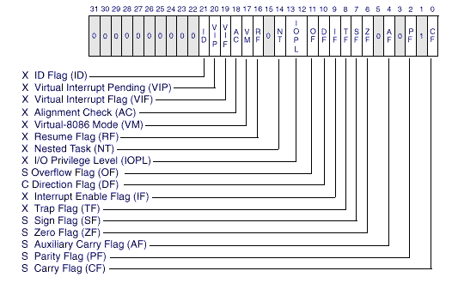
Program Status Word

Slide 7
External Components (287)
Address Bus – a series of wires that the CPU and other components share that specific a memory ADDRESS to access
Data Bus – a series of wires that the CPU and other components share that hold the actual DATA for the memory location currently being accessed
(see visualization)

Slide 8
Memory Access
Address (Bus) | Data (Bus)
00000101 (5) | 00100010 (34)
If the CPU wants to access memory location 5, it would put 00000101 on the ADDRESS BUS and issues a READ request.
The memory controller would look up the value in memory location 5 and return the value on the DATA bus, in this case if memory location 5 had the number 34 stored in it. The value returned on the DATA bus would be binary 34 (00100010)
(visualization on next slides)

Slide 9
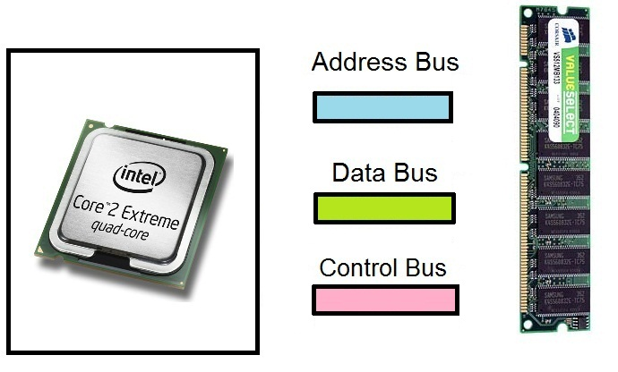
Memory Buses (read example)

Slide 10
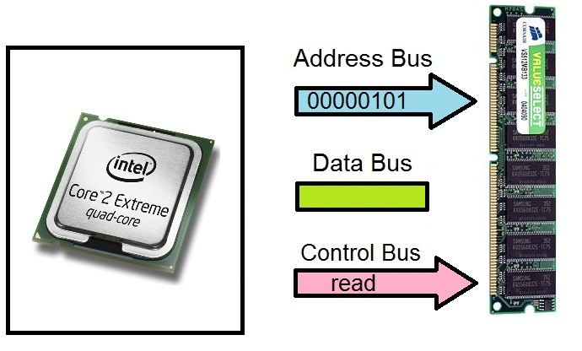
Memory Buses (read example)

Slide 11
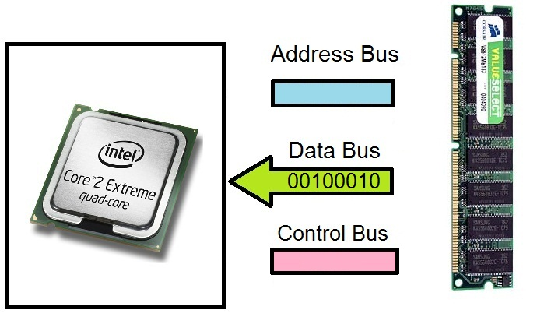
Memory Buses (read example)

Slide 12
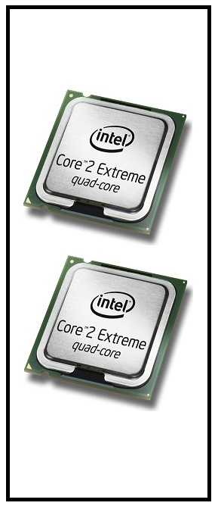
Multiprocessing (288)
Some computers have more than one CPU.

Slide 13
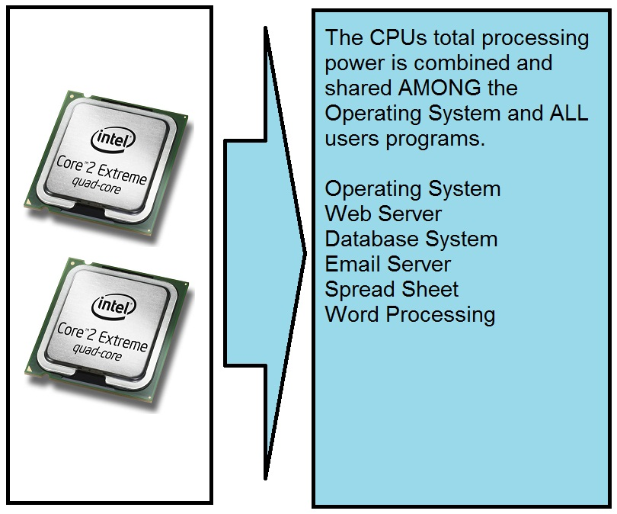
Symmetric Multiprocessing (288)

Slide 14
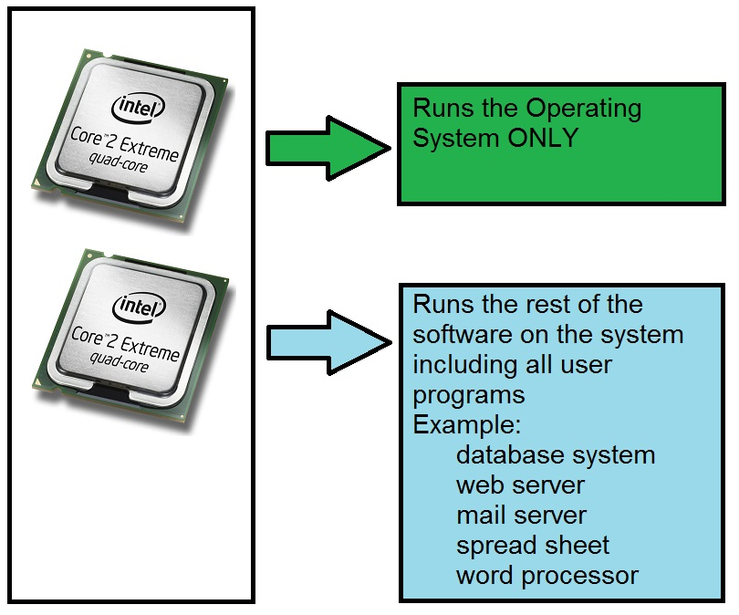
Asymmetric Multiprocessing (288)
1 or more processors are dedicated for the OS. Usually used in time-sensitive or real-time systems. (Like flight control systems)

Slide 15
Process management (289)
A process is a computer program that is actually running on a computer. (like Firefox, or MS Word).

Slide 16
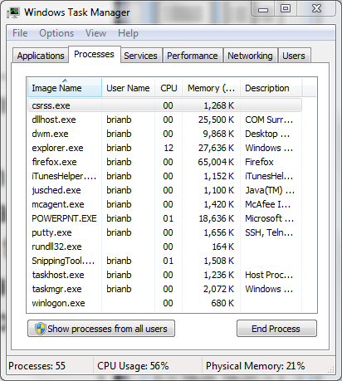
Multiprogramming
Multi-programming means that can be running more than one process at a time… Even if there is only 1 CPU…how does this happen?

Slide 17
Time Slicing (1 second)
Time Period | Program Running
0-99 milliseconds | MS Word
100-199 milliseconds | Firefox (web browser)
200-299 milliseconds | MS Excel
300-399 milliseconds | Adobe Photoshop
400-499 milliseconds | Windows Explorer
500-599 milliseconds | MS PowerPoint
600-699 milliseconds | Operating System
700-799 milliseconds | Adobe Acrobat Reader
800-899 milliseconds | Anti-Virus
900-999 milliseconds | Thunderbird (email)

Slide 18
Multi-programming (290)
Co-operative multitasking (used in windows 3.1) – one process must specifically release it’s control of the CPU before another can use the processor.
Pros?
Cons?
Pre-emptive multitasking – The Operating System takes the processor away from one program and gives it to another in a scheduled manner.
Pros?
Cons?

Slide 19
Multi-programming (290)
When there are multiple processes on a computer, these processes can be in one of these states
Running
process is actually using the CPU
Blocked
process is waiting for some input that it expects immediately, gives up CPU
Sleeping
process is waiting for some input but does not expect it for a while, gives up CPU
The processes, their states, and specific information (memory allocation, open files… etc) are stored in a “process table”

Slide 20
Process Table
Program | PID | State | State Info
Firefox | 1453 | Running | SP=19024, PC=20000 Memory allocation=…
telnet | 754 | Blocked | SP=1024, PC=2043 Memory allocation=…
mysql | 56 | Sleeping | SP=40112, PC=4321 Memory allocation=…
httpd | 1014 | Sleeping | SP=74123, PC=65123 Memory allocation=…

Slide 21
Multi-programming (291)
If a process needs to signal the CPU to perform some action it generates an interrupt. Interrupts tell the CPU to stop what it’s doing and take some action on behalf of the process.
Interrupts fall into two categories
Mask able
Non-mask able

Slide 22
A thread (293)
A thread is the set of instructions that will be run on a CPU. (this is also the definition of a process)
On modern OS’s threads rather than processes are scheduled for execution.
A process may be made up of multiple threads.
Thread usually handle some specific part of a program where a program wants to do two or more actions at the same time. (Example, printing, whiled editing… explain this, perhaps “cloning analogy)

Slide 23
Multi-threaded program
A program that is written such that different parts of the program can run in parallel. Keep in mind
threads can share resources like memory natively. Processes cannot. (explain this)

Slide 24
Thread
Process
Threads

Slide 25
Process/thread scheduling (294)
Scheduling processes is an important job that the OS must perform. The goal is to share the CPU effectively while keeping in mind the current demands for resources.
Concerns with processes scheduling –
Effective resource allocation
Being fair
Time critical (realtime) processes
Deadlocks*

Slide 26
Ensuring security on Multitasking systems (296)
Computers run multiple processes at the same time. These processes need to be protected from each other. They should not be able to access each others resources either intentionally or accidentally. The OS needs to enforce this. They attempt to do this using process isolation which provides the following services.
(next slides)

Slide 27
Ensuring security on Multitasking systems (296)
Encapsulation – No process can interact with another process. One process cannot read/write to the process space of another, or even communicate with another process without using some external interface/communications channel.
(visual next slide)

Slide 28
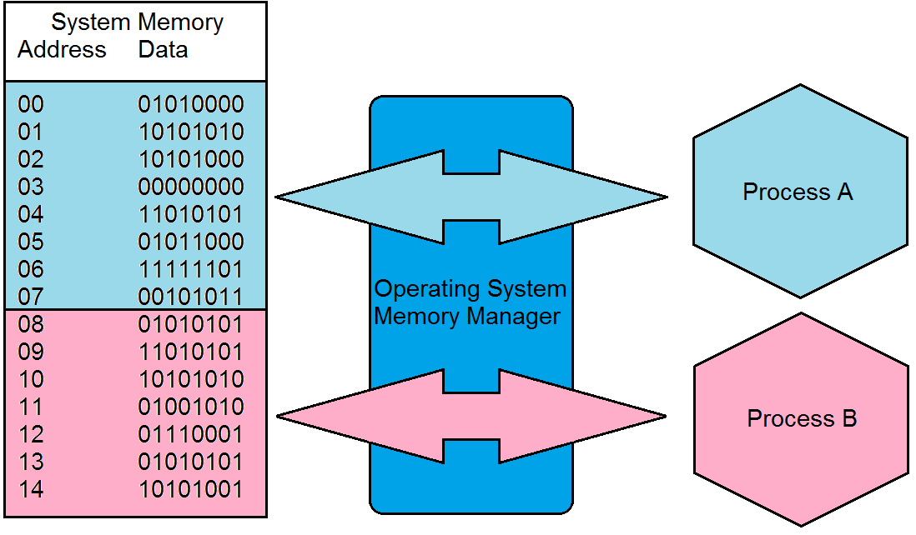
Memory Encapsulation/Isolation

Slide 29
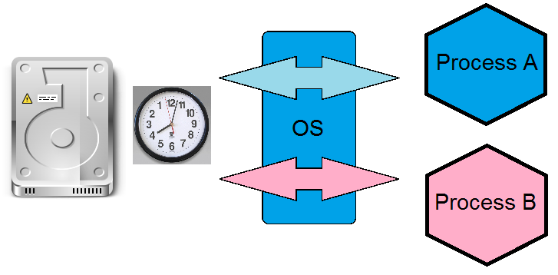
Ensuring security on Multitasking systems (297)
Time Multiplexing – Allows processes to share resources. They do this by each using the resources for a fraction of time.

Slide 30
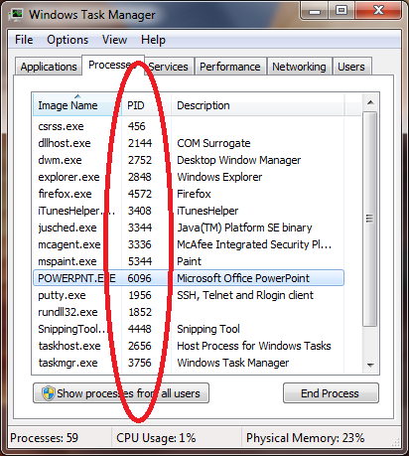
Ensuring security on Multitasking systems (297)
Naming Distinctions – Each process has it’s own name or id. In Unix and Windows processes have a PID (process id)

Slide 31
Ensuring security on Multitasking systems (297)
Virtual Mapping – A process thinks it’s the only process on the machine (at least with memory)
All processes see the same memory space (0 – maximum process memory). That memory is mapped into actually system memory space by a memory mapper*
(see diagram)

Slide 32
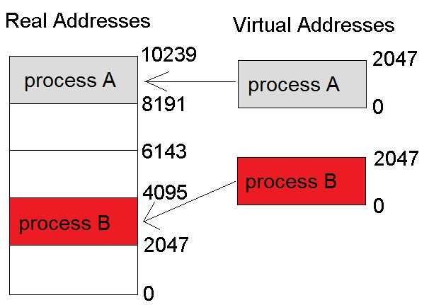
Virtual Mapping (297)

Slide 33
Memory Management (297)
Multi-tasking Operating Systems provide memory management. Goals of memory management are
Provide abstraction layer for programmers (how)
Maximize performance with the limited amount of memory (how)
Protect the OS and applications (how)
Programs don’t need to know the amount or type of memory.
(more)

Slide 34
Memory Management (297)
Responsibilities of the MM are:
Relocation – swapping, and virtual mapping
Absolute and Logical Addresses*
Real addresses are “Absolute Addresses”
Virtual Addresses are “Logical Addresses”

Slide 35
Memory Management
Protection – isolate processes memory space
Sharing – API for shared memory
Physical Organization – segment the physical memory space for applications and the OS.
Windows userspace 0x0000 – 0x7FFFFFF
Windows kernel space 0x8000000 – 0xFFFFFFFF

Slide 36
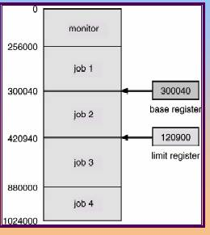
Memory Management
What are some methods that are used for this.
Base and limit registers are used to check memory access.
Base is the start of the memory space
Limit is the end of the memory space

Slide 37
Memory Types (300)
RAM – Temporary memory
DRAM – RAM which requires refreshing
SRAM – RAM with no refresh needs, much faster and more expensive.
(more)

Slide 38
Memory Types (300)
SDRAM – timed DRAM
DDR SDRAM – SDRAM which operates on both rising and falling of clock (twice as fast)

Slide 39
Memory Types (300)
ROM – Read Only Memory – non-volatile, non-writable. Good for firmware. Secure as it’s not writable. (why is this secure?)
PROM – Programmable ROM
EPROM – Erasable PROM (UV)
EEPROM – Electrically Erasable PROM that is Erasable but Electronically. (security implications)
Flash Memory – Reprogrammable on the fly
Cache Memory – what this, what are it’s attributes?

Slide 40
Other Memory Terms (306)
Memory Leak – what is this, what are issues, what type of attack can exploit a memory leak? What is a countermeasure for Memory Leaks (GC)
Virtual Memory – using secondary storage to virtually expand your memory.
Paging / Swapping
Page frames
Security concerns with paging, both live and reboots. What can you do to protect on reboots?

Slide 41
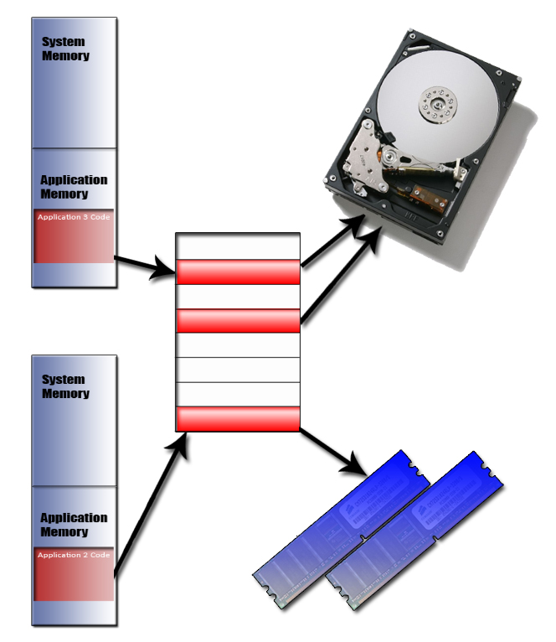
Paging (309)

Slide 42
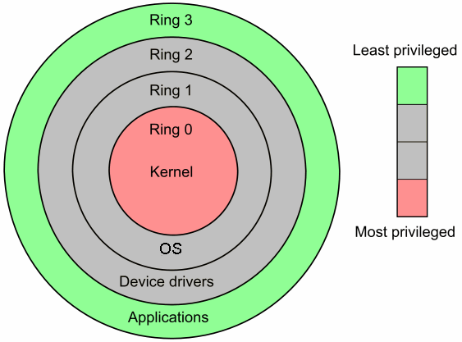
CPU Modes and protection rings

Slide 43
CPU Modes and Protection Rings (310)
The operating Systems protects itself by segmenting it’s components into rings, Each inner ring is more privileged and provides services on behalf of the outer rings. The Number of rings an OS can have is dependant on the type of processor that it runs on.
Code in one ring can only access other objects in the same ring, or request a service from the ring beneath it based on well defined standards/APIs

Slide 44
OS protection and memory rings ()
The Most commonly used architecture (according to the book) uses 4 rings
Ring 0 – Operating System Kernel
Ring 1 – Remaining parts of the OS
Ring 2 – I/O drivers and utilities
Ring 3 – Applications (ex. Web browser)
Current PC operating systems only use Ring 0 and Ring 3 (Hypervisor use extra rings)

Slide 45
Wrap up on OS Modes and Protection Rings
Rings allow the OS to place different components at different levels of security. Things at each level are in the same execution domain
Each level closer to the middle is more trusted
Each inner level provides services for an outer level. (give an example, i.e. write system call)

Slide 46
Operating Systems Architecture (313)
The operating system can be designed based on multiple models
Monolithic kernel* – means all kernel code runs in privileged mode
Microkernel – minimal kernel services that run in privileged mode and provide services to other kernel components in user mode
Note when code is running as part of the OS kernel. it is running in privileged mode

Slide 47
Virtual Machines (318)
What is a virtual machine. What is the purposes of a virtual machine. What are the strengths. How can a virtual machine help strengthen security?
Service isolation
Failover (Availability)
Memory forensics
…
What are some popular virtual environments?

Slide 48
I/O device management (320)
programmed I/O (polling) –
problems?
interrupt driven I/O –
problems?
DMA – what is it?
Premapped I/O –
problems?
Fully Mapped I/O - virtual I/O devices

Slide 49
System Security Architecture

Slide 50
System Architecture (324)
A OS should be able to enforce the security principals (CIA). How to properly design and build a system is called “Security System Architecture”.
We are going to talk about some terms that are used when discussing System security Architecture

Slide 51
Security Architecture Terms (325)
TCB – Trusted Computing Base* - the total combination of protection mechanisms within a computer system. This includes hardware, software and firmware. These are part of the TCB because the systems trusts that they will enforce the security policy and not violate it*. The TCB must enforce the security rules strictly AND ensure that that components react in a predictable manner.*

Slide 52
Trusted Computing Base
This term should be internalized, you should be able to name a system component and determine if it’s part of the TCB

Slide 53
Security Perimeter (329)
Not every process falls within the TCB. The security perimeter is the imaginary boundary that divides the trusted from the un trusted. Communications between the trusted and un trusted must be well defined and strictly controlled. (what is an example that falls outside the security perimeter?)
(more)

Slide 54
TCB Check
Quick Quiz: for each component IS it part of the TCB?
Kernel component that determines if a user has access to a specific file by ACL
Web Browser
Biometric reader authentication system
Spread sheet

Slide 55
Security Terms
Note that the TCB does not address the technical level of security the system provides.. Just the level of trust or assurance we have in it.
Trusted Path* – a communications channel between the user/program and the kernel. An example of a trusted path is hitting control-alt-delete on windows. Windows TCB provides that nothing can “intercept that sequence” and when you hit it you will actually be telling the operating system you’d like to login etc.
(more)

Slide 56
Reference Monitor (330)
Reference Monitor – is an abstract machine the mediates all access subjects have to objects. The RM ensures that the subjects have the necessary access rights to the object, as well as protecting the objects from destructive modification. For a system to have a higher level of trust it must require all subjects are authorized prior to allowing access to an object.
The RM is an abstract or conceptual idea, it’s not an actual piece of code*
(more)

Slide 57
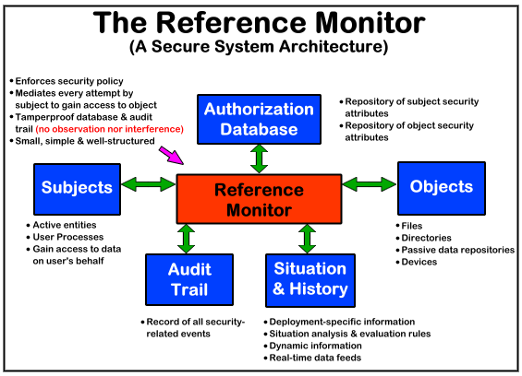
Reference Monitor

Slide 58
Security Kernel ()
This is the hardware, software and firmware that fall within the TCB and implements and enforces the reference monitor concept!*
The security kernel must provide the following
Provide isolation for processes carrying out the reference monitor concept, the processes must be tamperproof (why?)*
The SK must be invoked for every access attempt and be impossible to circumvent, therefore it must be foolproof (why?)*
It must be small enough to be tested and verified comprehensively*

Slide 59
Terms we need to know before we move on ()
Before we move on to System specific security models (rather than the company security model from chapter 3) we need to know a couple terms
Least privilege – a fundamental security concept. Someone should only have the absolutely minimum rights that they NEED to do their job.
Multilevel security policy – security policies that prevent information from flowing from a high security level to a lower security level.

Slide 60
System Security Models

Slide 61
System Security Model ()
A security model is a technical model of a system that enforces it’s security policy.
Maps the abstract goals of the policy into data structures and techniques necessary to enforce the security policy.
Represented in mathematical and analytical ideas. Which programmer then implement with code.
(more)

Slide 62
System Security Model
Example: if a policy states that subjects need to be authorized to access objects, the security model would provide mathematical relationships explaining how x can access y only through outlined methods. Then programmers write code based on this model to implement these relationships.
(more)

Slide 63
Systems Security Models
We will cover the following models
State Machine Model
Bell-LaPadula Model
Biba Model
Clark Wilson Model
Lattice Model
Brewer and Nash Model
Graham-Denning Model

Slide 64
State machine Model
Need a visualization – think flowchart

Slide 65
State Machine model
Like a flowchart with a number of states and transitions from state to state.
A developer needs to look at all the states and ensures that any transition from one state leads to the OS being in a state that is also secure.
If something in the OS fails it must fail to a secure state*

Slide 66
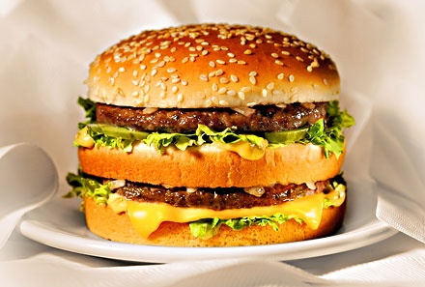
Bell-LaPadula It’s a MAC model
Distinct layers… along with 2 all beef patties, special sauce, lettuce, cheese, pickles, onions on a sesame seed bun…

Slide 67
Bell-LaPadula Model (336)
Possible the most famous model, and probably the model most “needed” in your exam studies is the Bell-LaPadula Model.
Explain the model here… levels and compartments/need to know
It was developed by the US military for use on time sharing mainframes* (what is that?)
First mathematical model of an MLS*
(more)

Slide 68
B-LP (336)
It is MAC Model
A system that employs B-LP is called an MLS system.
It is technically also an information flow model because it is proven that information flows security
It uses a Lattice structure
Only addresses Confidentiality, not I or A*

Slide 69
B-LP (336)
3 main rules
Simple security rule – subjects must dominate objects for read*
*-property rule – no write down (why?)*
Strong *-property -read and write must be at the same level*
You really need to understand this model and terms for the exam. You need to be able to solve access word problems based on this model.

Slide 70
Covert Channels (345)
A Covert Channel is a way for an entity to send or receive information in an unauthorized manner. It is an information flow that is not controlled via a security mechanism and was not intended to transfer information. Such methods violate the security policy.
(more)

Slide 71
Covert Channels (345)
Two types of CC
Storage – (give temp file example)
Timing – hold or not hold an object (give example)
They occur due to one of the following reasons
Improper oversight in the development of a product
Improper implementation of access controls
Existence of a shared resource between to subjects

Slide 72
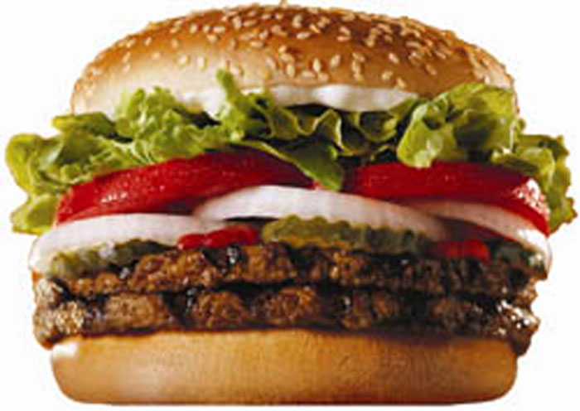
Biba (Whopper)
Biba… layered like the Big Mac.. but it’s more concerned with integrity and data quality… so this one is flamed broiled and much more delicious!

Slide 73
Biba Model (338)
A state machine model similar to Bell-LaPadula, but is only concerned with Integrity (not C or A).
3 rules
*-integrity axiom – no write up?!?
Simple Integrity Axiom – no read down ?!?
Invocation property – a subject cannot request services to another SUBJECT (not object)

Slide 74
Biba (338)
Remember Biba is also a MLS type system
Also uses lattices of levels
Concerned ONLY with integrity*
3 rules are pretty much the opposite of the B-LP model.

Slide 75
Lattice Model (348)
A lattice is a mathematical construct that is built upon the notion of a group. “A structure consisting of a finite partially ordered set together with least upper bound and greatest lower bound on the set”.* (memorize this definition)
This model (which Biba and Bell Ladula uses) has multiple levels of classification for resources and subjects and permissions are determined based on these levels of classification

Slide 76
Clark Wilson (341)
Also concerned with integrity, but uses a different approach, has 5 elements
Users
Transformation procedures
Constrained Data Items
Unconstrained Data Items
Integrity Verification Procedures
(visualization next slide)

Slide 77
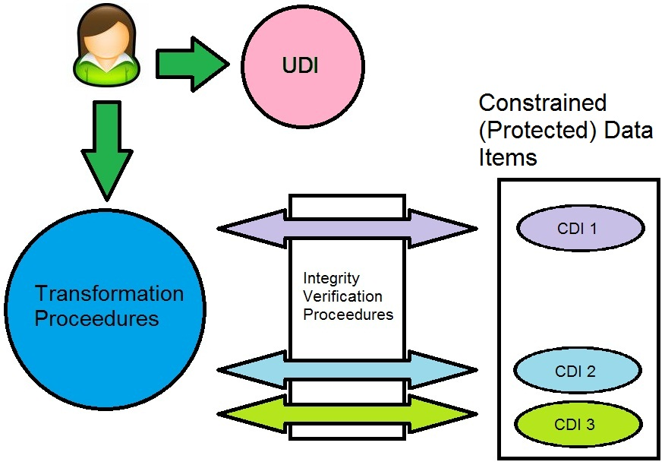
Clark Wilson

Slide 78
Clark Wilson (341)
Data is classified as highly protected (constrained) or not highly protected (unconstrained)
Users cannot modify constrained items directly, they must use software that has Transformation Procedures (TPs) that operated on the data on behalf of the users. TPs ensure the security and validity of the operations on the data by the users.
(more)

Slide 79
Clark Wilson (341)
All accesses to Constrained data are checked via an access triple which defines (users, TP, data) that is what TPs a user can invoke on what data.
Unconstrained data items, are not protected via TPs.
The Integrity Verification Procedures ensure that specific integrity rules are being carried out , these rules are abstract and are be defined by the vendor of the system based on the needs of the client. The kind of audits the TP actions on the data.
(more)

Slide 80
Clark Wilson (341)
The IVPs ensure that the CDI data is consistent*
Using TPs to modify CDIs is referred to as a well-formed transaction* (a series of operations to transfer the data from one consistent state to another consistent state).

Slide 81
Review of goals of Integrity Models
Prevent unauthorized users from making modifications
Prevent authorized users from making improper modifications
Maintain internal and external consistency (via well-formed transactions)

Slide 82
Non Interference Model (347)
Non interference is not concerned with data flow, but instead how actions by subjects at one level may interfere with subjects at another.
If a lower level entity was aware of activity that took place by an entity at a higher level it may be able to deduce too much information about the higher level activities
(more)

Slide 83
Non-Interference (347)
Users at one level should not have knowledge of the commands of users in another level. The commands the users run should not affect other in any way such that they can infer what is going on.

Slide 84
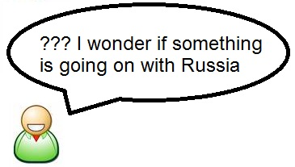
Non Interference

Slide 85
Brewer Nash / Chinese Wall (350)
A data flow model, who's purpose is to protect against conflicts. A BN mode can change dynamically to protect the interest of the model
Example:
An accounting company has two clients in the same industry. When accountant A is working on Clients X’s data, he cannot access Client Y’s data. There is a “Chinese wall” between them.
That’s all you really need to know about this model.

Slide 86
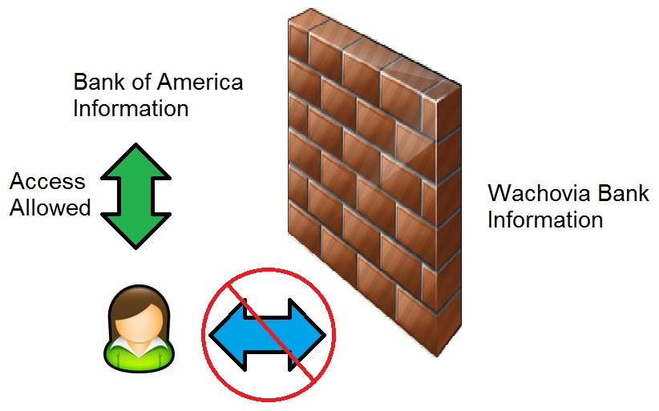
Brewer Nash – Chinese Wall

Slide 87
Brewer Nash – Chinese Wall

Slide 88
Graham-Denning Model (351)
A model more concerned with actual implementation than abstract concepts.
GD outlines 8 operations that define how objects should be created and deleted. It addresses how to assign specific access rights. The 8 operations specifically are
(more)

Slide 89
GD model (349)
How to securely create an object
How to securely create a subject
How to securely delete an object
How to securely delete a subject
How to securely provide the read access right
How to securely provide the grant access right
How to securely provide the delete access right
How to securely provide transfer access rights

Slide 90
Security Modes of Operation

Slide 91
Security Modes of Operation
A system can operate in different modes depending on the sensitivity of the data being processed and the clearance level of users. The mode of operation describes the security conditions under which the system actually functions.
The modes are used in MAC systems which hold one or more classifications of data. (TS, Secret, Confidential… etc)

Slide 92
Dedicated Security Mode (352)
A system is operating in dedicated security mode if
Only 1 classification of data on the system
All users have a clearance for all data on the system and
All users have a need do know about ALL data on the system.
All users have been given formal approval for data
All users have signed an NDA.
Generally this is used if a system only processes one level of data and ALL users on the system are cleared for this level.*

Slide 93
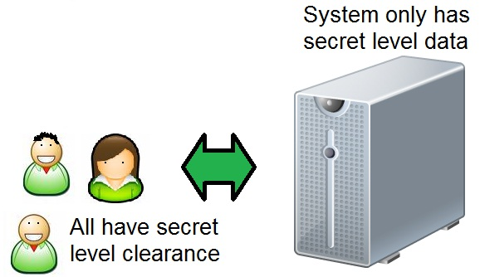
Dedicated Security Mode

Slide 94
System High Security Mode (353)
Only 1 classification of data on the system
All users have a clearance for all data on the system
Users do not have a need to know for all data.
All users have been given formal approval for data
All users have signed an NDA.

Slide 95
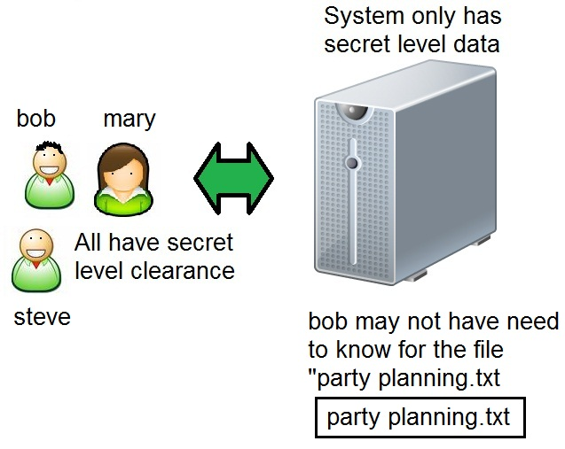
System High Security Mode

Slide 96
Compartmented Security Mode (352)
Multiple classifications of data on the system
All users have a clearance for all data/highest level of data on the system and
Users do not have a need to know for all data.
All users have signed an NDA.

Slide 97
Multilevel Security Mode
Multiple classifications of data on the system
Not all users are cleared for the highest level of data on the system.
Users do not have a need to know for all data.
All users have signed an NDA.

Slide 98
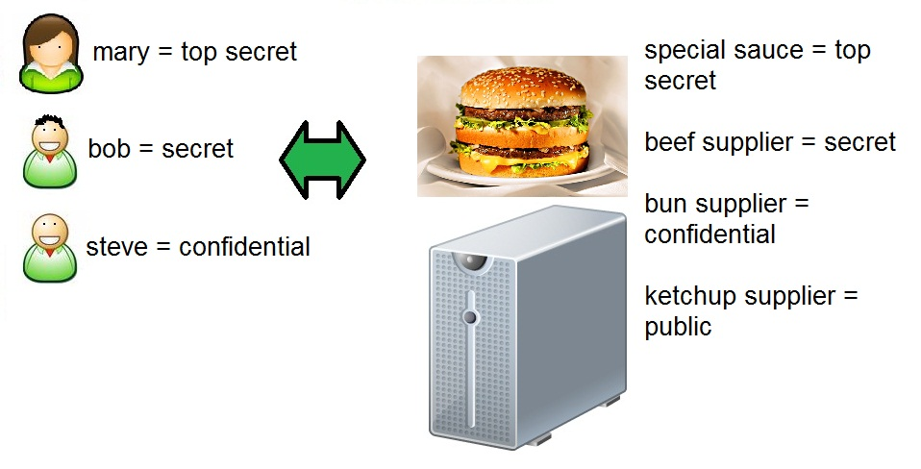
Multilevel Security Mode

Slide 99
Security Mode comparision
Dedicated, System High
1 level of data on the system
Dedicated
everyone has a need to know
System high
Not everyone has a need to know
Compartmentalized, Multilevel
Multiple levels of data on the system
Compartmentalized
All users are cleared for all data on the system
Multilevel
Not all users are cleared for all data on the system

Slide 100
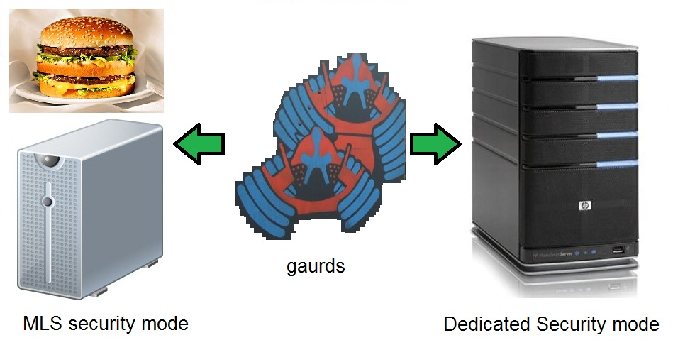
Guards

Slide 101
Guards (353)
Software and Hardware Guards allow the exchange of data between trusted and less trusted systems.
Example if a system is working in Dedicated security mode (high) and needs to talk to a MLS system with multiple classifications. They must talk through a guard, which accepts requests for data, reviews the request to make sure it’s allowed and then submits the request to a end system.

Slide 102
Trust and Assurance

Slide 103
Trust and Assurance (356)
Remember no system will EVER be 100% secure.
Functional level tells the customer how much/what protection he can expect out of the system
Assurance – is the how much we believe the system will act in a correct and predictable manner in each and every situation.
You need to understand the difference between these 2 terms.

Slide 104
Trust and Assurance (356)
We try to evaluate trust and assurance of a product so we can make an informed decision if a product is providing us with the necessary protection to support our security policy and model.
A security evaluation examines the security relevant parts of a system. (TCB, access control mechanisms, reference monitor, kernel and protection mechanisms)
(more)

Slide 105
Trust and Assurance
We will look at a few formal security evaluation criteria
TCSEC / Orange Book
ITSEC
Common Criteria

Slide 106
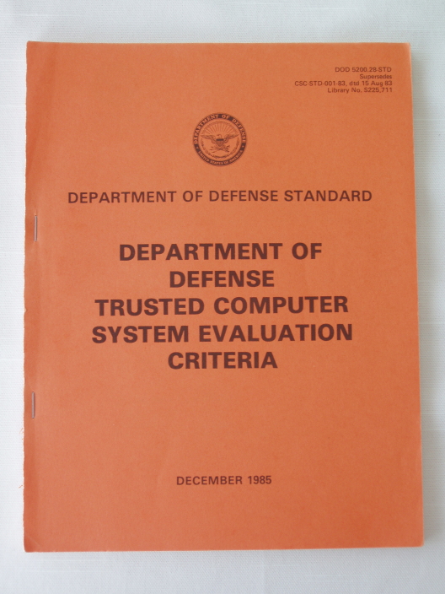
Orange Book (TCSEC)

Slide 107
Orange Book / TCSEC* (357)
The Trusted Computer System Evaluation Criteria (which is published in an orange book) as created by the DoD. The Assurance ratings defined are used to rate products. The main ratings are
A – Verified Protection
B – Mandatory Protection
C – Discretionary Protection
D – Minimal Security

Slide 108
TCSEC (358)
A system is evaluated on 7 properties and the rating (A#-D#) is given. The rating given is a function of the scores of these properties
Security policy – must be explicit and well defined and enforced by the mechanism in the system
Identification – all subjects must be uniquely identified
Labels – Access control labels must be associated properly with objects
(more)

Slide 109
TSEC (358)
Documentation – Must be provided, including test, design and specification documents, user guides and manuals.
Accountability – audit data must be created and protected to enforce accountability
Life-cycle assurance – software, hardware and firmware must be tested individually and each must enforce the security policy effectively throughout their lifecycle
Continuous Protection – the security mechanisms in the system must function predictably and “correctly” in all situations.

Slide 110
TCSEC rating (D) (359)
OK back to the rating! (from lowest to highest)
D – a system that is D has been evaluated but failed to meet the criteria and requirements of any of the higher levels.
There is only 1 level of D, which is D, unlike the other levels which have a rating and a number ex. C2

Slide 111
TCSEC C (360)
C – Discretionary Security Protection. From here on I’m going to read directly from the book for the next 2 pages as you NEED to understand and have read this. So We’ll do it together.
READ FROM THE BOOK HERE, this stuff must be memorized.

Slide 112
TCSEC wrap up
4 levels D, C2, C2, B3, B2, B1, A1
D = none
C = discretionary
B = MAC
A = formally verified design.
TCSEC addresses confidentiality ONLY not integrity!*
Functionality and assurance are not evaluated individually.*

Slide 113
TCSEC wrap up
Focused on government concerns really, not necessarily commercial concerns.
Only is concerned with OS, not networking or databases etc.
Only focused on confidentiality
Focused on government data classification levels only
Small number of ratings
Created in 1985 and retired in 2000

Slide 114
Rainbow series (363)
Since the Orange book is only concerned with the operating system, there have been other “book colors” to address other things, these series of books are collectively called the rainbow series.
One specific book focused on networking security is called the “red book” (or Trusted Network Interpretation). Much like the Orange book, the red book does NOT supply specific details on how to implement security.

Slide 115
ITSEC (364)
European answer to the TCSEC.
ITSEC evaluates “Functionality” and “assurance” separately*
Functionality is – does the system do what is says it does.
Assurance – how much confidence do we have that in our security methods and there capability to perform consistently. This is usually tested by examining development practices, documentation, configuration management and testing.
*Note when a system has an assurance rating that means it has the potential of providing a certain level of protection. Assuming it’s configured correctly…

Slide 116
ITSEC (365)
It is important to understand two systems protection mechanisms could provide the same functionality , but have different assurances.
Example, they might use the same functionality for authentication (like a fingerprint reader), however one system might have been developed and tested sloppily, which could lead to the system not performing consistently through bugs or less strict comparison. This system would get a lower assurance rating
(more)

Slide 117
ITSEC (367)
In ITSEC, functionality is rated F1 – F10
Assurance is rated in E0 – E6
Example
F1 – E5 would be low functionality, but high assurance of said functionality.
Note orange book levels can be mapped to ITSEC levels.. See pg 366

Slide 118
Common Criteria (367)
New “international standard”.
Orange book evaluated systems as they compare to Bell-LaPadula, CC, provides more flexibility. It evaluates a product against a “protection profile” which is structured to address real world needs/requirements. (like an RFP)
Each product is mapped to a protection profile (what services is provides) and is rated EAL1 – EAL7
(more)

Slide 119
CC (367)
Protection profiles can be added as needs arise* and describe environmental assumptions, the security objectives and the functional and assurance level expectations.
CC protection profiles provide flexibility that TCSEC does not. A protection profiles contains these 5 sections

Slide 120
CC (367)
Descriptive elements – name and description of problem to be solved
Rationale – justifies the profile and gives real world examples. Explains environment and usage assumptions
Functional Requirements – establishes a protection boundary, describing the threats that it will attempt to counter.
Development assurance requirements – Identified specific requirements that the product or system must meet during development
Evaluations assurance requirements – Establishes the type and intensity of the evaluation
A CC is like an business RFP.

Slide 121
Certification and Accreditation (370)
Once a product has been evaluated we know that if configured correctly it can provide a certain level of protection. HOWEVER security is not guaranteed. To provide the expected level of security you must have:
proper systems administration practices
physical security,
proper installation
Proper configuration
The rating of a system is just one component in the big picture.

Slide 122
C vs. A (371)
Certification is a comprehensive technical evaluation of the security environment/components and their compliance for the purpose of accreditation.
Certification can be done from a 3rd party or in house.
The Goal of certification is to ensure that the security measures implemented are appropriate and correct for the specific clients needs.
The Certification process and documentation should indicate the good and bad about the product and the environment. These results MUST be taken to management for accreditation*

Slide 123
Accreditation
Accreditation – the formal acceptance of the adequacy of a systems (or products) overall security and functionality by MANAGEMENT*
This is management reviewing the certification information and signing off saying “we understand the level of protection the system provides, and understand the risk associated with the system and that we believe this solution works and provides the required security”
(more)

Slide 124
Accreditation
Before management accredits a solution it is their responsibility to ask questions, review the certification report and decide for themselves if they believe the solution is adequate based on the information they have.
Management must not just sign off without understanding what that are singing off on. By signing the accreditation statement they are accepting the risk that is associated, and taking responsibility.*

Slide 125
Attacks
Do not worry about the attacks on pages 382 – 389 yet, we will cover them in a later chapters.

Slide 126
Chapter 5 – Review
Q. What is an address Bus?
Q. What is a data Bus.
Q. If developing a weapons system, would you like the operating code on the system in ROM memory or flash memory?
Q. What is multi-processing?
Q. What is multitasking?

Slide 127
Chapter 5 – Review
Q. What is the purpose of the base and limit registers?
Q. What is the concept of Virtual Memory Mapping?
Q. What is the concept of swapping or paging?
Q.What is the TCB?

Slide 128
Chapter 5 - Review
Q. What is the Reference Monitor
Q. What is the Security Kernel?
Q. What is Bell La-Padula mainly concerned with. What is it’s 3 rules
Q. What is Biba mainly concerned with, what is it’s 3 rules?

Slide 129
Chapter 5 - Review
Q. Describe Clark Wilson, what is it’s main concern?
Q. Describe the “Chinese Wall” model.
Q. What is a covert Channel
Q. What alphabet levels of the orange book requires discretionary access control?
Q. What levels of the orange book require mandatory access control?

Slide 130
Chapter 5 - Review
Q. What is the difference between functionality and assurance?
Q. What is a Dedicated Security Mode?
Q. How does the ITSEC rate security products?
Q. What is the difference between certification and accreditation?

