Slide 1

Chapter 7: Telecommunications and Network Security

Slide 2
Chapter 7
This chapter is HUGE and honestly you are not going to understand all of it unless you’ve done a lot of network or network administration or network security in your life. Don’t get too stressed, try to follow along I will try to point out the most important things to understand. If you have questions ASK ME, luckily this is my area of expertise so I should be able to help you out. Some questions may have to be directed to after class or in between breaks if they go to in depth.

Slide 3
OSI Model
Oh no…

Slide 4
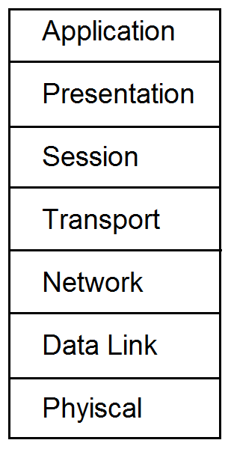
OSI

Slide 5
OSI model 485
7 layers
A P S T N D P… “All People Seem to Need Data Processing”… say that 10 times
  Application
  Presentation
  Session
  Transport
  Network
  Data link
  Physical

Slide 6
OSI
Before we talk about network equipment we need to discuss the OSI framework briefly.
The OSI is a model of how network communications should be broken down into functional tasks. Each layer performs one task. It provides services to the layer above it, and uses services from the layer below it.
We say devices talk to each other at the same layer.

Slide 7
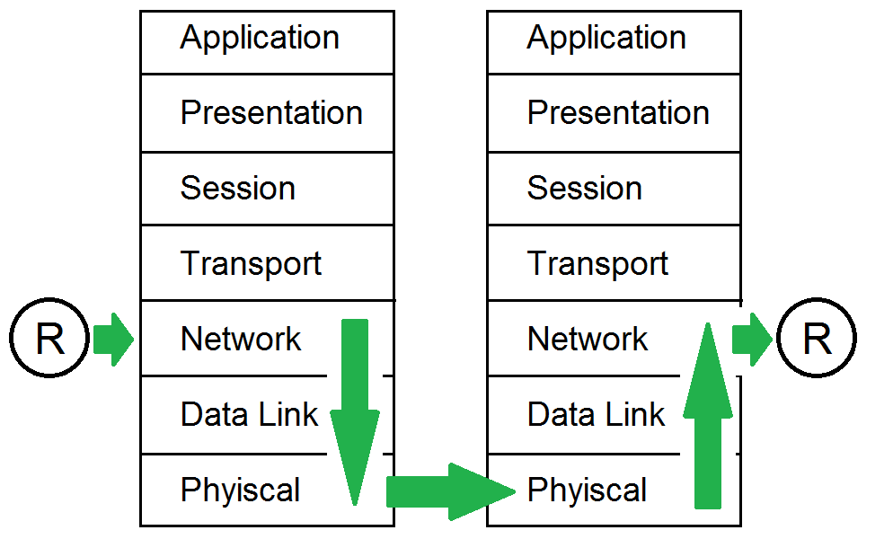
OSI

Slide 8
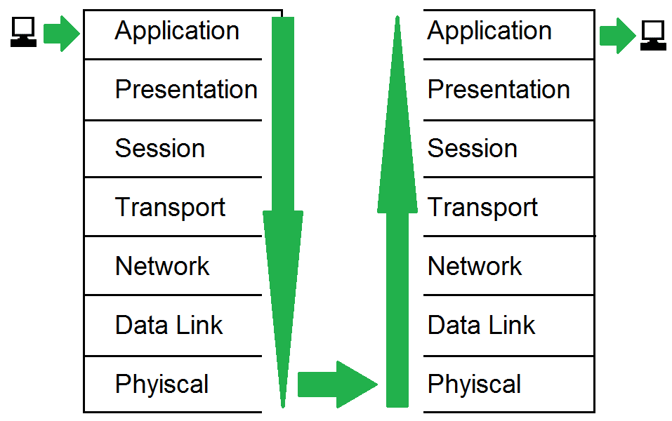
OSI

Slide 9
OSI (489)
The OSI model is broken down into 7 levels (layers) which we will discuss next.

Slide 10
OSI model – layer 1 physical (496)
Layer 1 Physical – simply put is concerned with physically sending electric signals over a medium. Is concerned with
  specific cabling,
  voltages and
  Timings
This level actually sends data as electrical signals that other equipment using the same “physical” medium

Slide 11
OSI model – layer 2 data link
Layer 2 Data Link – data link goes hand in hand with physical layer. The data link level actually defines the format of how data frames* will be sent over the physical medium, so that two network cards of the same network type will actually be able to communicate. These frames are sent to the physical layer to actually be turned into the electronic signals that are sent over a specific network. (layer 2 uses the services of layer 1)
Two network cards on the same LAN communicate at the data link layer.

Slide 12
OSI model – layer 2 (494)
Protocols that use the data link layer
  ARP
  RARP
  PPP
  SLIP
  Any LAN format (Ethernet)

Slide 13

Ethernet Frame

Slide 14
OSI model – layer 3 network (493)
Layer 3 (Network) – Layer 3 is concerned with network addressing and specifically moving packets between networks in an optimal manner (routing). Some Layer 3 network protocols are
  IP
  IPX/SPX
  Apple Talk

Slide 15
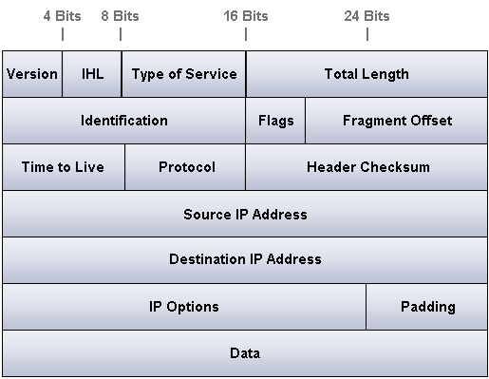
IP Packet

Slide 16
OSI model layer 3 network - 493
Other protocols that “work” on this layer are
  ICMP – IP “helpers” (like ping)
  IGMP – Internet Group Message Protocol
  RIP – routing protocol
  OSPF – routing protocol
  BGP – routing protocol
(more)

Slide 17
OSI model Layer 4 Transport (492)
OSI Layer 4 Transport – Provides end-to-end data transport services and establishes a logical connection between 2 computers systems”
Virtual connection between COMPUTERS
Protocols used at layer 4
  TCP (discussed later)
  UDP (discussed later)

Slide 18
OSI Model Layer 5 Session (491)
OSI Layer 5 (Session) – responsible for establishing a connection between two APPLICATIONS! (either on the same computer or two different computers)
Create connection
Transfer data
Release connection
TCP actually does session oriented services

Slide 19
OSI model Layer 6 – Presentation (489)
OSI Layer 6 – present the data in a format that all computers can understand
  Concerned with encryption, compression and formatting
Example: big endian vs. little endian
Decimal 10 is written in binary as 1010
However some computers read binary left to right and some read it right to left
1010 != 0101 1010 = 10, 0101 = 5
All computers on a network must agree what format to represent binary data in (left to right, or right to left) (note this is not “truly” what big endian means… but it’s close enough and easier to explain it with this example;)

Slide 20
OSI model Layer 7 – Application (489)
This defines a protocol (way of sending data) that two different programs or applications understand.
  HTTP
  SMTP
  DNS
This is the layer that software/applications use to talk with other software.

Slide 21
Quick OSI review
What layer is creates a connection between 2 applications?
What layer turns the frames sent to it into the proper voltages and timings to send across a wire?
What layer is concerned with finding paths between different networks?
What layer is concerned with the formatting of the data?
What layer is concerned with communicating between two of the? same interface types on computers on the same LAN?
What layer creates a connection between two computers?
What layer is concerned with the data/protocol that the application you are using uses?

Slide 22
TCP/IP model

Slide 23
TCP/IP Model (499)
No real network protocol is broken down into 7 layers.
  Too much overhead
Almost all network communication now uses TCP/IP so we use the TCP/IP Model
Based on OSI model
Some laters o
4 layers (see next slide)

Slide 24
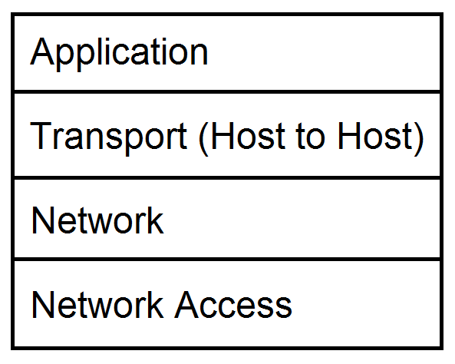
TCP/IP Model

Slide 25
TCP/IP model
Network Access = OSI layers 1 & 2, defines LAN communication
Network = OSI layer 3 – defines addressing and routing
Transport/Host to Host = OSI layer 4, 5 – defines a communication session between two applications on one or two hosts
Application = OSI layers 6,7 the application data that is being sent across a network

Slide 26
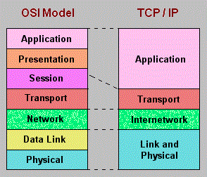
OSI vs. TCP/IP model

Slide 27
Some network equipment and what layers they generally work on
We will talk about these later on.
Hub/repeater – physical
Switch – data link
Router – network
firewall – can be one of many levels above network
Application proxy firewall – application

Slide 28
TCP/IP (499)
TCP/IP is a suite of protocols that define IP communications.
IP is a network layer protocol, and handles addressing and routing
We use IP version 4
Some day (theoretically) we’ll use IP version 6
(more)

Slide 29
IP Address (506)
The main components of an IP address
  IP address
    4 “sections” (called OCTETS*) each octet a number from 0-255
    Example: 192.168.100.104 or 130.85.1.4
  Net mask
    4 “sections” (octet) each octet a number of
      0, 128, 192, 224, 240, 248, 252, 254, 255 (usually 0 or 255)
    Example: 255.255.255.0 or 255.255.240.0
  What is the net mask used for?

Slide 30
IP addresses and Subnet Masks (506)
The subnet mask is used to break an IP address into 2 parts “Network” Address, “host Address”
192.168.100.14 - IP address
255.255.255.0 - network part
---------------------------------------------
192.168.100 - network part
.14 - host part

Slide 31
IP addresses and Subnet Masks (506)
All computers on the same “IP network” share the EXACT same “network” part.
So if my
IP = 192.168.100.14
Netmask = 255.255.255.0
My network portion = 192.168.100
ALL COMPUTER that have this part of the IP address the same are on the SAME network as I am.
Example: 192.168.100.15 is on the SAME network
192.168.101.7 is on a DIFFERENT network

Slide 32
IP address and subnet mask (506)
This of your network portion as your zip code. All addresses with your zip code are in your same town served by your post office.
All zip codes different are in a different town with a different post office.
Your host part is your street address

Slide 33
IP addresses and subnet masks (506)
Most of the net masks you will see contain either 255 or 0. 255 means that “octet” of the IP address is all “network” part, 0 means it’s all host part. In real life things can get more complicated than this.. Though people try to avoid it and you probably don’t have to worry about this for the CISSP exam.
Example: 192.168.100.14
255.255.255.240
You cannot directly look at the IP address to determine whether a host is on the same network as you. (in this case computers with an IP of 192.168.100.0 -192.168.100.15 are on your same network.. All others are NOT
(192.168.100.17 would be on a different network)

Slide 34
TCP/IP class networks - 506
Class A
  IP ranges 0.0.0.0 – 126.255.255.255
  Implied net mask 255.0.0.0
  Lots of hosts (about 16 million)
Class B
  IP ranges 128.0.0.0 to 191.255.255.255
  Implied net mask 255.255.0.0
  About 65,000 hosts
  (more)

Slide 35
TCP/IP class networks - 506
Class C
  IP ranges 192.0.0.0 to 223.255.255.255
  Implied net mask 255.255.255.0
  254 hosts
Class D
  IP ranges 224.0.0.0 to 239.255.255.255
  Reserved for multicast, not normal IP addresses
Class E
  IP ranges 240.0.0.0 to 255.255.255.255
  Reserved for research

Slide 36
TCP/IP Classless networks (508)
Classes are not really used anymore, CIDR has taken it’s place, which is just an IP address and a net mask or /
  Ex. 172.16.1.0/24 = 172.16.1.0 with a net mask of 255.255.255.0
This /xx notation is just shorthand for writing a normal net mask
Example /24 = 255.255.255.0
(more)

Slide 37
TCP/IP and CIDR (n/b)
To compute a normal net mask from a /xx do the following
Divide XX by 8, call this number Y, start creating your netmask by writing “255” Y times
  Example: /26
  26/8 = 3
  Y=3
  Net mask = 255.255.255.
  (more)

Slide 38
TCP/IP and CIDR (n/b)
Take your original /XX, subtract (8*Y), call the result Z
  Example: 26 – (8 * 3)
  26 – 24
  2 = Z
Use chart to figure out what Z is and that is the next octet in your net mask
So
Net mask = 255.255.255.Z (look up Z in chart on next slide)
Net mask = 255.255.255.128
If there are any left over octets to fill in, they are all 0’s

Slide 39
CIDR (n/b)
Z = 1 net mask octet: 128
Z = 2 net mask octet: 192
Z = 3 net mask octet: 224
Z = 4 net mask octet: 240
Z = 5 net mask octet: 248
Z = 6 net mask octet: 252
Z = 7 net mask octet: 254

Slide 40
Two quick examples to try
What is the net mask for /27?
What is the net mask for /18?

Slide 41
TCP and CIDR (answers)
/27
Y = 27 / 8
Y = 3
Net mask=255.255.255.
Z = 27 - (8*Y)
Z = 27 – 24
Z = 3
Net mask=255.255.255.Z
Net mask=255.255.255.224

Slide 42
TCP and CIDR (answers)
/18
Y = 18 / 8
Y = 2
Net mask = 255.255.
Z = 18 – (8*Y)
Z = 18 – (8*2)
Z = 18-16
Z = 2
Net mask = 255.255.128.
Net mask is not 4 octets long… fill in zeros
Net mask = 255.255.128.0

Slide 43
TCP/IP - 500
We currently use IPv4 with has 2^32 addresses
  about 4 billion IP addresses
IPv6 has 2^128 addresses (4 billion x 4 billion)
IPv6 also has
  a simplified format
  additional features such as IPSEC. (talk about IP SEC later)

Slide 44
TCP/UDP - 498
TCP/UDP handle the transport and session layers. They setup a communications channel between two programs talking over the network
Programs talk via ports which are numbers that generally define what program/services you want to talk to (talk about this in a couple slides)
More on TCP/UDP in the next slides

Slide 45
TCP
Connection oriented “guaranteed” delivery.
Advantages
  Easier to program with
  Truly implements a session
  Adds security
Disadvantages
  More overhead / slower

Slide 46
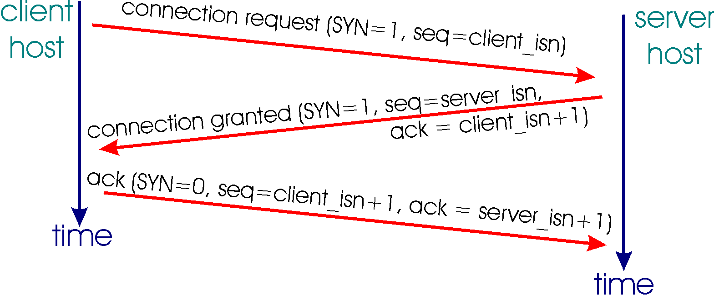
TCP - 504
Reliable connection-oriented protocol
  Has a true connection
  Starts with a 3-way handshake, (SYN, SYN-ACK, ACK)

Slide 47
TCP - 504
  Keeps state, and will guarantee delivery of data to other side (or inform the application of the inability to send) does this with sequence and acknowledgement numbers, these numbers also provide ordering to packets
  Has some security due to the state of the connection
  Nice to program with, but slower/more overhead because of the work done to guarantee delivery.

Slide 48
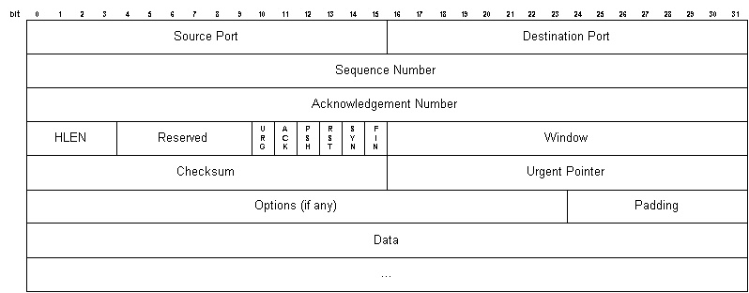
TCP header

Slide 49
UDP
Connectionless, non-guaranteed delivery (best effort)
Advantages
  Fast / low overhead
Disadvantages
  Harder to program with
  No true sessions
  Less security
  A pain to firewall (due to no connections)

Slide 50
UDP - 500
Like a postcard, each packet is separate
No guarantee on delivery
Best effort
Fast, little overhead
No sequence numbers (ordering)
No acknowledgements
No connection
Security issues due to lack of a connection

Slide 51
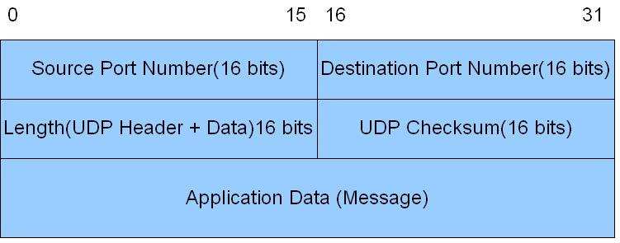
UDP header

Slide 52
Ports - 503
Both TCP and UDP use ports as the end points of conversations. Ports for services that are defined and static are called well known ports some well know ports are*
  telnet TCP/23
  Email (SMTP) TCP/25
  Email (POP) TCP/110
  Email (IMAP) TCP/143
  Web (HTTP) TCP/80
  Web (HTTPS) TCP/443
  DNS TCP & UDP 53
  FTP TCP/21 & 20

Slide 53
Random Networking Terms - 512
Latency
Bandwidth
Synchronous – synchronized via a time source
Asynchronous – not timed
Baseband – use the entire medium for communication
Broadband – slide the medium into multiple channels for multiple simultaneous communications

Slide 54
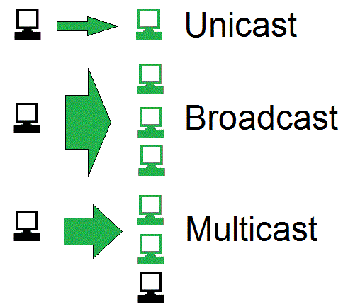
Random Networking Terms

Slide 55
Network Topologies

Slide 56
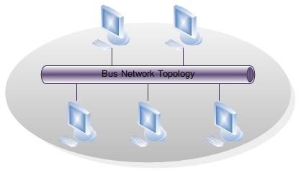
Bus (514)
Advantages?
Problems?

Slide 57
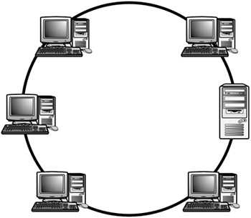
Ring (514)
Problems?
Advantages?

Slide 58
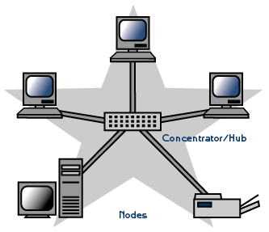
Star Topology (514)
Advantages?
Problems?

Slide 59

Mesh (515)
Advantages
Problems
Full Mesh =
(n(n-1))/2

Slide 60
Network Topology
Perhaps memorize chart at top of 516*.

Slide 61
Network Types

Slide 62
Ethernet - 517
Most common form of LAN networking, has the following characteristics
  Shares media
  Broadcast and collision domains (see next slides)
  CSMA/CD
  Supports full duplex with a switch
  Defined by IEEE 802.3

Slide 63
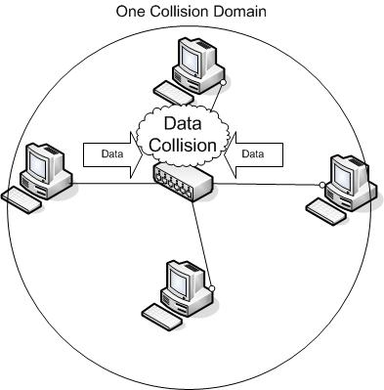
Collision Domain

Slide 64
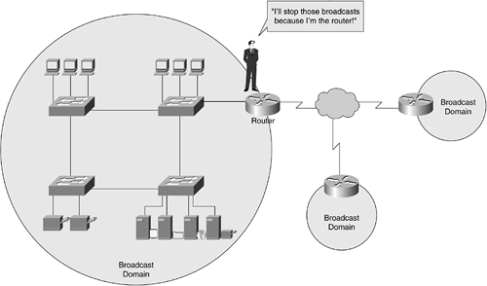
Broadcast Domain

Slide 65
Ethernet media types - 518
10Base2
  Thin net, coaxial cable (like TV cable, but different electrically)
  More resistant to EMI than UTP
  Max length about 200 meters
  10 Mbs second
  Requires a BNC connector
  BUS/Shared medium (security problems?)
  obsolete
(more)

Slide 66
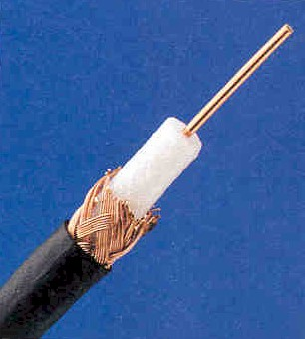
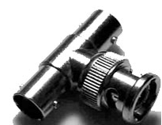
Coax (10 base 2)

Slide 67
Ethernet Media Types - 514
10base5
  Thick net, thicker coax
  Max length about 500 meters
  10Mbs
  Uses vampire taps
  More resistant to electrical interference
  BUS/shared medium
  Used to be used as backbone
  Obsolete
  (more)

Slide 68
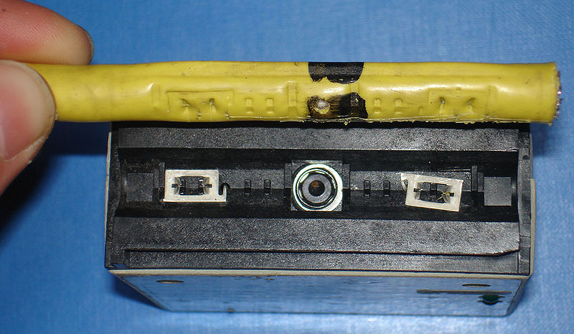
10 Base 5 and Vampire Tap

Slide 69
Twisted Pair
Like phone wire, but more wires.
100 meter maximum lengths
RJ-45 connector
Two main types UTP, and STP
STP is shielded and better if you have EMI issues
UTP is unshielded and susceptible to EMI and crosstalk
UTP also gives off signals which could be picked up if you have sufficient technology. (enimation security)
“least secure vs. coax and fiber”
(different types coming up next)

Slide 70
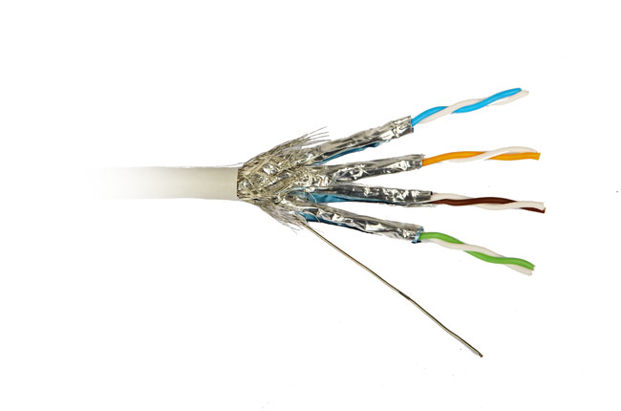
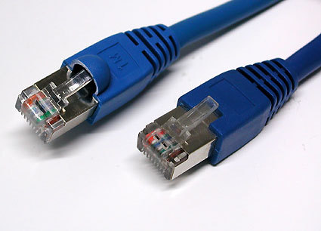
Twisted Pair

Slide 71
Ethernet Media Types - 524
10BaseT
  Length about 100 Meters
  10Mbs second
  Twisted pair (like phone wire) (CAT 3)
  Use RJ-45 connector
  Use in star topology
  Susceptible to interference
  Mostly obsolete
  (more)

Slide 72
Ethernet Media Types - 518
100BaseTX
  Length about 100 Meters
  100Mbs
  Twisted pair (like phone wire) (CAT 5, 6)
  Use RJ-45 connector
  Use in star topology
  Susceptible to interference
  (more)

Slide 73
Ethernet Media Types
1000BaseT
  Length about 100 Meters
  1000+Mbs
  Twisted pair (like phone wire) (CAT 5e,6)
  Use RJ-45 connector
  Use in star topology
  Susceptible to interference

Slide 74
Token Ring (520)
Briefly describe token ring
  Ring topology, though using a HUB
  HUB = Multistation access Unit (MUA)
  Token passing for control of network
  Beaconing for failure detection
Not used except legacy networks

Slide 75
FDDI - 521
Similar to token ring but uses fiber.
High Speed
Used to be used as backbone networks
2 rings to create a wrap if one goes down

Slide 76
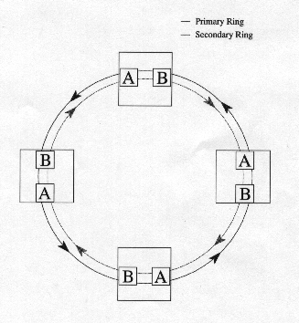
FDDI dual ring

Slide 77
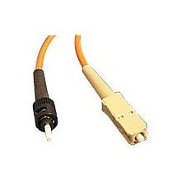
Fiber

Slide 78
Media Access Technologies (526)
Token Passing
CSMA/CD – waits for clear, then starts talking, detect collisions
CSMA/CA – signals intent to talk
Collision Domain – where collisions can occur. (i.e. two people try to talk at the same time)
What is a security impact of collision domains? sniffing, DoS

Slide 79
LAN Protocols - 529
ARP – Network Adapters have 2 addresses, and IP address, and a MAC address. (what is each used for? How do they relate? which “layer” does each exist on?)
  ARP is the glue for relating the IP and the MAC addresses
Attacks
  ARP table poisoning – what is this how does it happen, what would it do?

Slide 80
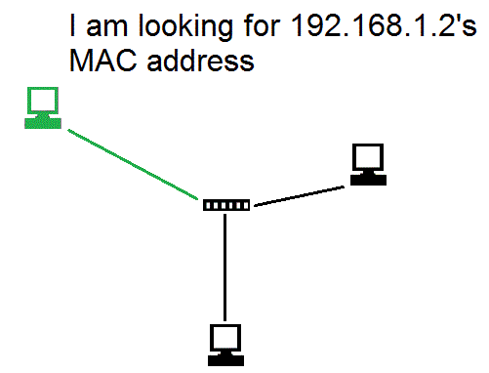
ARP (533)

Slide 81
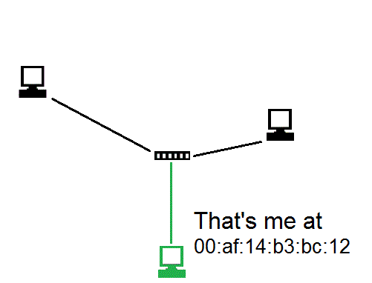
ARP (533)

Slide 82
DHCP - 534
DHCP – what is it what is it used for?
  Precursors
    RARP – what did it do?
    BOOTP – what did it do?

Slide 83
ICMP - 537
ICMP – “IP helper”
  Echo request/reply
  Destination unreachable
  Source quench
  Redirect
  Trace route
Security problems?
LOKI – sending data in ICMP messages. (stealthy… we will talk about this later in this chapter)

Slide 84
Basic Networking Devices (541)
There are different types of networking devices that exist we will look at
Repeaters
Hubs
Bridges
Switches
Routers

Slide 85
Repeaters - 541
Layer 1 device
No intelligence
Simply repeats and electrical signal from an input to an output.
Used to increase range (ex. Put a repeater 200 meters down a 10Base2 run to double the length)

Slide 86
Hub (542)
Multiport repeater
The initial way to connect computer together in a STAR configuration, using twisted pair wiring (really still a BUS)
Layer 1 device
No intelligence
Just repeats a signal down ALL the wires

Slide 87
Bridge (542)
A bridge connects two segments of the SAME LAN together. However a bridge has some interesting features
It is intelligent, it learns which MAC addresses are on each side of the bridge and uses that to determine how to send traffic
A bridge isolates traffic to each side of the bridge and only forwards it across the bridge if necessary (good for security and performance) See next 3 slides

Slide 88
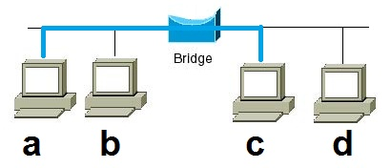
Bridge
A bridge learns which computers (MAC addresses) are on each side of the bridge) It will forward traffic across the bridge if necessary.

Slide 89
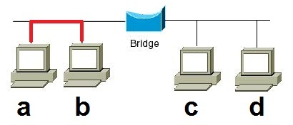
Bridge
A bridge will only forward traffic across the bridge IF and ONLY IF, a computer on one side of the bridge is trying to communicate with a computer on the other side of the bridge.

Slide 90
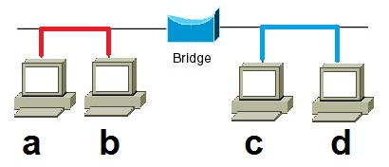
Bridge
A bridge can optimize performance, by allowing two conversations to occur (one on each side of the bridge).
A and B can communicate at the SAME time C and D communicate

Slide 91
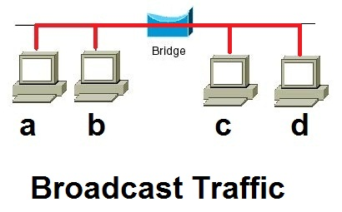
Bridge
Bridges will forward all broadcasts. Bridges will also forward traffic if doesn’t know which side the destination address is.

Slide 92
Bridge Overview
A bridge builds a table of the layer 2 (MAC) addresses on each side of the bridge and only forwards communication if communication is between MAC addresses on each side of the bridge
A bridge increases performance and security
A bridge is a layer 2 (data link device)
Reduces collision domain by ½
Does not affect broadcast domain (doesn’t affect broadcast storms)
more

Slide 93
Bridge Overview
A bridge can be used to mix different LAN technologies (ex. a wireless AP is a bridge)
Recreates the signal
Uses Spanning Tree algorithm to detect loops.

Slide 94
Switch (546)
A network Switch is just a multi-port bridge. Switches will often have 24 or more ports, and learns which MAC addresses are on which ports.
Works at layer 2 (data link)
On a switch a computer can send data AND receive data at the same time (full duplex… increasing performance by up to 2x)
On a switch each port is it’s own collision domain, and will not have a collision, therefore allowing line speed communication on each port
more

Slide 95
Switch (546)
A switch does not alter broadcast domains
A switch only sends traffic from the sending computer to the receiving computer, therefore stops sniffing (watch for MAC flooding attacks though)
Since switches inspect the MAC address on all traffic, a switch can be programmed to only allow certain MAC addresses to communicate, and ignore other MAC addresses.

Slide 96
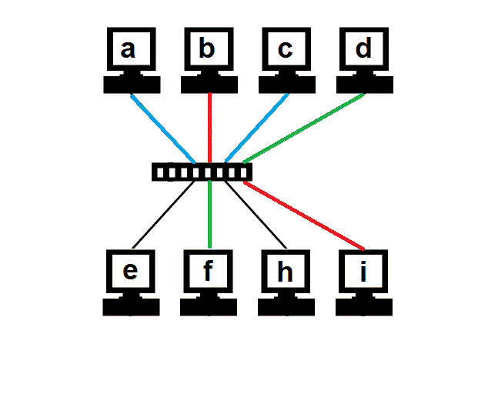
Switch
Multiple conversations can occur on a switch at the same time!

Slide 97
Switch Specific Attacks
Mac Flooding – Putting out tons of packets with different MAC addresses in the attempts to overfill the switches MAC tables. If this happens a switch might simply drop into “hub mode” and start simply sending traffic down each port.

Slide 98
Hubs Bridges and Switches
An important concept… all computers connected via Hubs, Bridges and switches are in the same broadcast domain and these computers form a LAN. They SHOULD be on the same IP network. (see slide)
192.168.1.4 / 255.255.255.0
192.168.1.100 / 255.255.255.0
192.168.1. 14 / 255.255.255.0

Slide 99
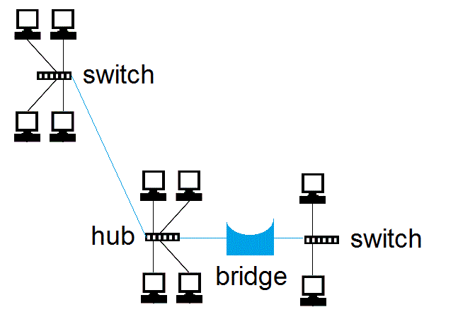
LAN
All these computers are on the same LAN, and logical IP network. All are in the same broadcast domain.

Slide 100
VLANs (549)
A VLAN is the concept of creating multiple broadcast domains (LANs) on a single switch
Two different VLAN protocols
  802.1q*, or Cisco ISL* for trunking between switches
Use VLANS for convenience and for creating network security zones.
Combine with 802.1x for dynamic VLAN assignment

Slide 101
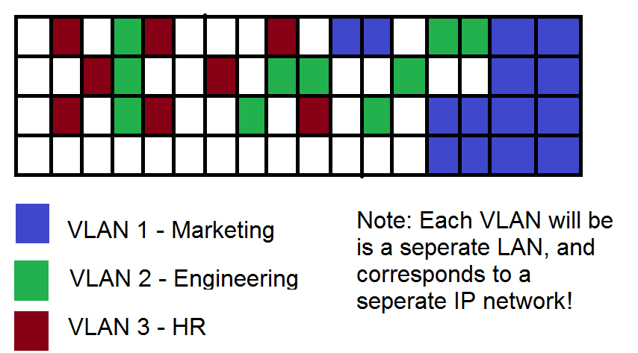
VLAN (549)

Slide 102
Routers (544)
Routers connect different networks.
Move packets between networks
Find the optimal path between networks
Layer 3 (network) devices
Look at IP addresses not MAC addresses
Routers do not forward broadcasts, as such they create different broadcasts domain
Can statically determine routes, or dynamically
Can apply access control lists to allow or deny certain types of traffic

Slide 103
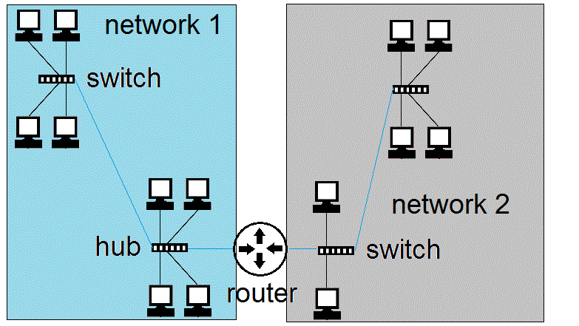
Router (544)
192.168.1.0 / 255.255.255.0 10.1.2.0 / 255.255.255.0
Routers create separate LAN networks. These networks will have different IP ranges

Slide 104
Routers and IP addresses
Routers work with IP addresses which in IPv4 have the form
0-255 . 0-255 . 0-255 . 0-255
Example: 130.85.1.4
There are a few ranges of IPs that are considered private*
  10.x.x.x
  192.168.x.x
  172.16.x.x – 172.31.x.x

Slide 105
Routers vs. Switches - 546
You should understand the different between a router and a switch.
You should also know when you need a router and when you need a switch.
Also memorize the table at the top of 546

Slide 106
Advanced Networking Devices
These are devices that are beyond the basic fundamental networking devices, they generally provide some specific advanced functionality.
  Gateway
  PBX
  Firewall* (multiple types)

Slide 107
Gateway - 550
Generic Term for something that connects two separate things together (can be any level).
  Default gateway = router to get you off your network
  Application gateways – work at the application level and help translate between two different applications (NFS <-> SMB).
  Email Gateway – translate between different email types. (Exchange and SMTP)

Slide 108
PBX 552
Private Branch Exchange – phone system
  Old systems analog*
  New systems digital and VoIP
Crackers that hack phone systems used to be call phreakers*
  Free calls (long distance)
  Masquerade as other people/hide calls
  Often this goes un-noticed as companies often do not audit their phone bills closely

Slide 109
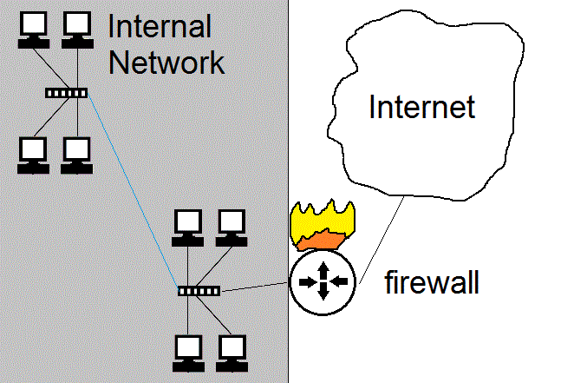
Firewall 553

Slide 110
Firewalls - 553
Enforce network policy.
Usually firewalls are put on the perimeter of a network and allow or deny traffic based on company or network policy.
MUST have IP forwarding turned off*
Firewalls are often used to create a DMZ.
Generally are dual/multi homed*
Types of firewalls
  Packet filtering
  State full
  Proxy
  Dynamic packet filtering

Slide 111
Packet filter - 555
Uses Access control lists (ACLs), which are rules that a firewall applies to each packet it receives.
Not state full, just looks at the network and transport layer packets (IP addresses, ports, and “flags”)
  Do not look into the application, cannot block viri etc.
  Generally do not support anything advanced or custom

Slide 112
Example Packet Filter
permit tcp any host www.me.com eq 80

Slide 113
Packet Filter
Packet filters keep no state*
  Each packet is evaluated own it’s own without regard to previous traffic
  Advantages
  Disadvantages
    fragments
Rule based access control
Packet filters are still used on the edge of the network before a statefull firewall for performance reasons.

Slide 114
State full firewall - 556
router keeps track of a connections in a table. It knows which conversations are active, who is involved etc.
It allows return traffic to come back where a packet filter would have to have a specific rule to define returned traffic
More complex, and can launch DoS against by trying to fill up all the entries in the state tables/use up memory.
If rebooted can disrupt conversation that had been occurring.
Context dependant access control*

Slide 115
Dynamic packet filtering 562
I believe the author is confusing about this topic and actually is describing a state full filter in the book. However there are firewalls that do allow “triggers” these could be called dynamic packet filters
Like a state full firewall but more advanced. Can actually rewrite rules dynamically.
Some protocols such as FTP have complex communications that require multiple ports and protocols for a specific application, packet and statefull filter cannot handle these easily, however dynamic packet filter can as they can create rules on the fly as needed.

Slide 116
Proxy firewalls - 557
Two types of proxies
  Circuit level*
  Application*
Both types of Proxies hide the internal hosts/addressing from the outside world.
Talk about each of these on next slides

Slide 117
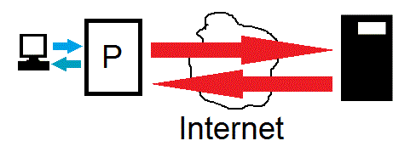
Circuit Level Proxy - 559
A middleman.
A proxy takes client information and sends it to a remote server, it also receives a response and sends it back to the client.

Slide 118
Circuit Level Proxies - 559
Main purpose is to hide internal network and stop direct communications between external machines and internal machines.
Advantages
Fairly simple
Works with all network protocols
Hides internal network addresses
When used with a firewall, stops people from directly starting conversations with internal hosts, while still allowing internal hosts to communicate with the Internet
Disadvantages
A single point of failure and performance issues
Does not analyze data does not protect from dangerous data
Cannot protect against, violations in the protocol or bad data being passed around,

Slide 119
Application Proxies - 559
Like circuit layer proxies, but actually understand the application/protocol they are proxing.
This allows for additional security as they can inspect the data for protocol violations or content.

Slide 120
Application Proxies - 559
Advantages
  Application proxies understand the protocol, so they can add extra security
  Can have advanced logging/auditing and access control features
    Ex. Restrict users to only allowed websites
    Ex. Inspect data for protocol violations
    Ex. Inspect data for malware (viri etc)
Disadvantages
  Extra processing requires extra CPU (slower)
  Proxies ONLY understand the protocols they were written to understand. So you generally have a separate application proxy for EACH protocol you want to proxy

Slide 121
Application Proxies - 559
Examples:
  Squid web proxy server
  Internet Security and Acceleration Server (MS web proxy)
  SMTP proxies
  FTP proxies

Slide 122
NAT/PNAT
A proxy that works without special software and is transparent to the end users.
Remaps IP addresses, allowing you to use private addresses internally and map them to public IP addresses
NAT allows a one-to-one mapping of IP addresses
PAT allows multiple private address to share one public address

Slide 123
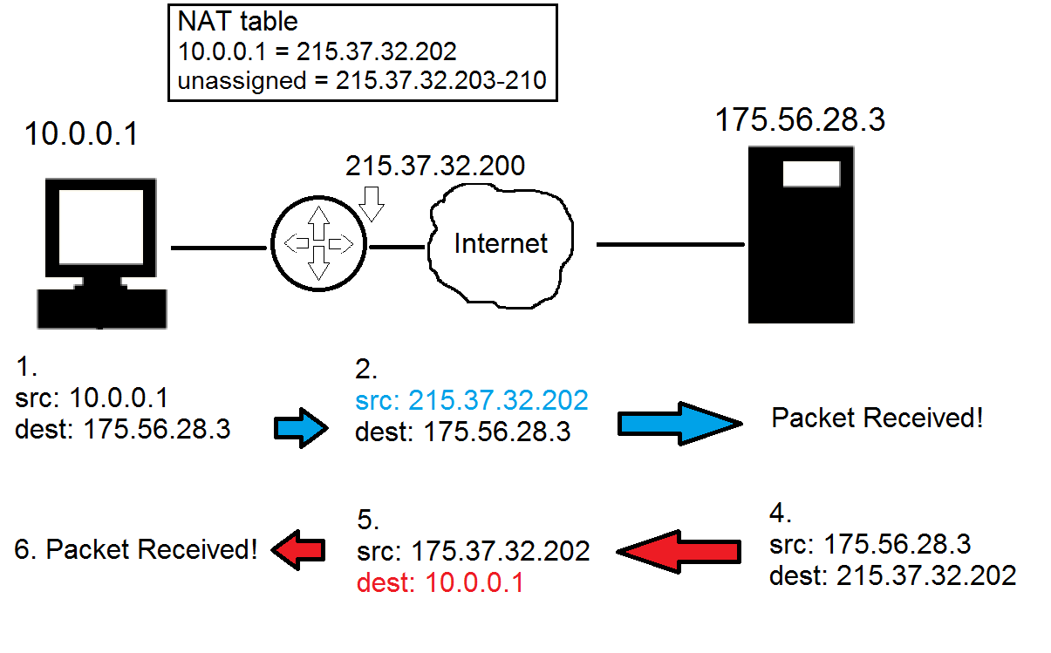
NAT

Slide 124
NAT
Computer 10.0.0.1 sends a packet to 175.56.28.3
Router grabs packet, notices it is NOT address to him.. Modifies the src address to one from it’s pool (215.37.32.202), then sends the packet on it’s way to the destination*
The end machine accepts the packet as it’s addressed to him.
End machine creates response, src = itself (172.56.28.3) dest = 215.37.32.202
Router grabs packet, notices the dest address, and looks up in it’s NAT table, rewrites the dest to 10.0.0.1 and sends it on its way*
Originating machine grabs response since it’s addressed to him, he processes it.

Slide 125
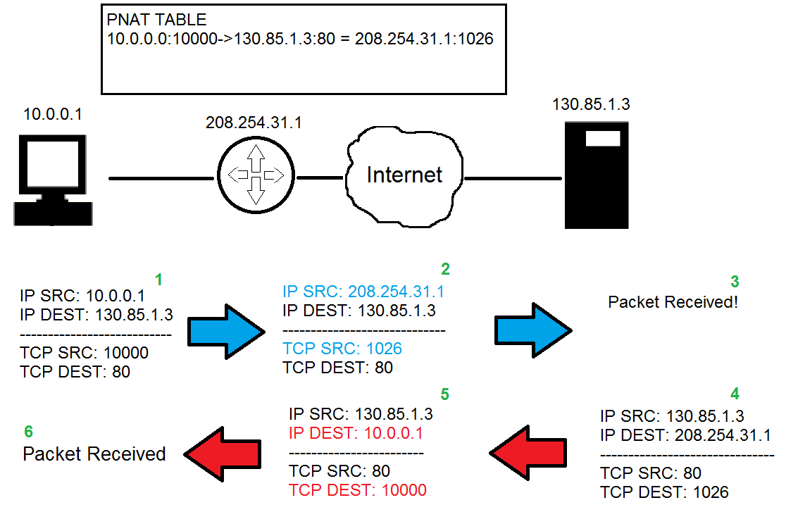
PNAT

Slide 126
PNAT
Client computer creates packet
  SRC: 10.0.0.1:TCP:10000
  DEST: 130.85.1.3:TCP:80
Router rewrites the source address and port to be
  SRC: 208.254.31.1:1026
  Makes an entry in the PAT table
End server accepts packet
End server creates return packet
  SRC: 130.85.1.3:TCP:80
  DEST: 208.254.31.1:1026
Router receives packet, rewrites destination to be
  DEST: 10.0.0.1:TCP:10000
6. Client receives the return packet

Slide 127
NAT/PAT difference
NAT ONLY looks and rewrite the IP addresses*.
NAT requires 1 public IP for each computer that wants to access the Internet simultaneously. If you have 100 computer and you expect 20 of them to access the Internet at any time, 20 public IP addresses are required.
PAT looks at the IP and transport layer port number and rewrites both*
PAT only requires 1 public IP address and can support about 65,000 simultaneous connections for each IP public IP address.

Slide 128
NAT / PNAT
Advantages
  Allows you to use private addresses Internally, you don’t need to get real public IP addresses for each computer
  Protects the network by stopping external entities from starting conversations to internal machines
  Hides internal network structure
  Transparent, doesn’t require special software
Disadvantages
  Single Point of Failure / Performance Bottleneck
  Doesn’t protect from bad content

Slide 129
Overall Firewall best practices (563)
Block un-necessary ICMP packets types.
  (Be careful though, know your environment)
Keep ACLS simple
Use Implicit deny*
Disallow source routed packets*
Use least privilege*
Block directed IP broadcasts
Perform ingress and egress filtering*
Enable logging
Drop fragments or re-assemble fragments

Slide 130
Overall Firewall issues
Potential bottleneck
Can restrict valid access
Often mis-configured
Except for application proxies firewalls generally do not filter out malware or improper content.
Don’t protect against internal attacks!*

Slide 131
Firewall Architecture

Slide 132
Security Zones
It is common practice in network and physical security to group different security levels into different areas or zones. Each zone is either more or less trusted then the other zones. Interfaces between zones have some type of access control to restrict movement between zones (like biometric and guard stations) or firewalls.) In Network security there is often a median zone between the Internet and internal network called a DMZ.

Slide 133
DMZ
A buffer zone between an unprotected network and a protected network that allows for the monitoring and regulation of traffic between the two.
  Internet accessible servers (bastion hosts) are placed in a DMZ between the Internet and Internal network

Slide 134
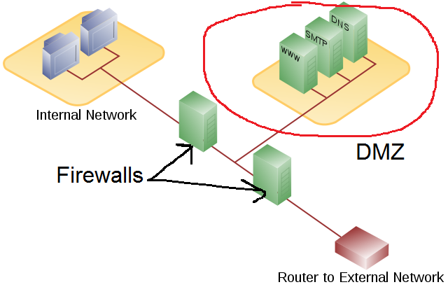
DMZ

Slide 135
DMZ architectures
Multi-homed Firewall
Screened Subnet

Slide 136
Multi Homed Firewall - 565
Multi-homed firewalls may be used to setup a DMZ with a single firewall. (see next slide)
On any multi-homed machine, IP forwarding should be disabled.*

Slide 137
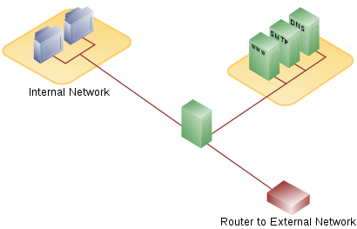
Multi-homed firewall

Slide 138
Screened Subnet - 566
In a screen subnet, there is a separate firewall on both sides of the DMZ.
When using this model it is recommended that each firewall be a different vendor/product.
  Diversity of defense*

Slide 139
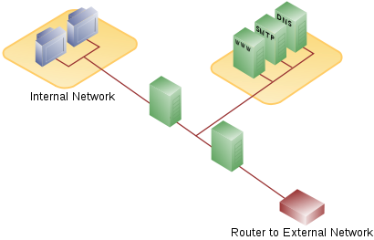
Screened Subnet

Slide 140
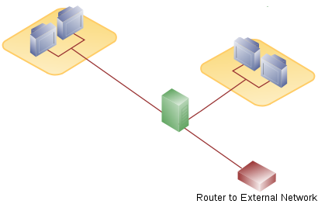
Multiple interface firewalls - 560
A firewall can be placed internally to protect internal networks from each other!

Slide 141
Other Random Network Terms

Slide 142
Other Technological security concepts (572)
Honey pot – a machine left open for attackers to attack.
Honey net – an entire network left open for attackers to attack.
Know the difference between entrapment and enticement?*

Slide 143
NOS (568)
NOS - Network Operating System. All modern OSes are NOS.
  This just means they manage more than just the local computer, they usually provide or use network services in a client server architecture.

Slide 144
DNS - 574
Network software uses IP addresses, however these are difficult for users to remember (especially in IPv6). So DNS is used to help map names that we use such as www.paladingrp.com to addresses that computers use like 63.251.179.13

Slide 145
DNS - 576
DNS uses a hierarchical model. Starting with the “.” then the top level domains “com, edu, org” etc. “Sub domains” are broken out into zones, and organizations can be assigned authority for their own zones and run their own DNS servers to provide DNS lookups for their own zone.
A name server that is authoritative for a zone is called an authoritative server for example. paladingrp.com runs is authoritative for it’s own DNS and has it’s own group of name servers that provide DNS resolution” to the rest of the Internet for names ending in paladingrp.com
Authoritive servers can be primary or secondary and perform zone transfers* to each other.
authoritative DNS servers should NOT be caching DNS servers.

Slide 146
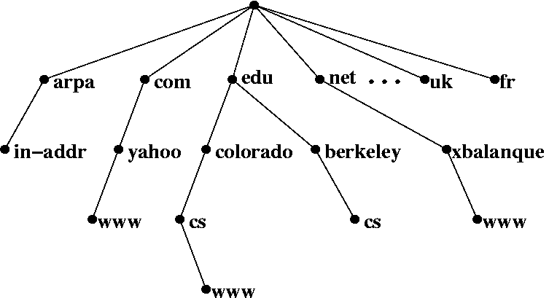
DNS (also example on 571)

Slide 147
DNS
Common top level domains are
  .COM
  .EDU
  .MIL
  .GOV
  .ORG
  .NET
You should be aware of these above

Slide 148
DNS cache poisoning - 577
Besides authoritative name servers organizations also have caching name servers that simply do DNS resolution on behalf of clients.
One common attack is DNS cache poisoning*

Slide 149
DNS SEC
DNS sec tries to ensure integrity of DNS queries by digitally signing responses.* This attempts to defeat cache poisoning.

Slide 150
Intranet, Extranet - 582
Intranet – internal IP network, though often used to define a set of resources made available through a web interface for INTERNAL use
Extranet – a set of network resources (usually web based) for two companies to collaborate or share resources, may or may not make use of VPNs

Slide 151
LAN, WAN, MAN - 581
LAN – local area network
  High speed
  Small physical area
WAN – wide area network
  Used to connect LANS
  Generally slow, using serial links
MAN – metropolitan area network
  Connect sites together within a medium range area (like a city)

Slide 152
Types of links for WANs and MANS
Dedicated/leased/point to point – a link that is pre-established and used ONLY for communications between 2 locations, it is DEDICATED (see next slide) to their use
  Expensive, cost per distance
  Types
    T1 - about 1.5Mbs
    T3 - about 45 Mbs
    Fractional T – some fraction of a T1/T3
    T1s are time division multiplexed*
    T1s are annoying, because the local loop often fails
    T1/T3 can also be used in shared/frame relay

Slide 153
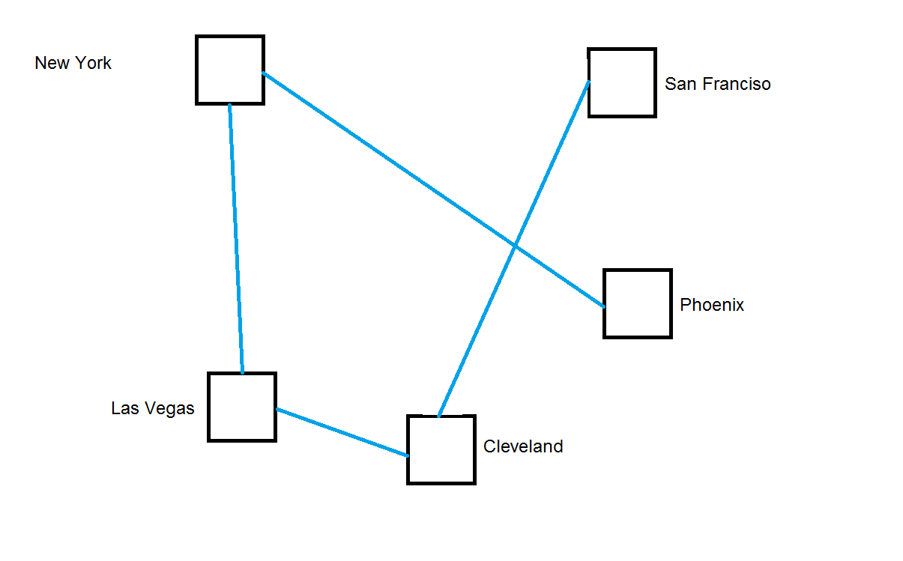
Dedicated (589)

Slide 154
Frame Relay - 595
Data link protocol (layer 2)
Not a point to point connection, but a connection into a cloud
CIR*
Uses virtual circuits (PVC)
Uses DLCIs*
Still uses T1/T3 but rather than going all the way, they just go to the carriers Point of Presence*.

Slide 155
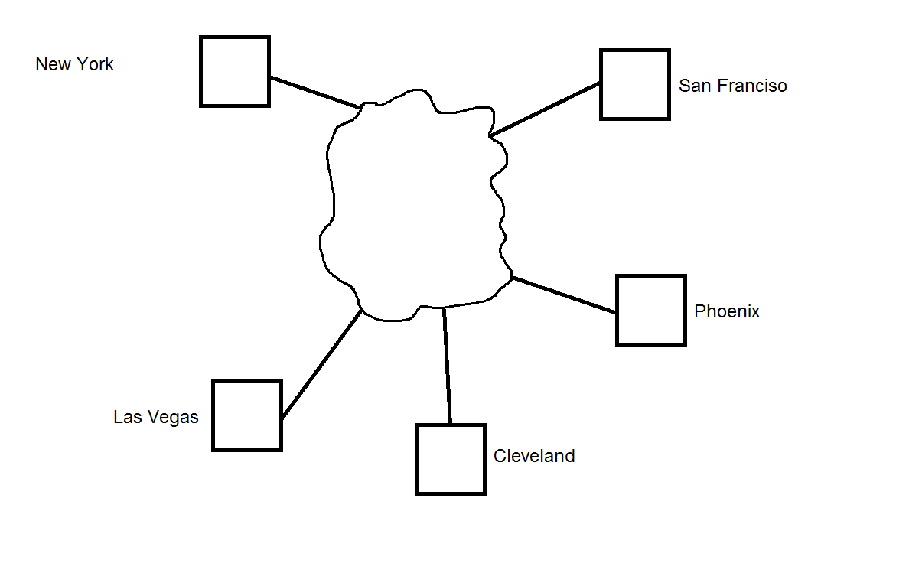
Frame relay / cloud

Slide 156
WAN terms

Slide 157
Multiplexing - 591
Time Division
Frequency Division
Wavelength Division
CDMA – speak multiple “languages” /mathematic multiplexing
  * this is technically incorrect, but easy to understand the analogy

Slide 158
CSU/DSU - 592
Channel Service Unit / Data service Unit – effectively the modulator/ memodulator (modem) for serial lines.*

Slide 159
Circuit vs. Packet Switching - 594
Packet-based networking vs. circuit based
  Packets are small, quick to send
  Routes vary
  Route determined after computer begins to send the packet
  Can arrive from different routes in different order than sent.
  Can introduce delays as packets traverse network, where as with circuit switching the delays is before data is sent (circuit/setup)*
  Circuit switching – connection oriented/dedicated resources and circuit
  Circuit switching has fixed delays.

Slide 160
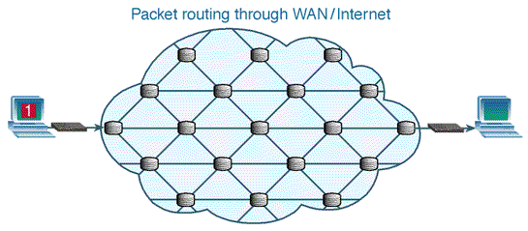
Packet Switching (this should be automated)

Slide 161
ATM - 598
A type of packet based switching used to emulate circuit switching
  Used by telcos
  53 byte cells *
    48 bytes data
    5 bytes header
  Sets up a virtual circuit
  Guarantees resources once a circuit is setup*
  Guarantees QoS*

Slide 162
QoS - 598
QoS
  What is it
  Why is it needed
  Network convergence

Slide 163
VoIP - 602
VoIP
What are some concerns with VoIP
  Technical
    Latency, Jitter, dropped packets QoS
  Security
    Eavesdropping
    Caller id Spoofing and vishing
    Long Distance calls
SIP – Session Initialization Protocol
Call processor
  Sets up calls, terminates calls.

Slide 164
Remote Access

Slide 165
Remote Access - 610
Home users/remote users need a way to access work
  Dial Up
  ISDN
  DSL
  Cable Modems

Slide 166
Dial up - 610
Advantages
  Reduce networking costs (use internet) as opposed to dedicated connections
  Allows work from home
  Streamlines access to information
  Provides a competitive advantage
(more)

Slide 167
Dial Up - 610
Disadvantages
  Back door into networks (bypass firewall)
  Often forgotten about
  Slow
Attacks*
  War dialing
Defenses*
  Dial Back /
  Caller ID restrictions
  Use authentication
  Answer after 4 or more rings (why/war dialing)

Slide 168
ISDN - 611
Uses same lines as phone lines, directly dial into company or ISP
  BRI
    2 B Channels (64Kbits x 2)
    1 D Channel (control channel) Out of Band
  PRI
    23 B Channels
    1 D Channel
    Not for personal use

Slide 169
DSL - 613
MUCH faster than IDSN (6-30 times faster)
Must live very close to the DSL equipment
Symmetric and Asymmetric
Always on (security concerns)
Doesn’t connect directly to company
  use VPN

Slide 170
Cable Modem - 613
High speed access up to 50Mbps via cable TV lines.
Shared bandwidth
Always on (security concerns)
Doesn’t connect directly to company
  require VPN

Slide 171
VPNs

Slide 172

VPN
N

Slide 173
VPN - 615
Virtual Private Network – Generic term for building a secure virtual network over a public network
Often used for remote access for users
Often used to tie organizations remote offices together

Slide 174
Tunneling
A component of some VPNs - Tunnel encapsulates one protocol within another protocol to create a virtual network.
Can encrypts original IP headers
Can encrypts data
Allows for routing non routable protocols and IP addresses
Can provide remote/internal IP addresses

Slide 175
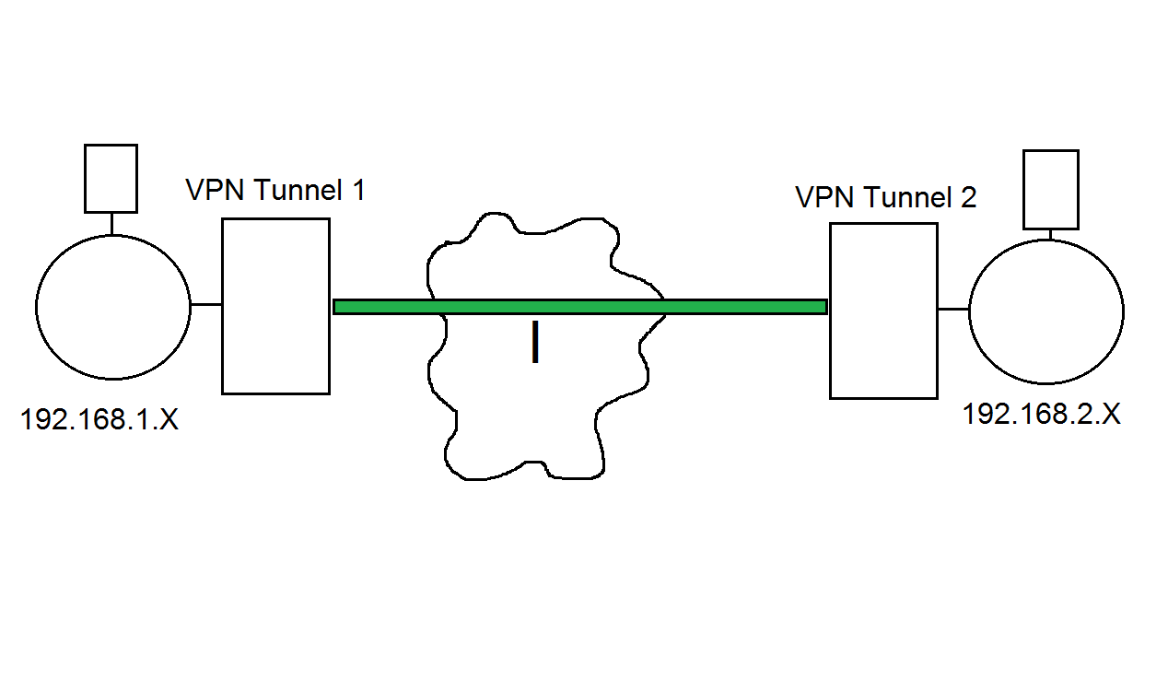
Example of Tunneling

Slide 176
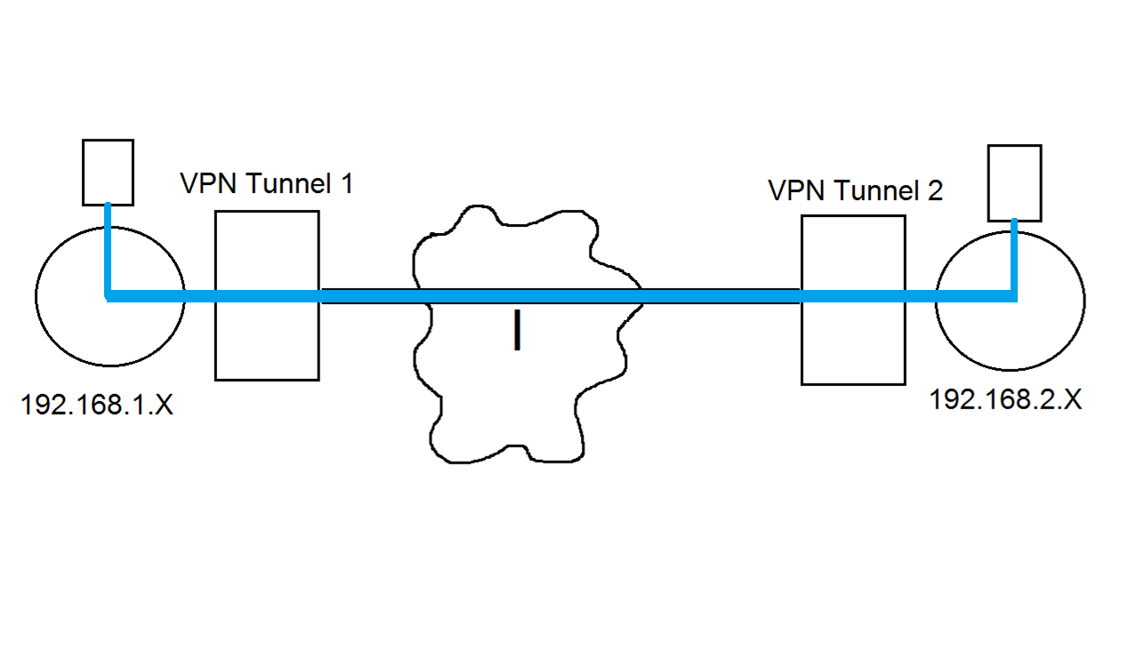
Example of Tunneling

Slide 177
Transport
Transport does not actually tunnel IP within IP. It only encapsulates the transport layer and above to protect the DATA.
Can encrypt DATA
Can provide origin authentication
Cannot encrypt original IP headers*
Does not provide remote/internal IP addresses*

Slide 178
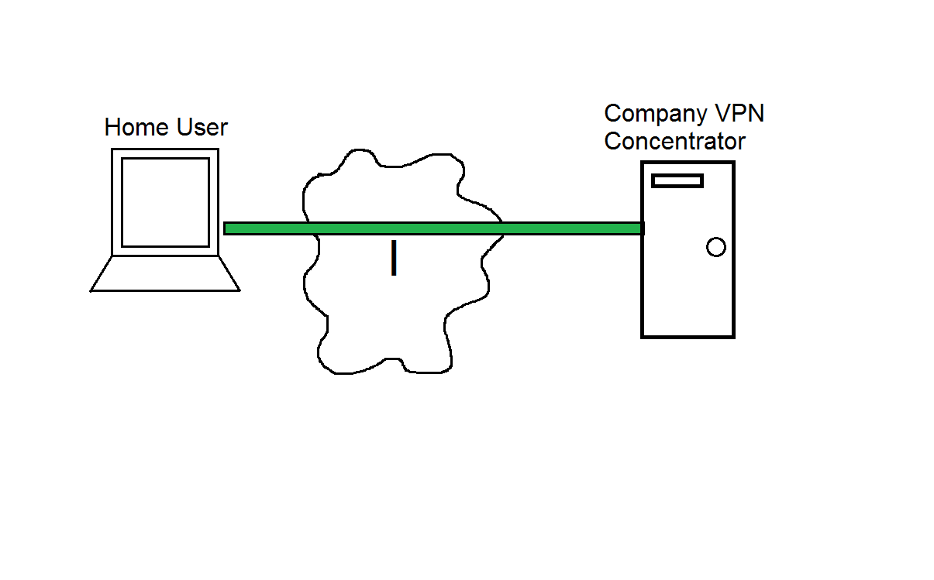
Example of transport

Slide 179
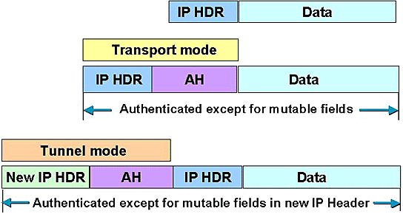
Transport vs. Tunnel

Slide 180
VPN protocols
Different protocols
  PPTP
  L2TP
  IPSEC

Slide 181
PPTP - 619
Point to Point Tunneling Protocol
Lead by Microsoft protocol for a tunneling VPN
Uses TCP port 1723
  must keep open on firewall*

Slide 182
PPTP operation
Remote user connects to ISP, get’s an Internet Address
Establishes VPN connection to work VPN server, get’s Internal IP address.
Sends private IP packets encrypted within other IP packets.
visualization next slide

Slide 183
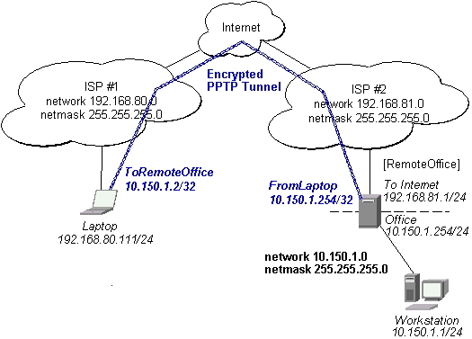
PPTP

Slide 184
L2TP
Layer 2 Transport Protocol
  Cisco designed
  Designed to be implemented in hardware
  Does not provide encryption
  UDP 1701

Slide 185
IP Sec - 617
Intended to add security to IPv6, back ported to IPv4
Can provide Integrity and Confidentiality as well as data origin authentication.
Uses additional headers
  AH
  ESP
Tunnel, or Transport
Uses Security Associations (SA)
Uses IP protocol 50 ESP headers, 51 for AH headers.
http://www.ciscopress.com/articles/article.asp?p=25477

Slide 186
IPSEC
AH - authentication header
  Protocol number 51
  Authentication only
ESP – Encapsulating security payload
  Protocol number 50
  Encryption

Slide 187
IP SEC SA
From Cisco:
The concept of a security association (SA) is fundamental to IPSec. An SA is a relationship between two or more entities that describes how the entities will use security services to communicate securely. IPSec provides many options for performing network encryption and authentication. Each IPSec connection can provide encryption, integrity, authenticity, or all three. When the security service is determined, the two IPSec peers must determine exactly which algorithms to use (for example, DES or 3DES for encryption, MD5 or SHA for integrity). After deciding on the algorithms, the two devices must share session keys. As you can see, there is quite a bit of information to manage. The security association is the method that IPSec uses to track all the particulars concerning a given IPSec communication session

Slide 188
IP Sec SA
Unidirectional, need two for bi-directional communication
SAs are identified by an SPI (Security Parameter Index )
Dynamic protocol for establishing SA and keys in IPSEC is ISAKMP
  UDP port 500

Slide 189
Remote Access Best Practices
Always authenticate users
Use multi-factor authentication
Audit access
Answer modems after 4 rings (modems)
Use caller id (modems)
Use callback (modems)
use VPNs

Slide 190
Wireless

Slide 191
Wireless (625)
Wireless, very common now.
  No wires
  Easy to use
  Uses CSMA/CA
  Shared Medium
    Problems?

Slide 192
Spread Spectrum - 625
Spreads communication across different frequencies available for the wireless device.
  Frequency Hopping Spread Spectrum
    Hop between frequencies (helps if other devices use same frequencies) (doesn’t use the entire “bandwidth of frequencies)
    Harder for eavesdroppers (if everybody didn't know the sequence.. Which they actually do)
  Direct Sequence Spread Spectrum
    Sends data across entire bandwidth, using chipping code* along with data to appear as noise to other devices.

Slide 193
Wireless Components - 627
Access points are like wireless hubs, they create a infrastructure WLAN
If you use just wireless cards of computers to communicate together that is called an ad-hoc* network.
Wireless devices must use the same channel
Devices are configured to use a specific SSID (often broadcasted)

Slide 194
802.11 standard - 630
Wireless networking
2.4, 3.6, 5 GHz
Data Link layer specifications
Access point (a type of bridge)

Slide 195
802.11 family - 630
802.11a
  54Mbps
  5Ghz
  8 channels
802.11b
  11Mbs
  2.4Ghz (same as other home devices)
802.11g
  54Mbs
  2.4Ghz
802.11n
  100Mbs
  2.4Ghz or 5Ghz

Slide 196
Wireless security problems
Unauthorized access
sniffing
War driving
Unauthorized access points (Man in the middle)

Slide 197



Airsnarfing (wireless MiM)
Wireless AP
Wireless User
Attacker

Slide 198
Transmission encryption – 632
There are many different types of wireless encryption protocols
WEP
  Shared authentication passwords
  64 or 128 bit
  Easily crackable
  Only option for 802.11b
WPA PSK
  Shared authentication password
  TKIP

Slide 199
Transmission Encryption
WPA2 PSK
  Shared authentication password
  AES
WPA and WPA2 Enterprise
  Uses 802.1X authentication to have individual passwords for individual users
  RADIUS – what was radius again?
802.11i* – the official IEEE wireless security spec, WPA2 supports 802.11i

Slide 200
802.1X - 627
Authenticated port based access control.
Provides distinct user authentication
Has supplicant (client), authenticator (AP) and authentication service (usually radius)

Slide 201
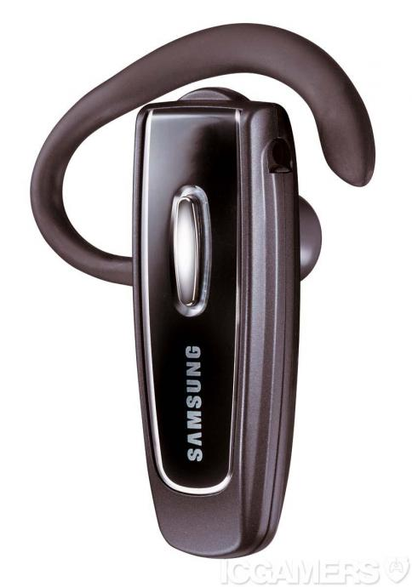
Bluetooth

Slide 202
Bluetooth (640)
Bluetooth is a Personal Area Network protocol designed to free devices from physical wires.
Bluetooth Modes
  Discovery Mode
  Automatic Pairing

Slide 203
Bluetooth Attacks
Blue jacking
  Sending forged message to nearby bluetooth devices
  Need to be close
Blue Snarfing
  Copies information off of remote devices
Blue bugging
  More serious
  Allows full use of phone
  Allows one to make calls
  Can eavesdrop on calls

Slide 204
Bluetooth Countermeasures
Disable it if your not using it
Disable auto-discovery
Disable auto-pairing

Slide 205
WAP (641)
Wireless Application Protocol – a protocol developed mainly to allow wireless devices (cell phones) access to the Internet.
Requires a Gateway to translate WAP <-> HTML (see visual)
Uses WTLS to encrypt data (modified version of TLS)
Uses HMAC for message authentication
WAP GAP* problem (see visual and explain)
A lot of wireless devices don’t need WAP anymore.

Slide 206

WAP

Slide 207

WAP GAP
As the gateway decrypts from WTLS and encrypts as SSL/TLS, the data is plaintext. If someone could access the gateway, they could capture the communications

Slide 208
Attacks against Networks and Software

Slide 209

LOKI
Pings easily go through the firewalls undetected!

Slide 210

MAC flooding

Slide 211
Buffer Overflows (chapter 11)
What are they? What are the attributes of a buffer overflow?
NOTE SERIOUS LIBERTIES have been taken with the example slides of a buffer overflow to simplify the attack so it’s easier to understand. In reality it’s more complicated than shown

Slide 212

Buffer Overflow

Slide 213

Buffer Overflow

Slide 214

Buffer Overflow

Slide 215

Buffer Overflow

Slide 216

Buffer Overflow

Slide 217
Buffer Overflow

Slide 218

Buffer Overflow

Slide 219

Buffer Overflow

Slide 220

Buffer Overflow

Slide 221

Buffer Overflow

Slide 222
Buffer Overflow
The previous example as shown was closer to command injection.
A real stack based buffer overflow would replace the reboot command with the machine code to make the system reboot, as well as over writing the return pointer on the stack with the address of the inserted machine code that would reboot the computer.

Slide 223
Buffer Overflows
Common buffer overflow types
  Stack based
  Heap based

Slide 224
Buffer Overflow
Best Defense against buffer Overflows
Educate software engineers with secure coding practices including input validation
Patching and making sure code is latest version (systems administrators)

Slide 225
Buffer Overflow
Buffer overflow defense unlikey to be seen on the exam.
Stack Canaries (compilers)
Non-executable stack and non-executable memory sections
  NX bit
  DEP
Address Space Layout Randomization (ASLR)

Slide 226

Smurf Attack

Slide 227

Smurf Attack (chapter 11 – 1031)

Slide 228
Smurf Attack
How would a smurf attack someone?
Find site to attack, say www.ebay.com
Forge Ping packet from www.ebay.com to a BROADCAST network address
Watch as the computers on the network all start pinging back www.ebay.com
Countermeasures
Drop forged packets at routers
Drop directed broadcasts at routers or end system
Use and IDS

Slide 229

Fraggle

Slide 230
Fraggle (like Fraggle rock)
(chapter 11 – 1031)
Like Smurf, but uses UDP (echo and chargen)
Countermeasures
Drop forged packets at routers
Drop directed broadcasts at routers or end system
Disable echo and chargen services
Block echo and chargen ports on router
Use an IDS

Slide 231

SYN Flood (chapter 11 – 1033)

Slide 232
SYN Flood
Attack
  Forge IP SYN packet from downed system
  Server responds to fake downed address, which never responds
  Use up all the listen queue slots
  Stops real new connections from establishing
Countermeasures
  Drop forged packets at routers
  Patch OS
  Decrease 3 way handshake timeout values
  Increase 3 way handshake max connections
  Use a firewall as a middleman

Slide 233
Ping of Death

Slide 234
Session Hijacking

Slide 235
Tear Drop
Overlapping fragments, cause OS to get confused and crash.
Countermeasures
Patch the OS
Drop fragments (problems?)
Use a firewall that does fragment re-assembly.

Slide 236

Tear Drop (chapter 11 – 1034)

Slide 237
LAND attack
Forging a SYN packet from a host to itself. Causing an loop of constant response to itself.

Slide 238
DDoS (chapter 11 – 1034)
Distributed Denial of Service – a brute force method that generally uses zombies or bots to build a botnet to overwhelm a target.
May consist of a hierarchy of Attacker, Masters and Slaves (see image 2 slides)

Slide 239

DDoS

Slide 240
DDoS
How are zombies and botnets usually created?

Slide 241
Maintenance Hooks (382)
(chapter 5)
A backdoor that software developers put into the code so they can easily access a system for the purpose of troubleshooting.
Countermeasures
  Code reviews by 3rd parties, if source code is available
  Use an IDS system to detect backdoors/maintenance hook usage
  Auditing (same as above)

Slide 242
Time of Check/Time of Use Attack (383)
A situation where the outcome of a command or processes are dependant on when certain steps are done.
Example.
Imagine I have $50.00 in an online gambling account. I say “bet all that’s in my account” on a football game tonight. After I place the bet I insert an additional $500.00 to my account. If for some reason that deposit gets in before the bet goes though, I might end up betting $550.00 when I only meant to bet $50.00

Slide 243
Time of Check/Time of Use Attack (383)
Countermeasures
  Do not split up critical tasks into pieces (make transactions atomic
  Lock out resource access to new operations while a current operation is running.
    Basic database concept of transactions
Race conditions are a time of ToC/ToU attack.

Slide 244
Root Kit (649)
What is a root kit?
What is the purpose of a root kit?

Slide 245
Chapter 7 - Review
Q. What is blue jacking?
Q. What is TKIP?
Q. What can be used to defeat callback security?
Q. Why are switches more secure than hubs?

Slide 246
Chapter 7 - Review
Q. What is a Smurf Attack?
Q. What is a teardrop attack?
Q. What is a buffer overflow?
Q. what are used for DDoS attacks?
Q. Is TCP connection or connectionless?

Slide 247
Chapter 7 - Review
Q. does a switch create multiple
  Collision Domains?
  Broadcast Domains?
Q. What is an Advantage of a circuit level proxy? Disadvantage?
Q. What is an Advantage of a application proxy? Disadvantage?
Q. How many IP Sec SAs are required for communications between point A and point B?

Slide 248
Chapter 7 - Review
Q. what is a botnet?
Q. how does a SYN-flood attack work?

Slide 249
Chapter 7 - Review
Q. What layer of the OSI model does a switch work on? Hub? Router?
Q. What types of addresses do switches use for forwarding packets?
Q. What protocol and port does PPTP use?
Q. What is the best type of cable for high security or to avoid electrical interferance?

