Slide 1

Chapter 8: Cryptography
Brian E. Brzezicki

Slide 2
Cryptography (665)
Cryptography – science of encrypting information.
  “scrambles” data so only authorized parties can “unscramble” and read data

Slide 3
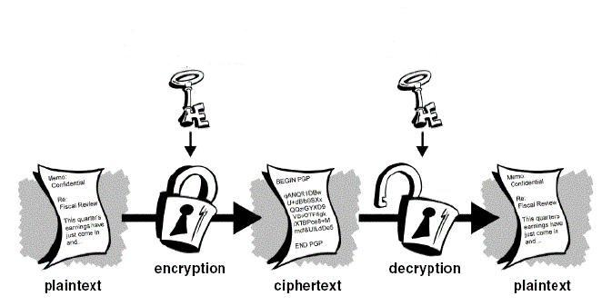
Basic Idea

Slide 4
Cryptography (665)
How do we scramble data?
  Substitution (confusion)
  Transposition (diffusion)
A strong cipher will use BOTH these methods.

Slide 5
Cryptography (665)
  Now it’s time to memorize some terms…

Slide 6
Cryptographic Terminology
Cryptography - a method of storing and transmitting data in a form only intended for authorized parties to read or process.
Cryptanalysis* - science of studying, breaking, and reverse engineering algorithms and keys.

Slide 7
Cryptographic Terminology (671)
Encryption – the method of transforming data (plaintext) into an unreadable format.
Plaintext – the format of data before being encrypted
Cipher text – the “Scrambled” format of data after being encrypted

Slide 8
Cryptographic Terminology (671)
Decryption – the method of turning cipher text back into
Encryption algorithm – a set or rules or procedures that dictates how to encrypt and decrypt data. Also called an encryption cipher
Key (crypto variable) - a values used in the encryption process to encrypt and decrypt

Slide 9
Cryptosystem Definitions (672)
Key space – the range of possible values used to construct keys
example:
Assume a key can be 4 digits long and consist of 0-9
  Key space is all combinations from 0000 – 9999
  Key space = 10,000
Assume a key can be 6 digits long and consist of 0-9
  Key space is all combinations from 0000 – 999,999
  Key space = 1,000,000

Slide 10
Cryptosystem Definitions (672)
Key Clustering – Instance when two different keys generate the same cipher text from the same plaintext
Work factor – Estimated time and resources to break a cryptosystem
  Ultimate goal is to make the work factor too high for the attacker.

Slide 11
Cryptosystem Development Concepts (674)
Assume the attacker knows your encryption/decryption algorithm.
Algorithms should be open to review.
The only thing that should be secret in a cryptosystem is the “key” (Kerckhoffs Principal)

Slide 12
Key Generation and Management

Slide 13
Key Generation and Management (674)
The goal of designing an encryption method is to make compromising it too expensive to be worth it*.
The amount of work to break it is called “work-factor”*
Protecting the key is important. There is no point to designing an encryption system that would take 1,000,000 years to break if you can easily just get some ones key!
Key Protection is CRITICAL*
(more)

Slide 14
Key Generation and Management
The larger the key space is, the more secure a cryptosystem is, this is called “Key Complexity”
Keys should be extremely random and use the full spectrum of the key space
  Example:
    Assume your key can be 10 digits
    Is 0000000001 a good key?
(more)

Slide 15
Key Generation and Management
Keys must be securely distributed and stored
Keys lifetime should correspond with the sensitivity of the data to be protected, and the amount of times the key is used.
If a key is used often, it should be retired after a certain lifetime.
Keys should be destroyed when their lifetime is at and end.
Keys should be backed up in case of emergency

Slide 16
Cryptography History

Slide 17
Cryptography History (667)
Romans used a shift cipher called a “CEASAR” cipher. Shift Ciphers simply shift characters in an alphabet.
(visual on next slide)

Slide 18
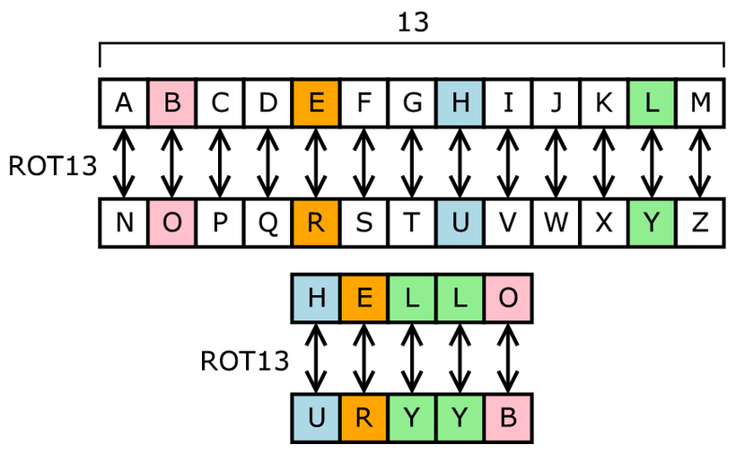
ROT 13

Slide 19
ROT 13
Go to http://www.rot13.com to try

Slide 20
Transposition Cipher
Jumbles up the ordering of characters in a message. The Spartans of Greece used a form of this called the “Scytale” Cipher.

Slide 21
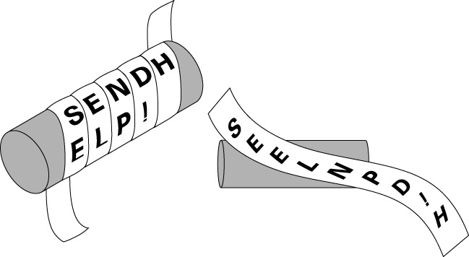
Scytale (667)

Slide 22
Vigenere Cipher (669)
Polyalphabetic Substitution Cipher – A more advanced substitution cipher as it any letter can have multiple letters substituted for it!
That is an A will not always map to an N
Harder to break!
Visual next slide

Slide 23
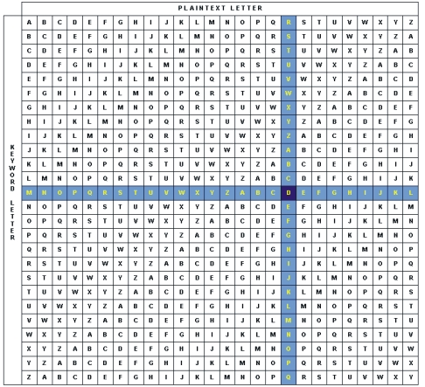
Vigenere Cipher

Slide 24
Symmetric Encryption

Slide 25
Symmetric Encryption (686)
Idea same key is used to BOTH encrypt and decrypt data!

Slide 26
Symmetric Encryption (686)
Called Symmetric or Private Key encryption
Anyone with the key can either encrypt or decrypt
Must securely distribute keys to both parties.
  Chicken in the egg situation with networks
Very Fast to encrypt or decrypt
Key Management is the big issue

Slide 27

Key Management (687)
n: number of parties who want to securely communicate
# keys = (n*(n-1)) / 2
5 = (5*4)/2 = 10 keys
10 = (10*9)/2 = 45 keys
100 = (100*99)/2 = 4950 keys
1000 = (1000*999)/2 = 499500 keys

Slide 28
Encryption Modes

Slide 29
Encryption Modes – Block (692)
Take the message and break it up into fixed sized blocks, encrypt each block using the given key.
Visual next page

Slide 30

Block (692)

Slide 31
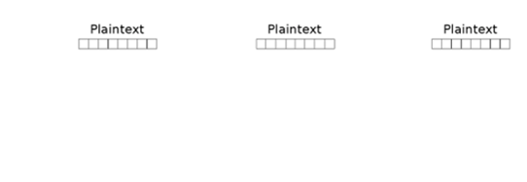
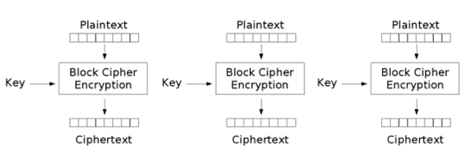
Block (692)

Slide 32
Block Encryption (692)
Problems with Block Encryption?
If a block has the same contents, the resulting cipher text block will have the same cipher text. (Example next slide)

Slide 33
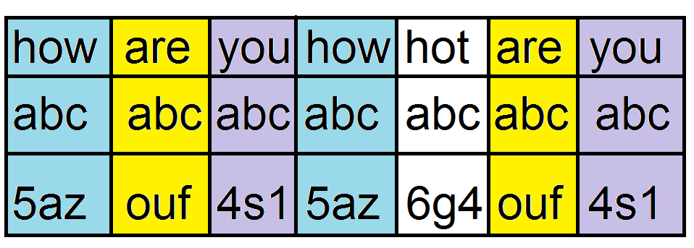
Block encryption problem

Slide 34
Block Encryption Problems (695)
Often with block encryption, we include a value in addition to the key that changes for each block, so we don’t get repetitive cipher text blocks.
  CBC chaining & Initialization Vectors

Slide 35
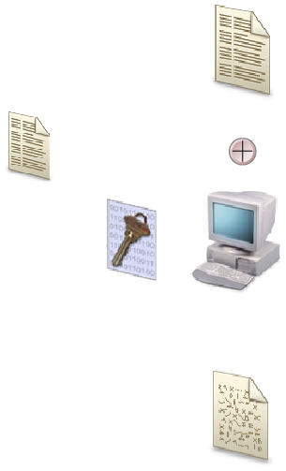
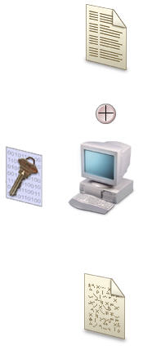
Cipher Block Chaining (706)
Replaces IV
IV

Slide 36
Counter Mode (709)
Sometimes you want to do cipher block chaining but you the data is not processed serially.
  Use an increasing counter as the extra encryption information.

Slide 37
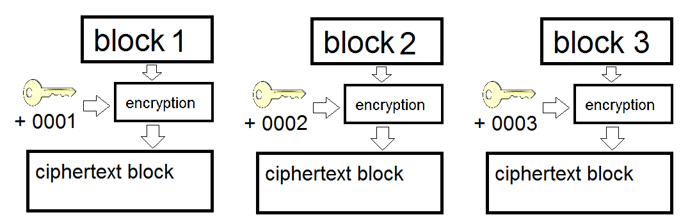
Counter Mode (709)

Slide 38
Stream Encryption

Slide 39
XOR (n/b)
XOR is a Boolean mathematical function which creates an output bit based on two input bits. It outputs a 1 IF and ONLY if one bit of input is 1 and the other is a 0.
INPUT1 INPUT 2 XOR OUTPUT
-------------------------------------------------------------------
0 0 = 0
0 1 = 1
1 0 = 1
1 1 = 0

Slide 40
Stream Encryption (695)
The key is used with a key stream generator which creates a series of bits each are mathematically combined with the bit stream of plaintext to produce cipher text.
Used when data is not available in large blocks
  Keyboard input
  Morse code
  Any input that arrives one bit or byte at a time
(visual next slide)

Slide 41
Stream Encryption
Plain Text Bit Keystream Bit Output Bit
0 1
1 1
1 0
0 1
1 XOR 1 = 0
Cipher text = 0

Slide 42
Stream Encryption
Plain Text Bit Keystream Bit Output Bit
0 1
1 1
1 0
0 XOR 1 = 1
Cipher text = 0 1

Slide 43
Stream Encryption
Plain Text Bit Keystream Bit Output Bit
0 1
1 1
1 XOR 0 = 1
Cipher text = 0 1 1

Slide 44
Stream Encryption
Plain Text Bit Keystream Bit Output Bit
0 1
1 XOR 1 = 0
Cipher text = 0 1 1 0

Slide 45
Stream Encryption
Plain Text Bit Keystream Bit Output Bit
0 XOR 1 = 1
Cipher text = 0 1 1 0 1

Slide 46
Stream Cipher considerations
Stream ciphers are hard work, better done in hardware*
The key stream generator should :
  Produce a key stream with a balanced number of equivalent number of 0’s and 1’s
  Not generate repeating patterns.
  Not product predictable output
  Not produce a key stream related to the key

Slide 47
Cipher Feedback Mode (707)
Similar to Cipher Block Chaining in block mode, however in this case. We are using a stream cipher. We will use 1 few bits of the cipher text to modify the output of a key stream generator.
  Think “Cipher Block Chaining” for stream encryption.

Slide 48
One Time Pad (677)
A perfect cryptosystem that works as follows.
  each party has a book (pad) of symmetric keys, each key is as at least as long as the message to be encrypted.
  A message is encrypted with the first key, then that key is discarded.
  The message is decrypted on the other side with the first key, then that key is also discarded.
  After each time a message is encrypted/decrypted the key is destroyed and never used again.

Slide 49
One Time Pad considerations
For a One Time Pad to truly be perfect the following conditions must be met.
  The pad must be shared by both sides*
  The pad must be used only one time*
  The pad must be as long as the message*
  The pad must be securely distributed*
  The pad must be used up of truly random values*

Slide 50
One Time Pad (677)
  1011 – plain text
  0101 – pad
  ------ XOR
  1110 – cipher text

Slide 51
Symmetric Algorithms

Slide 52
Symmetric Algorithms – DES (703)
Data Encryption Standard
Developed from at NIST request for an encryption standard
Chosen algorithm was called “Lucifer” from IBM
Block Cipher
Fixed sized blocks of 64 bits
Key size 64 bits, effective size is 56 bits
16 rounds of substitution and transposition
DES is no longer considered strong enough, can be broken easily with distributed computing.

Slide 53
Triple DES (710)
Nothing but DES 3 times
3DES – EEE3
3DES – EDE3
3DES – EEE2
3DES – EDE2
Since it’s 3 x DES, 48 rounds of substitution and transposition.

Slide 54
AES (711)
Developed as a replacement to DES
Actual algorithm is called “Rinjdael”
Block cipher
128 bit blocks
Key sizes of 128,192, 256
Rounds depend on key size
  9: for 128 keys
  11: for 192 keys
  13: for 256 bit keys

Slide 55
RC5 (712)
Block cipher
Block size 32, 64, 128
Key Size up to 2048 bits
Rounds up to 255, minimum of 12 recommended

Slide 56
RC6 (712)
Block cipher based on RC5, same attributes as RC5
Developed to be a AES candidate
Faster that RC5

Slide 57
RC4 (712)
Stream cipher – what was that again?
Was proprietary, but released on Internet in 1994, “ARC4” is the “open version of RC4”
Key length 8 – 2048 bits
Used in SSL and WEP communication

Slide 58
Blowfish (712)
Block cipher
64 bit blocks
Key size 1 - 448 bits
16 rounds of substitution and transposition
Created by Bruce Schneier for anyone to use freely
  "Blowfish is unpatented, and will remain so in all countries. The algorithm is hereby placed in the public domain, and can be freely used by anyone."

Slide 59
IDEA (711)
International Data Encryption Algorithm
Proposed AES candidate
Block cipher
64 bit blocks
128 bit keys
Used in PGP

Slide 60
Symmetric Review

Slide 61
Symmetric Pros
  Encryption is fast

Slide 62
Symmetric Cons (688)
Keys must be security distributed
  How do you get a key securely across an insecure channel?
Key management becomes difficult as the number of nodes increases.
Does Not provide Authenticity or Non-repudiation

Slide 63
Symmetric (688)
For the exam:
Understand the concept
Understand it’s strengths
Understand it’s weaknesses
Understand the different algorithm properties highlighted on the slides.

Slide 64
Asymmetric Encryption

Slide 65
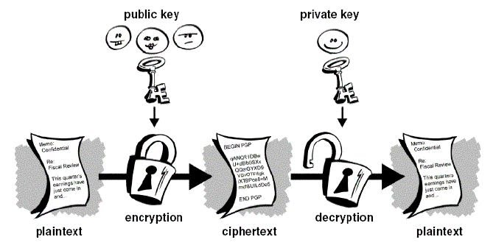
Asymmetric Encryption (688)
Use 2 keys, public key to encrypt a message, private key can decrypt
!=

Slide 66
Asymmetric Encryption (688)
Also called public key encryption
Requires 2 related keys
  Public key – given to anyone
  Private key – kept secret
Public key is used to encrypt message
Private key is used to decrypt message
Private key is used to sign messages
Public key is used to validate signed messages

Slide 67
Asymmetric Properties
Key exchange is simple!
Asymmetric encryption is SLOW
Asymmetric is not used for bulk encryption
Asymmetric Encryption uses “trapdoor” functions to make hard work easier. (just memorize this)
Can be used to “digitally sign” a message
  Provides integrity
  Provides non-repudiation

Slide 68
Diffie-Hellman (713)
The original Asymmetric algorithm
  Developed to address shortfalls of key distribution in symmetric key distribution.*
  Enables two people to receive a symmetric key securely without a previous relationship*
  Generates session keys for secure SYMETRIC encryption communications*
  Algorithm is based on “difficulty of calculating discrete logarithms in a finite field”*
  Vulnerable to “man in the middle” attacks*

Slide 69
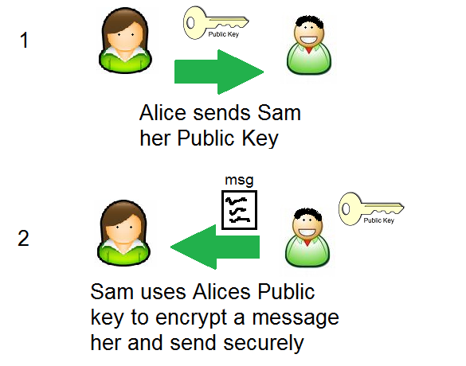
Using Asymmetric Encryption for Key Exchange

Slide 70
Asymmetric Algorithms – RSA (716)
Can be used for digital signatures, key exchanges*, and encryption
Security based on difficulty of factoring large numbers.
Private and Public keys are functions of large prime numbers.
Was patented, has expired

Slide 71
Asymmetric Algorithms – DSA
Designed for use in the Digital Signature Standard (DSS).
Can only be used for signing.

Slide 72
El-Gamal (719)
Encryption, key exchanges or digital signatures
Actually an extension of Diffie-Hellman
Security based on computing discrete logarithms in a finite field
Slowest of all methods we will discuss

Slide 73
Elliptic Curve Cryptosystem (719)
Used for digital signatures, encryption and key distribution
The fastest asymmetric algorithm that we discuss*
Deals with discrete logarithms of elliptic curve*.
Because it’s fast and does not require a lot of resources it is used on devices with limited resources*

Slide 74
Asymmetric Overview
Uses 2 keys, one for encryption, one for decryption
This mitigates the key management, key distribution problem (kind of…)
Can provide integrity and proof of sender (non-repudiation)
Is VERY slow
Often used in a hybrid system
  Encrypt symmetric keys using asymmetric algorithms
  Do large scale encryption with these asymmetric keys!

Slide 75
Hashing (721)
Hey… didn’t I already tell you to get your mind out of the gutter? …

Slide 76
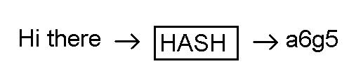
Hashing (721)
Hashing is similar to encryption… but different.
  Hashing is a one way operation.
  Take input message of any length
  Put through hashing function
  Retrieve fixed length output (hash digest)

Slide 77
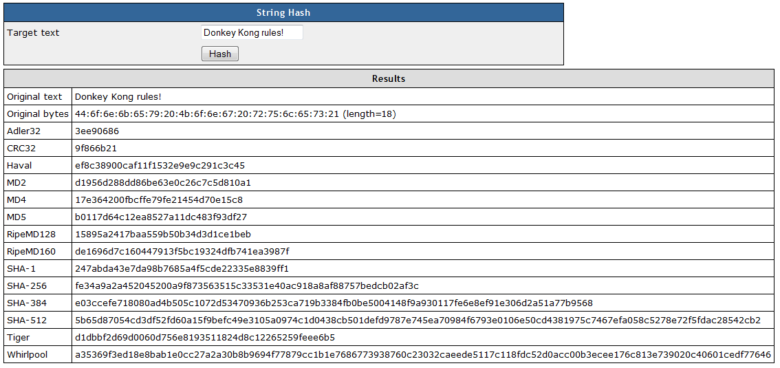
Hash
Try for yourself at http://www.fileformat.info/tool/hash.htm

Slide 78

Hashes (721)
Hashing is a one way operation. Once hashed, no way to get back the original message
Hash digests are fixed, so multiple messages could produce the same hash digest (collision) oh… no...

Slide 79
Hashes (721)
Hashing can provide integrity against non-intentional modifications.
Hashes can be combined with a private key to provide protection against intentional modification.
Generally, the more bits in the digest the more secure, all other things being equal

Slide 80
Hash algorithms – SHA (727)
Secure Hash Algorithm
Designed/Published by NIST
Designed for use in the DSS
Modeled after MD4
SHA-0 (retired)
SHA-1 (SHA-160) – 160 bit digest
  512 bit blocks
SHA-256 – 256 bit digest
  512 bit blocks
SHA-384 – 384 bit digest
  1024 bit blocks
SHA-512 – 512 bit digest
  1024 bit blocks

Slide 81
MD2 (727)
Developed by Ronald Rivest (of RC and RSA fame)
Optimized for 8 bit computers
128 bit digest
128 bit blocks

Slide 82
MD4 (727)
Optimized for 32 bit computers
128 bit digest
Used as the hash algorithm for Windows NTLM password hashes

Slide 83
MD5 (727)
Similar to MD4, but more secure
Slower
128 bit digest
512 bit blocks
Moving away from, to SHA

Slide 84
Attacks against Hashes (729)
Collisions – figure out how to create a message with the same hash value (collision)
  Ex. “I’d like to buy 100 units of the widget” => A3BT
  What if I could make the messages “I’d like to buy 500 units of the widget” and have the same hash value “A3BT” I can beat the integrity constraint
This is called a birthday attack

Slide 85
Hash overview
Know what a hash is
  Concept
  Fixed length digest
  What is a hash used for
  Know what a collision is
  Know it’s susceptible to MiM
  Know what HMAC is, and what it tries to accomplish

Slide 86
Hash Overview
Understand a good hash function should not make it predictable on how to “force” a collision
Be familiar with MDx, and SHA-x
Understand that SHA is considered the best algorithm

Slide 87
HMAC (722)
HMAC – uses a secret hey in combination to a hash algorithm to verify that a hash is not tampered with.
Rather than just computing the hash digest of the message. Compute the hash digest of the message + a shared secret key.
  The hash digest is called a MAC (Message Authenticating Code)

Slide 88
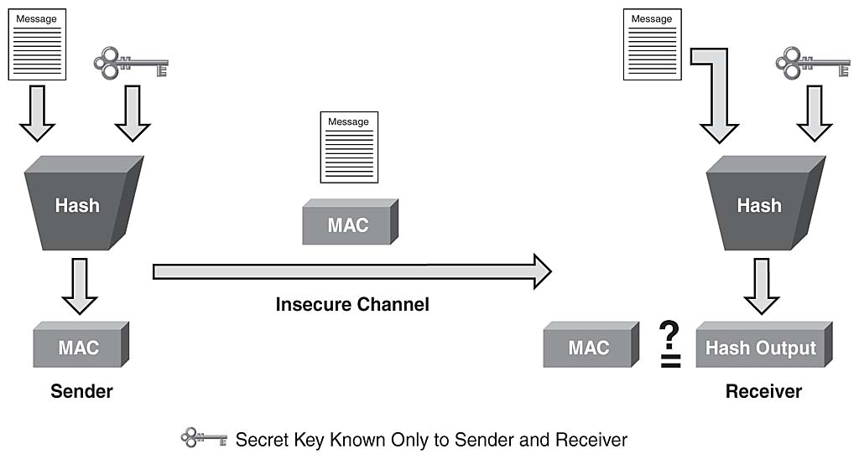
HMAC (722)

Slide 89
HMAC (722)
Provide integrity and data origin authentication
  Does not provide confidentiality
  Does not provide specific originator authentication

Slide 90
Validating a Messages Integrity

Slide 91
CBC-MAC (724)
Message is encrypted with a symmetric block cipher the final block of cipher text is used as the MAC.
Sender sends the plaintext and the MAC.
Does not use a HASH
Provides authentication and integrity
Does not provide confidentiality

Slide 92
Non-Repudiation (675)
Non-Repudiation – being able to definitively prove someone said or wrote something.
  Proves they actually sent a message
  Proves the message was not altered

Slide 93
Non-Repudiation (675)
How can we provide non-repudiation?

Slide 94

Digital Signatures
No!!!

Slide 95
Digital Signatures (730)
We can use Asymmetric Cryptography and Hashes. To provide
  Message authenticity
  Integrity
  Non-repudiation

Slide 96
Digital Signing (730)
To digitally sign something.
Run message through hash algorithm to generate a message digest
Encrypt the message digest with your private key
Send both the original message and the encrypted message digest

Slide 97
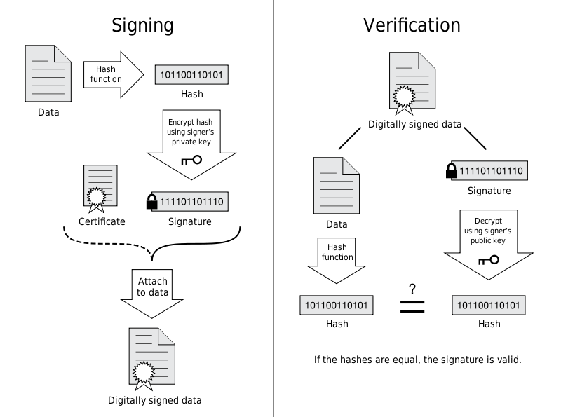
Digital Signature

Slide 98
Digital Signing (730)
If a user can decrypt the encrypted hash it proves:
  You sent the message
  The message has not been altered

Slide 99
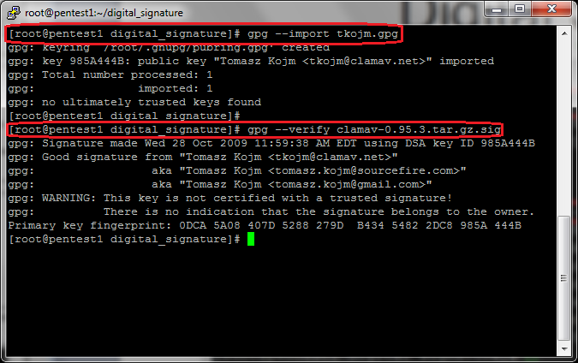
Digital Signing

Slide 100
Services Cryptosystems Provide
Cryptosystems provide the following services
Confidentiality
Integrity
Authentication
Authorization – upon authentication, a user can be provided with a password to access a resource
Non repudiation

Slide 101
Attacks Against Cryptology

Slide 102
Cipher Text Only Attacks (761)
An attacker collects lots of cipher text messages that have been encrypted with the SAME key
Use statistical analysis to attempt to determine the encryption key

Slide 103
Known-Plaintext Attack (761)
An attacker has some plaintext and the corresponding cipher text of a messages
Use statistical analysis to try to obtain the key
Example
  in WWII Japanese and German transmissions always started with a certain phase. The “Allies” knew the starting phrase and they could record the encrypted messages so they were able to eventually determine the key.

Slide 104
Chosen-Plaintext Attack (761)
Same as known plaintext, however the attacker can chose which plaintext he has access to.

Slide 105
Chosen Cipher text Attack (762)
An attacker can choose some portion of the message to be decrypted and receive the corresponding plaintext.
Goal is to figure out the key
This is much less likely a scenario.

Slide 106
Non-Encryption Ciphers

Slide 107

Steganography

Slide 108
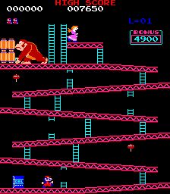
Stenography

Slide 109

Stenography

Slide 110
Steganography
Donkey Kong is cool!
Don’t believe me?
  Go to http://www.paladingrp.com/splus/dk.png
  Save that file
  Go to http://www.imagecipher.com
  Upload the file, and decrypt

Slide 111
Steganography (680)
Attempts to send a message “in plain sight”, by hiding it in another message (a picture)
What is a picture as far as a computer is concerned?
How does this work?

Slide 112
Other Non-Encryption Ciphers (679)
Running Cipher – does not use encryption.
  Example.
  Find a certain book, turn to a certain page, then pick the letter from word 50 character 5.. An on and on to build a message.
Concealment Cipher – a message within a message. Similar to running cipher but delivered in a single message.

Slide 113
PKI

Slide 114
Public Key Infrastructure (733)
Symmetric key encryption is fast , but has what MAJOR problem?
  Secure key distribution
  No way to provide non-repudiation

Slide 115
Public Key Infrastructure (733)
Asymmetric Key encryption can be combined with Symmetric Key encryption to solve both problems.

Slide 116
Using Asymmetric Encryption for Key Exchange

Slide 117
Public Key Infrastructure (733)
But…

Slide 118
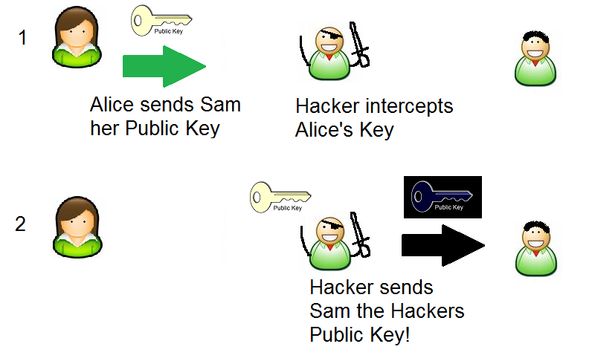

Slide 119
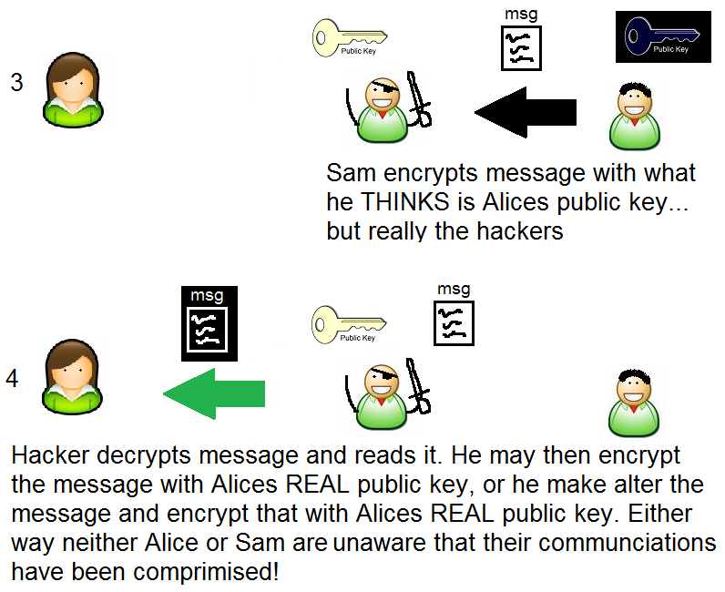

Slide 120
Public Key Infrastructure
Wouldn’t it be nice if some one we could distribute public keys AND be assured that the public key we received was the actual public key of the person we expect to talk to?

Slide 121
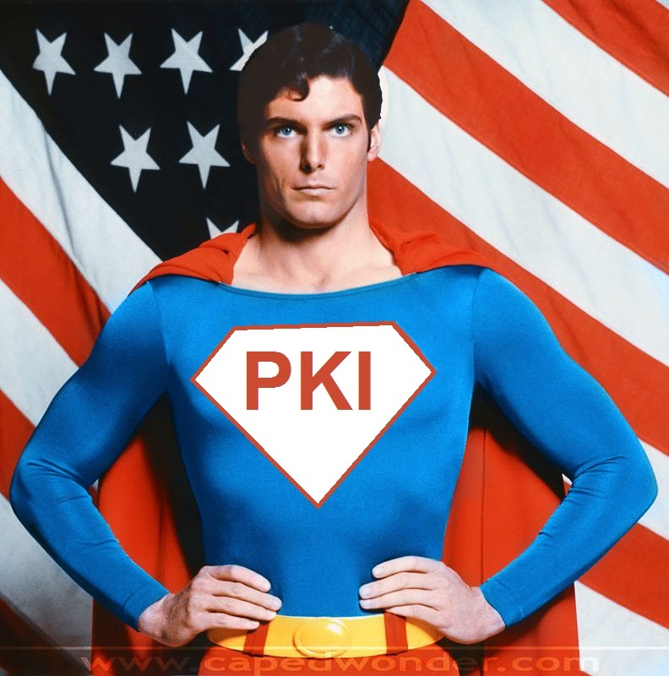
PKI to the rescue!

Slide 122
PKI
PKIs are generally concerned with ensuring and managing identity trust, specifically using digital certificates.
Provides all the components necessary for users to be able to communicate securely in a managed method.
Includes hardware, software, policies, services, algorithms and protocols.
Enables C, and I of the CIA triad
Enables non-repudiation

Slide 123
PKI components (726)
Each entity has a digital certificate* which has information about a person, including the entities public key.
The certificates are signed by a Certificate Authority*. By signing the Certificate the Certificate authority vouches for the authenticity of the certificate.

Slide 124
PKI components (729)
A registration authority (RA) – establishes and confirms the identification of an individual. Once registered, the CA actually assignees, holds and distributes the Certificates.

Slide 125
PKI steps ()
User makes a request to RA
RA requests certain info from the user (like drivers license, address etc)
RA verifies user is who he says he is, and sends a request to create a cert to the CA.
CA creates a cert with users public key and identity information.
(more)

Slide 126
PKI steps (739)
Now when someone requests users info, the CA sends the certificate
The requesting user can extract the public key and knows that the information is valid as the CA also has signed the certificate.

Slide 127
Lets look at a digital Certificate together
Firefox – https://www.redhat.com
Click on the yellow lock at the bottom
In the pop-up click on “view certificate”
What version is it?
What’s the “Common Name”
Who is the Issuing Certificate Authority
When does the Certificate Expire
Why would a certificate expire?
(more)

Slide 128
Lets look at a digital Certificate together
Now click on the details tab
What is this “Certificate Hierarchy” stuff?
Who Signed the cert for www.redhat.com
Who signed the cert for that CA?
This “vouching” for CAs is called a “certificate chain”
If someone signed for someone else… who signed for them? When does this end? Let’s explore this…

Slide 129
PKI hierarchy
PKI implementations are usually a hierarchy, where one CA signs another CAs certificate.
Parent Child relationship
Top parent is called a root CA
All others are called subordinate CA
Visualization next slide

Slide 130
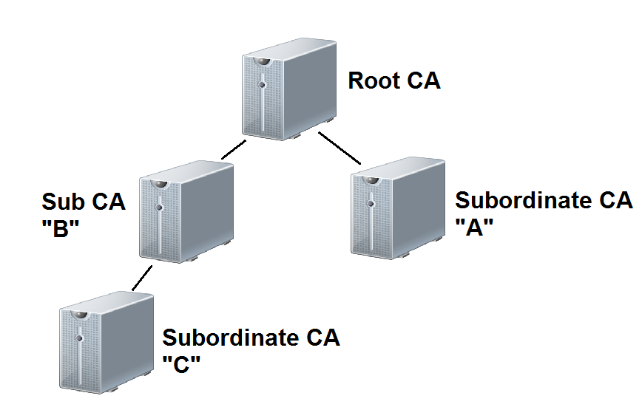
PKI hierarchy

Slide 131
CA concerns
Every CA should have a Certification Practice Statement which outlines
  How the RA verifies identities
  How the Certificates are transferred
  How keys are secured
  What data is in a Digital Certificate
  How revocations are handled… etc
Before using a 3rd party CA, you should understand and be comfortable with CPS and the security controls they use.*

Slide 132
Multiple Certificates
Some PKIs use multiple certificates, and as such multiple public/private key pairs.
One for digitally signing data
One for encrypting data
Why would we want to have two different keys?

Slide 133
Certificate Renewals
Certificates have a lifetime after which they expire. Why?
When a certificate expires you have to renew it. You don’t have to go through the RA again. You just have to be able to sign a message with your old private key.
When renewing you can use the old public/private key pair or generate a new key pair. What is the advantage of generating a new pair?

Slide 134
Certificate Revocation
We have a wonderful system of distributing and verifying Digital Identities (certificates). But we may need to revoke a users digital Identity?
Why?
  Hint – think Human Resources
  Hint – think hacking

Slide 135
Certificate Revocation
The CA publishes a Certificate Revocation List.
Certificate serial number that have been revoked
Reason for revocation
Date of revocation
The CRL is digitally signed by the CA*

Slide 136
Certificate Revocation (736)
Client software must check the CRL before trusting a digital certificate
Once a certificate is revoked, it cannot be un-revoked
A certificate could be suspended. This also goes on the CRL, however a special “reason” of suspended is used.
Suspended certificates may be un-suspended

Slide 137
OCSP (737)
Online Certificate Status Protocol – a client server model, where a client program actually queries a server to see if someone’s certificate is valid. This way the client does not need to know how to find the CRL for the given certificate Authority and doesn’t have to actually search through the CRLS.
Be aware of this term for the exam.

Slide 138
Key Recovery
When an organization uses encryption to protect data, it must also backup the keys.
  This is called key archival
  Only backup the encryption private key in a multi-certificate system
  Need to ensure the safety of these backups
  Use dual controls (m of n) concept to protect keys

Slide 139
Key Recovery
No need to backup public keys.
The process of retrieving keys is called key recovery
Key recovery should be highly controlled and audited

Slide 140
Key Escrow
key archival using a 3rd party

Slide 141
PKI concerns
What happens if the CA is compromised?
What happens if the Certificate repository is compromised?
What happens if someone steals my digital certificate?
A digital certificate contains an entities public key. Why?
Does it make sense to put a private key in a digital certificate?

Slide 142
PKI concerns
Remember PKI requires public keys (in the certificate) and private keys (kept private to a user). Often private keys are kept in storage on a hard drive, or on a removable drive (USB key)
What are some concerns and countermeasures dealing with private key storage?

Slide 143
PKI concerns
Remember PKI requires public keys (in the certificate) and private keys (kept private to a user). Often private keys are kept in storage on a hard drive, or on a removable drive (USB key)
What are some concerns and countermeasures dealing with private key storage?

Slide 144
Extended Validation Digital Certificates
Digital certificates issued after the issuing authority performs a more extensive background check on the entities identity prior to issuing.
  Needed if the entity wants to provide additional assurance to the end user of their identity. Such as
    Banks
    Online stores

Slide 145
Email Security

Slide 146
Internet
The Internet has been around for a LONG time... For most of it’s life nobody cared about the Internet except for government, researchers and geeks like me.
The Internet was never intended for security. IT was indented as a resilient network for communications. Nobody ever though it would be used for what it’s used for today

Slide 147
Email (745)
Email has been around for a LONG time as well, as such the is NO security in the SMTP protocol. It was assumed that everyone who was using Email would just play nice. As such SMTP provides.
No Authentication
No Encryption
Email wasn’t even intended to send anything advanced (like images, sounds, word documents). It was just intended to send text.

Slide 148
Email Security
Email is counted on by organization for a means of communications, some would say it’s even mission critical. That leaves two problems:
  Forged email
  Compromise of confidential information sent over email

Slide 149
Forged Email
Forging of email is TRIVIAL in most cases.
  What are some concerns with forged emails?

Slide 150
Forged Email
Can anyone think of any technologies we already discussed that can help with the email forgery problem?

Slide 151
Signing Email
If we use digital certificates we can sign our email to solve the authentication problem.

Slide 152
Email Encryption
The other problem with email is that sensitive information might be sent over email.
  SSNs
  Credit card
  Private data
Encrypting email would solve this problem.

Slide 153
Email Security (745)
There are a few technologies we can use to secure email both by providing non-repudiation services, and encryption services
  S/MIME
  PEM
  MSP
  PGP

Slide 154
PEM (746)
Privacy Enhanced Mail – Internet standard to provide secure email. Provides authentication, integrity, encryption and key management.
RSA for authentication and key management
X.509 certificates
Never widely deployed

Slide 155

S/MIME
S

Slide 156
S/MIME (745)
MIME was the original extension to email that allowed us to attach files in email, such as images and sounds and word documents etc.
SMIME is an extension to MIME that allows for
Integrity, privacy and sender authentication
Uses x.509 digital certificates
Uses RC2 or Triple DES

Slide 157
Message Security Protocol (747)
Military’s version of PEM

Slide 158
PGP (747)
Pretty Good Privacy - Can provide Integrity, Security and Non-Repudiation
  Certificates for identification and authentication
  Signed messages for non-repudiation
Used to use a web of trust model, but now can tie into an organizations PKI.
Originally used IDEA heavily but can use many encryption algorithms.
Originally used MD5 hash for integrity newer versions use SHA series and other hash algorithms.

Slide 159
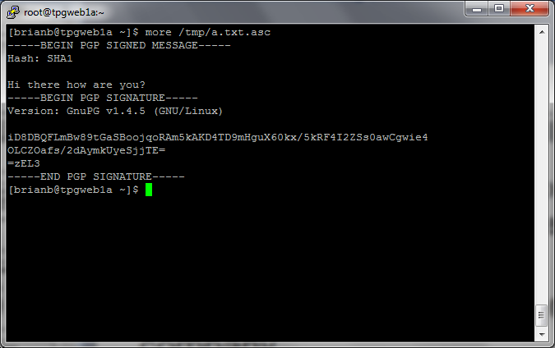
PGP signed message example

Slide 160
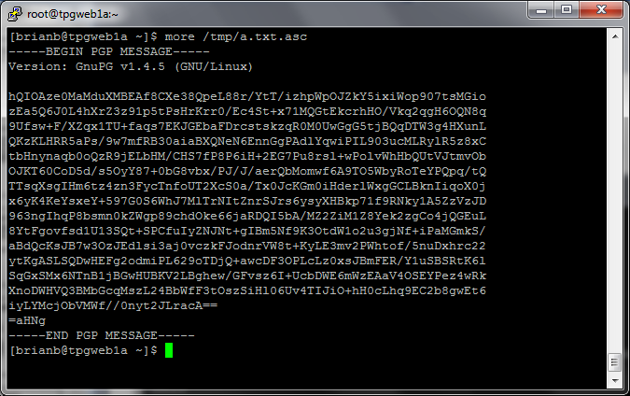
PGP encrypted and signed

Slide 161
Other Email Terms
Content based filtering – Some companies try to ensure that sensitive information is not sent over email. They may scan outgoing email for text that looks like SSNs or credit card numbers etc.
SPAM – Unsolicited email

Slide 162
Chapter Review
Q. Which of the CIA triad does a hash provide?
Q. An HMAC is used to try to prevent MiM attacks. Does a HMAC provide non-repudiation?
Q. Why isn’t Asymmetric Encryption for all encryption?
Q. What is Diffie-Hellman used for?

Slide 163
Chapter Review
Q. What is AES meant to replace, what is the algorithm that was chosen to be AES?
Q. True or false, If a message is encryptd with an entities public key, anyone with the public key can decrypt it?
Q. What is the Asymmetric algorithm commonly used in PDAs and cell phones?
Q. How many rounds does triple DES have?

