Slide 1

Chapter 9
Business Continuity Planning and Disaster Recovery
Brian E. Brzezicki

Slide 2
BCP and DR (778)
An organization is dependant on resources, personnel and tasks performed on a daily bases to be healthy and profitable. Loss or disruption of these resources can be detrimental. Causing great damage or even complete destruction of the business.
Business MUST have a plan to deal with unforeseen events.

Slide 3
BCP and DR (778)
Business Continuity Planning is a broad approach to ensure that a business can function in the event of disruption of normal data processing operations.
Disaster Recovery Planning is a subset of BCP. The goal of a DRP is to minimize the effects of a disaster and take necessary steps to ensure that the resources, personnel and business processes are able to resume operation in a timely manner.

Slide 4
Terms for This Chapter (779)
Business Continuity Planning – Planning to help organizations identify the impacts of potential data processing and operation disruptions and data loss, formulate recovery plans to ensure the availability of data processing and operational resources.
(more)

Slide 5
Terms
Business Impact Analysis – Process of analyzing all business functions within the organization to determine the impact of a data processing outage.
Business Resumption Planning – BRP develops procedures to initiate the recovery of business operations immediately following and outage or disaster.
(more)

Slide 6
Terms
Critical Business Functions – The business functions and processes that MUST be restored immediately to ensure the organizations assets are protected, goals met and that the organization is in compliance with any regulations and legal responsibilities.
Critical System – The hardware and software necessary to ensure the viability of a business unit or organization during an interruption in normal data processing support.
(more)

Slide 7
Terms
Disaster Recovery Plan – A plan that provides detailed procedures to facilitate recovery of capabilities at an alternate site.

Slide 8
Objectives of the BCP (779)
By doing BCP planning and DR planning an organization attempts to
Understand the risks to it’s ability to function continually.
Ensure survivability of the business
Reduce business impact of disasters
Provide an immediate response to emergency situations
Resume critical business functions ASAP after a disaster
Protect lives and ensure safety*
Reduce confusion during a crisis

Slide 9
Business Continuity Planning

Slide 10
BCP Overview ()
The goal of a BCP is ultimately to ensure the continued operation of business functionality in the event of a damaging event.
The BCP is really part of the larger security program. As such a BCP should be part of the security policy*

Slide 11
Steps in BCP (overview) (780)
ISC states 7 Phases in BCP. We will outline them now, and detail them later.
Project Initialization – establish a project team and obtain management support
Conduct BIA – identify time-critical business processed and determine maximum “outages”
Identify Preventative controls
Recovery Strategy – identify and select the appropriate recovery alternatives to meet the recovery time requirements.
(more)

Slide 12
Creating the BCP (overview) (772)
  Develop the contingency plan – document the results of the BIA findings and recovery strategies in a written plan
  Testing, Awareness, and Training – establish the processes for testing the recovery strategies, maintaining the BCP, and ensuring that those involved are aware and trained in the recovery strategies.
  Maintenance – Maintain the plan

Slide 13
Business Continuity Planning The 7 Steps expanded

Slide 14
BCP the 7 Step
Beware, as these steps go into detail and often contain sub steps… things are going to get confusing.

Slide 15
BCP: Phase 1 (783)
Project Management and Initialization:
Solidify management support
  Without management support, it’s guaranteed to fail
Develop a Continuity Planning Policy Statement
  lays out the scope of the BCP project, roles and members, and goals.
(more)

Slide 16
BCP: Phase 1 (783)
Identify a Business Continuity Coordinator*
  the BCP team leader
Establish a BCP team
  What types of people/roles should be on the team (pg 784)* (should expand out on actual slide)

Slide 17
BCP Phase 2: BIA
The organization must do a Business Impact Analysis as stage 2.
  Ultimately want to determine the important business processes.
  Determine cost (qualitative or quantitative) that a loss of these processes will cost
  Determine Maximum Tolerable Downtime (MTD) for these processes*.

Slide 18
BCP Phase 2: BIA
Here are some common MTD classifications*
  Critical: 1 – 4 hours
  Urgent: 24 hours
  Important: 72 hours
  Normal: 7 days
  Nonessential: 30 days

Slide 19
BCP Phase 2: BIA
Keep in mind when prioritizing things, use both quantitative and qualitative analysis to determine what is critical.
Example:
  Loss of some process might not cause immediate financial loss, but could damage reputation or competitive advantage, that damage could be devastating.

Slide 20
BCP Phase : BIA
Once the research is done and organization must document and present the findings to management.
  Note at this point there is not a Business Continuity Plan yet, just research.
  Once Management reviews findings and gives the OK to proceed the plan will start to be developed.

Slide 21
BCP Phase 3: : Identify Preventative Controls (794)
Once critical business processes and associated MTDs have been determined. Analysis must be done to identify the specific resources that each process relies upon and the vulnerabilities and threats to these resources and choose cost effective preventative countermeasures.
  This is risk management as described in chapter 3
  The idea is to find ways to prevent the problems from occurring in the first place.

Slide 22
BCP Phase 4: Recovery Strategies (795)
At this stage a plan for recovering in case of disaster starts coming into existence.
  Up to now it was just research and analysis and obtaining management support.
  We determined preventative controls
  Now we are going to look at recovery

Slide 23
BCP Phase 4: Recovery Strategies (796)
This is a more technical and tangible stage. The idea is to figure out what the company actually needs to do to be able to recover the necessary business processes in the event of a catastrophe.
Goals of this stage are:
  Determine the most cost-effective* recovery mechanisms
  Formally define the activities and actions that will be implemented and carried out in response to a disaster.
  These strategies will be based on the 5 main business recovery strategies listed on the next page

Slide 24
Phase 4: Recovery Strategies
5 categories
  Business Process Recovery
  Facility Recovery
  Supply and Technology Recovery
  User Environment Recovery
  Data Recovery
We will go into more detail on each of these categories coming up.

Slide 25
Business Process Recovery (796)
A Business Process is a set of interrelated steps linked through specific actives to accomplish a specific task. For these processes the team must know the components of the process including
  Required roles
  Required resources
  Input and output mechanisms
  Workflow steps
  Required time for completions
  Interdependencies between this processes and other processes.

Slide 26
Facility Recovery (797)
Facility Recovery is concerned with the ability to move processing operations to an alternate facility in case of the failure of the main facility. We can have multiple method to deal with this including
  subscriptions services with service bureaus*
  Reciprocal Agreements*
  Redundant Sites*
Lets looks into each of these more

Slide 27
Facility Recovery (797) Subscription services
A subscription service is a contract with a 3rd party to provide access to a facility. There is generally a monthly fee to retain the right to use the facility along with a large activation fee and hourly fee when actually using the facility. This is obviously a short term only solution. There are 3 types of subscription services which we will talk about more of in the next slides
  Hot Site
  Warm Site
  Cold Site

Slide 28
Alternate Sites
You need to understand the different types of alternate sites discussed on the next few slides as well as the terminology, characteristics, pros and cons of each. The exam explores these topics heavily.

Slide 29
Hot Site (798)*
Hot Site – a facility that is fully configured and ready to operate in a few hours. The only resources missing from a hot site is the actual data and the actual employees.
Hardware and software MUST be fully compatible or it’s pointless
Vendor may not have customer specific or proprietary hardware/software
+ can allow for annual testing
+ ready within hours
- Very Expensive

Slide 30
Warm Site (798)*
A facility that is usually partially configured with some computing equipment, but not significant hardware. i.e. a hot site without the expensive stuff.
Generally can be up in an acceptable time period.
May be better for customers with specific hardware/software needs, customer will bring computing hardware with them.
Most widely used model
+cheaper
+available for longer timeframe due to reduced costs
+ good if you have our own custom hardware/software
- takes longer to prepare
-actual yearly testing not generally possible

Slide 31
Cold Site (798)*
Supplies basic environment, (AC, electrical, plumbing etc), but NO actual computing equipment. Can take a while to activate.
+cheaper
+available for longer timeframe due to reduced costs
+ good if you have our own custom hardware/software
- May take weeks to get activated and ready
- Cannot do yearly tests

Slide 32
Reciprocal Agreement (801)
RA also called Mutual Aid is when two companies agree to help each other out in the case of an emergency. Ultimately this is not really practical for most business.
  What are the Pros and Cons of mutual aid are?
  Why is mutual aid ultimately unreliable and impractical?

Slide 33
Redundant Sites (802)
Organizationally owned mirror sites. This also may have live or slightly delayed data backups and some staff.
Literally mirrors the original site
Data available at mirror site.
+ best solution if turn around time and ability to recover all processing aspects are required
- VERY EXPENSIVE (duplicate costs except for personnel)

Slide 34
Multiple Processing Centers (803)
Different model then mirror site -
Rather than live/mirror site. Normal business practice is to split the work among multiple active centers such that there is no single point of failure.
  Solid approach
  Good Scalability for normal business growth
  Make sure that the other centers have more resources then they individually need in case they need to take on more work, due to the failure of another center.*

Slide 35
Supply and Technology Recovery (803)
With alternate sites, the organizaion plans to recover it’s facilities and it’s main processing requirements from a overhead veiw. But what about the operational details.
  Hardware Backups
  Software Backups
  Documentation
  Human Resources
These considerations need to be taken into account also and will be discussed.

Slide 36
Hardware backups (804)
When using an alternate site an organization has a space to process, but unless using a a hot site or redundant site and already has the necessary equipment.
  Where does it get the replacement servers from.
  What about the desktops that the staff needs?
Does the organization have vendors to provide these in a timely manner?
  How long will it take to get new equipment from the vendor?
  What happens if the equipment is legacy equipment.
These concerns need to be addressed before hand.

Slide 37
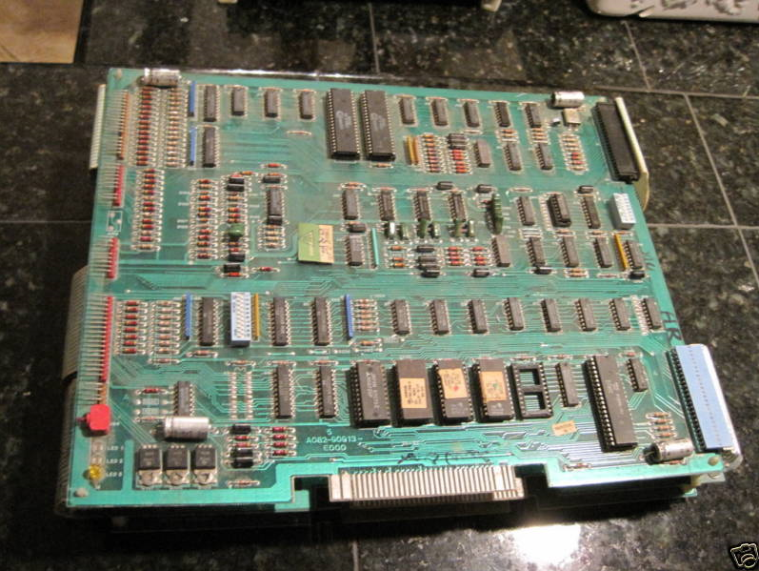
Legacy Equipment

Slide 38

Legacy Equipment
1982

Slide 39
Spare Equipment

Slide 40
Software Backups (805)
Similar concerns about hardware backups but regarding software:
  How do we get copies of the software.
  how to we roll out installs.
  What about licensing?
  What about custom software that we had created that we cannot just go out and buy at the store?
  Software escrow*

Slide 41
Data and System Backups
We are actually going to discuss backup strategies later.

Slide 42
Documentation (806)
A company can plan for procuring sites, hardware and software but then:
  how does a companyt get the servers and networks all rolled out and configured such they operate the same as before?
  Incorrect configurations could cause compromises in integrity or confidentiality*! (how?)
  Does the organization even know how it’s old network was configured? Can it reproduce it?
  An Important concept for BCP that should be in company policy is that ‘All documentation should be kept-up to date and properly protected’

Slide 43
Documentation (806)
  A very important concept for BCP is that:
    Company policy should require that ‘All documentation should be kept-up to date and properly protected’

Slide 44
Human Resources (807)
What happens if the alternate site is 250 miles away?
  How do the employees get to the alternate site?
  What happens if the disaster was a natural catastrophe and some important employees are injured or worse.
  Executive Succession Planning – what is this?

Slide 45
End User Environment ()
Concerns dealing with end users or employees.
How do we notify the users about a disaster and the change of operating procedure?
Once there we need to have some type of people on the ground directing issues pertaining to employees. These people should be easily identified.*
There must be ways to manually do tasks that may be previously automated, but resources no longer exist to automate.
The BCP team needs to consider these types of issues.

Slide 46
Phase 4: Restoration Strategies (817)
Now that we covered recovery strategies we need to look at a couple of recovery concepts that we will need to understand in the planning stage.

Slide 47
Phase 4: Restoration (817)
When planning it must be recognized that there are 3 different teams in DR.
Damage Assessment team
Restoration team
Salvage team
Lets look at these in the next slides

Slide 48
Phase 4: Restoration (817)
Damage Assessment Team’s purpose and goals:
Assess the damage.*
Determine cause of disaster
Determine potential for further damage
Identify affected business functions and assets*
Indentify resources that must be replaced immediately
Estimate how long it will take to bring critical functions* online
Determine whether the BCP should be put into operation*

Slide 49
Phase 4: Recovery (821)
Restoration Team – should be responsible for getting the alternate site into a working and functioning environment so business continuity is ensured.

Slide 50
Phase 4: Recovery (819)
Salvage Team – responsible for starting the processes of recovering the original site and moving back from the backup site. *
  The least critical functions should be moved first.*
  When moving things back to the original site the most critical functions should be moved last*

Slide 51
Phase 5: Plan design and development ()
Now the organization needs to actually come up with a goals and a plan for attaining these goals. These plans must contain certain key information.
  Responsibility – who are the individuals responsible for what. What is expected of them, how will they be trained
  Authority – in times of crisis who is in charge.
  Priorities – What are the critical processes, what are the priorities.
  Implementation and Testing – how will we implement our plans, how will it be tested.

Slide 52
Phase 5: Plan Design and Development ()
Strategies/concerns for the plan
  Copies of the plan need to be kept in one or more locations. (why)
  Plans must be in paper and electronic format
  Call tress should be implemented

Slide 53
BCP: Phase 6 – Testing ()
Once the plan is developed we need to have assurance that the plan and strategies will work, the plan needs to be tested.
  Testing it also allows us to see where the plan can be improved, or if new changes in environment will require the plan to be updated (what company doesn’t change and grow?)
  Testing should be carried out at LEAST once a year.*
  Any problems that occurred should be documented and reported to management.*
Overview of testing methods on upcoming slides.

Slide 54
Checklist Test (826)
BCP is distributed to departments and functional areas for review. The managers read over and indicate if anything is missing or should be modified. (manager “checks off” that the plan is OK for their department)

Slide 55
Structured Walk-Through (826)
Representatives from each department come together AS A GROUP, they walk through the plan and different scenarios from beginning to end to make sure nothing is left out.

Slide 56
Simulation Test (827)
A specific scenario is proposed, all required employees come together and start to simulate that the event has happened and start taking action to recover. The idea is to see if any problems come up or if any concerns were left out.

Slide 57
Parallel Test (827)
Some systems are moved to the alternate site and processing takes place. The results are compared to the real processing to see if anything needs to change.

Slide 58
Full Interruption test (827)
The original site is shutdown and processing is moved to the alternate site .The recovery team fulfils it’s obligation in preparing the systems and environment for the alternate site.
  Most intrusive, it is a full blown drill.
  Requires a hot, mirror or redundant site.
  Requires massive planning and co-ordination
  It is a risky test and can cause damage if not managed properly*
  Senior management approval is required due to the risks involved*

Slide 59
Phase 7: Maintaining the Plan (829)
Now that the plan it tested and verified. It needs to be maintained!
Systems and processes become out of date and need constant refrest.
BCP plan may not be integrated into change management process (it should be)*
Infrastructure or environment changes*
Company re-organization or growth
Changes in hardware or software
Employee turn over

Slide 60
Phase 7: Maintaining the Plan (829)
Strategies to keep the plan maintained and valid.
  Make BCP planning part of every business decision!
  Insert BCP maintenance responsibilities into job descriptions
  Include maintenance in personnel evaluations
  Perform internal audits that include DR and BCP procedures
  Test the plan yearly*

Slide 61
Backups

Slide 62
Backups (809)
I said we’d talk about backups later : )

Slide 63
Backup types (809)
Archive bit – A bit or way of an operating system of noting when a file has been altered and needs to be backed up. Required for any type of traditional backup.
Type of traditional backups (next slides)
  Full
  Incremental
  Differential

Slide 64
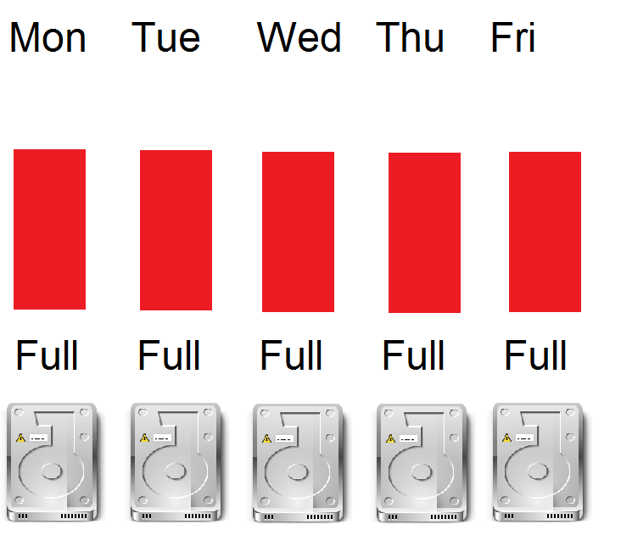
Full (810)
All data everyday!
Clear archive bit after backups

Slide 65
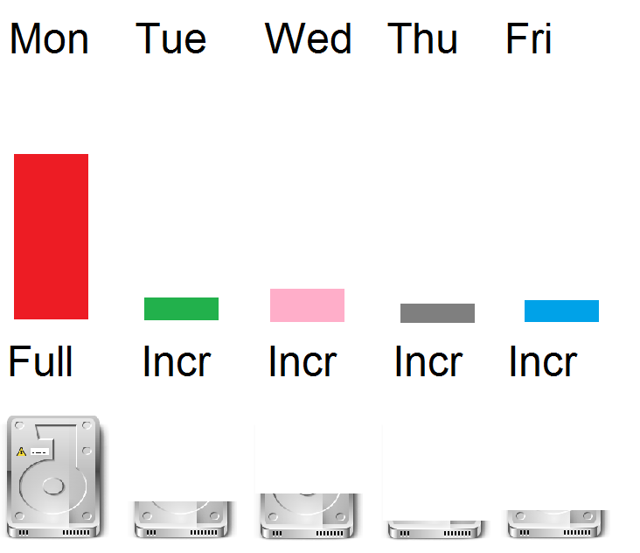
Incremental (810)
Only files that changed since last full or last incr
Reset the archive bit

Slide 66
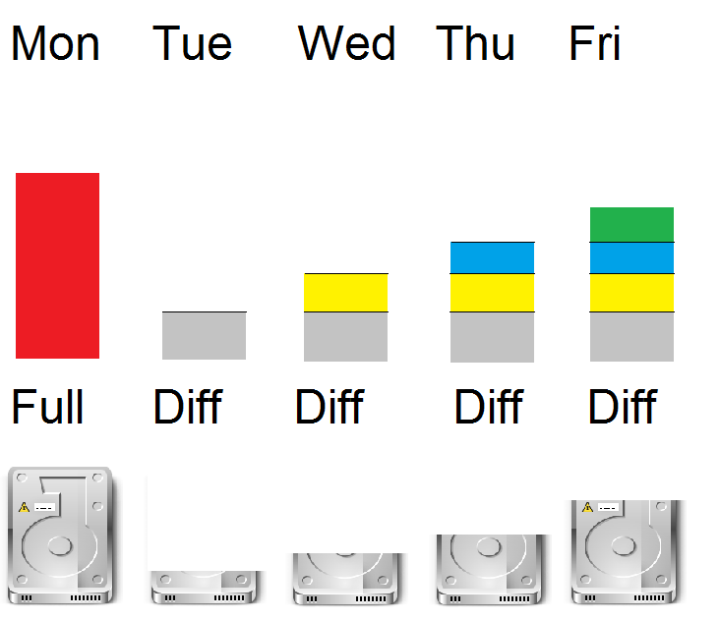
Differential (810)
Only files changed since last full or diff
DO NOT reset the archive bit

Slide 67
Backup Types
For the exam. Be able to
  order the backup types by time needed to backup.
  Explain the Restore process for each type
  Order the backup types by ease needed to restore.
  Determine which type of backup is best for a certain scenario/set of needs and requirements.

Slide 68
Backup storage
Backups should always be storedat a secure off-site location
  Bank vault
  Other organization location
  Secure storage company
Additional there should be a set of backups on site.

Slide 69
Backups concerns
Ensure all necessary data is backed up
Ensure documentation exists on backup and restore process
Verify backups
Do test restores
Ensure all necessary team members are trained and up to date on this. (rotate responsibilities to ensure )

Slide 70
Questions (n/b)
If I do a full backup every day, and I lose my data on Wednesday morning. What tapes would I need to restore, what is the restoration order?
If I do a full backup on Sunday and incremental mon-sat, and my system is lost on Wednesday morning, what tapes do I need to restore, what is the restoration order? (problems with this?)
If I do a full backup on Sunday and diffs on mon-sat, system lost on Wednesday morning, what tapes do I need to restore, what is the restoration order.
Can I mix incremental and differential backups? Why or why not?

Slide 71
One other type of backup (n/b)
There is another type of backup, called a delta or continuous backup. This is a very exciting idea.
How it works.
For each file make sure you get a full copy when the file is created
Anytime a file changes, copy ONLY the changes that occurred. Do this in real time if possible

Slide 72
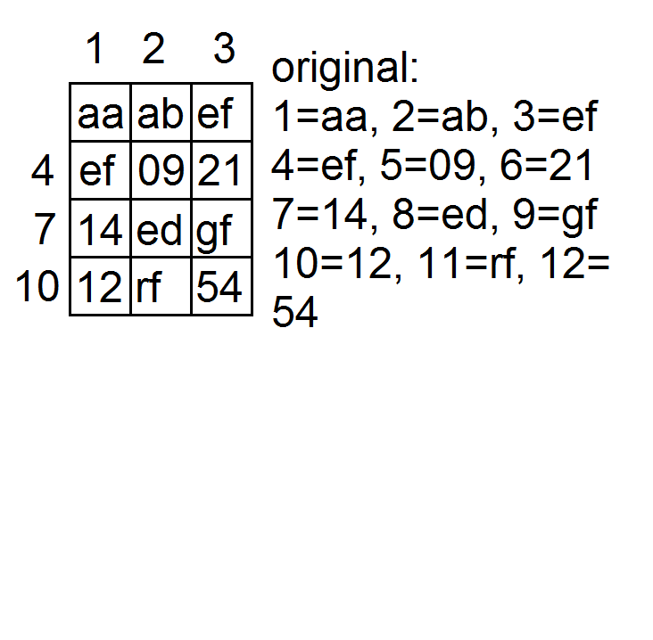

Slide 73
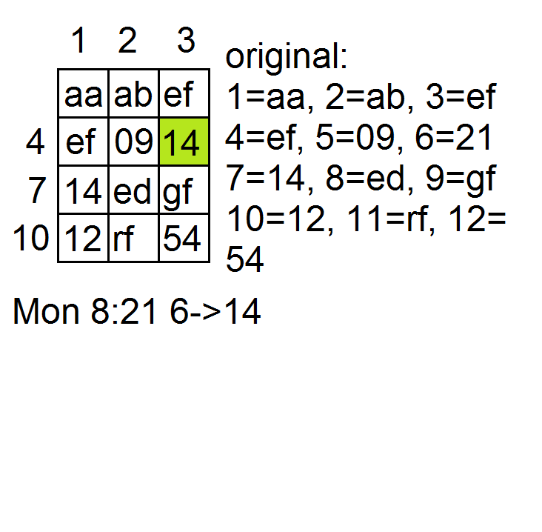

Slide 74
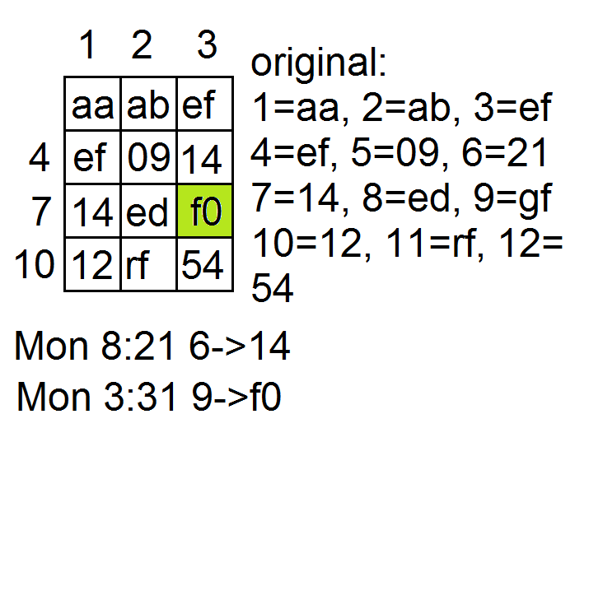

Slide 75
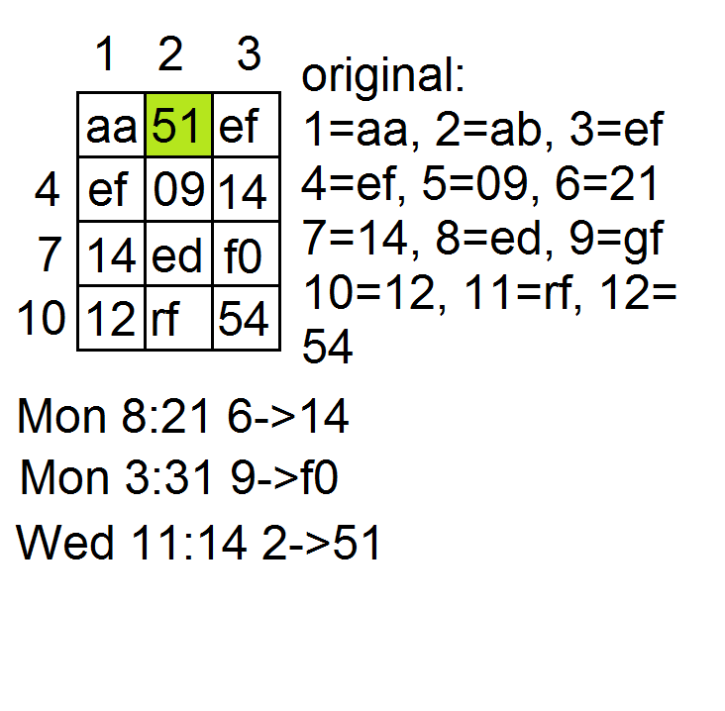

Slide 76
Continuous Backups
Advantages:
Much less backup time/cost
Real Time!
Point in time recovery!
No scheduled backups
Disadvantages
Usually require online server to handle changes

Slide 77
Electronic Vaulting and Remote Journaling

Slide 78
Electronic Vaulting (813)
Electronic Vaulting* is the idea of sending all changes to a file to a remote site (using non-backup methods). This usually done in batches and not real time.
Example:
  bank transactions might be copied daily to another office

Slide 79
Remote Journaling ()
RJ is the same concept as a continuous backup to a remote facility. It is different than EJ.
  It is done in real-time
  Entire files are not copied, only changes (deltas) to files.
    also called transaction logs
  From the base files and the transaction logs you can recreate the current environment.

Slide 80
Tape Vaulting ()
A type of backup, however rather than backing up to a local device you back up to a remote device.

Slide 81
Chapter 9 - Review
Q. What is the purpose of a BIA?
Q. What is a Hot Site
Q. What is a warm site.
Q. What is a cold Site.
Q. What is the difference between a Hot Site and a Mirror Site

Slide 82
Chapter 9 - Review
Q. What is a Full Backup
Q. What is an incremental Backup
Q. What is a differential Backup?
Q. What is a continuous Backup?

