Slide 1
Chapter 11 – Application Security

Slide 2
Overview (921)
Applications are the primary purpose of any computer/network system.
Applications are usually developed for functionality first, security is often an afterthought.

Slide 3
Overview (921)
Proper application security requires that security is a primary concern in the development process*. Security should be:
interwoven into the core of a product and
provide protection at different layers.
Security should NOT be tried to applied on later*.

Slide 4
Why is security usually overlooked during development?
Often people try to secures the perimeter and leave internal applications wide open.
This happens because:
In the past, security was often not a concern as systems were less connected
Software developers are not usually security people
Vendors want to rush out a product to market, security slows things down

Slide 5
How application and security usually goes (923)
Product is pushed out the door by vendors
Crackers find vulnerabilities
Sites post the vulnerabilities (bugtraq, NT-bugtraq etc)
Vendor develops and releases patch to fix vulnerability
Admins test and apply patches
This is very reactive, the model needs to change to be proactive.

Slide 6
Problems with Application Security
Developers/vendors want easy to use, easy to setup, highly functional software
Functionality/usability and security are inversely related*
Even when security controls exist, they are usually disabled or set by default to easy/functional settings rather than highly security settings.

Slide 7
Database Management

Slide 8
Databases (912)
Databases are centralized systems that store, manipulate and query data.
Databases are the back ends of almost all enterprise products.
A DBMS is a suite of programs used to manage “large sets of structured data with ad hoc query capabilities for many types of users…” i.e. a database.

Slide 9
Databases
Databases should provide the following features and characteristics
Centralized data storage
Easier backup /centralized
Transaction persistence
Consistency of data
Recovery and fault tolerance
Sharing of data with multiple users
Security controls that implement integrity checking, access control and can provide confidentiality

Slide 10
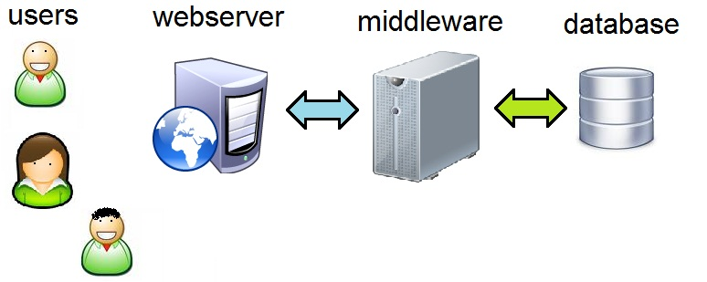
Databases
Databases used to be on the backend away from users, but now organizations write code that lets user query and manipulate their databases. This is usually done via a web front end and a middleware component.

Slide 11
Middleware
Middleware is an often mis-understood term
Allows different systems to communicate
Used by web systems to manipulate databases in a structured and secured fashion.
Is to the web server code as a view is to a user.
Allows the web servers to access the database using pre-defined methods, which are limited, have access controls and monitored
Protects the database from the code on the web servers, only valid queries/transactions are allowed via the middleware components.

Slide 12
Database Models (930)
There are different types of database models
Relational
Hierarchical
Network
Object oriented
Object relational
We will discuss each in the next couple slides

Slide 13
Databases Relational
The traditional database model.
Uses attributes (columns) and tuples (rows) to store and organize data.
These tuples create tables (next slide)
Most commonly used type of database
(more)

Slide 14
Relational Database (Table)

Slide 15
Relational Database (Attributes/Columns)

Slide 16
Relational Database (Records/Rows/Tuple)

Slide 17
Relational Database
Entries in a relational database are linked by relationships.
Primary key is a unique identifier for each object in a table
Foreign keys link rows (entries) in 1 database table to related rows in another table. Foreign keys in one table reference primary keys in another table
see slides

Slide 18
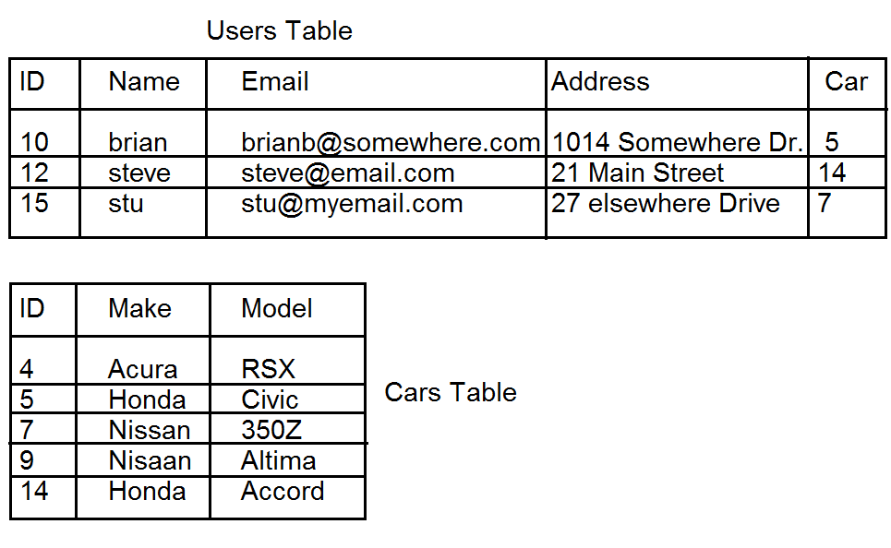
Database Tables

Slide 19
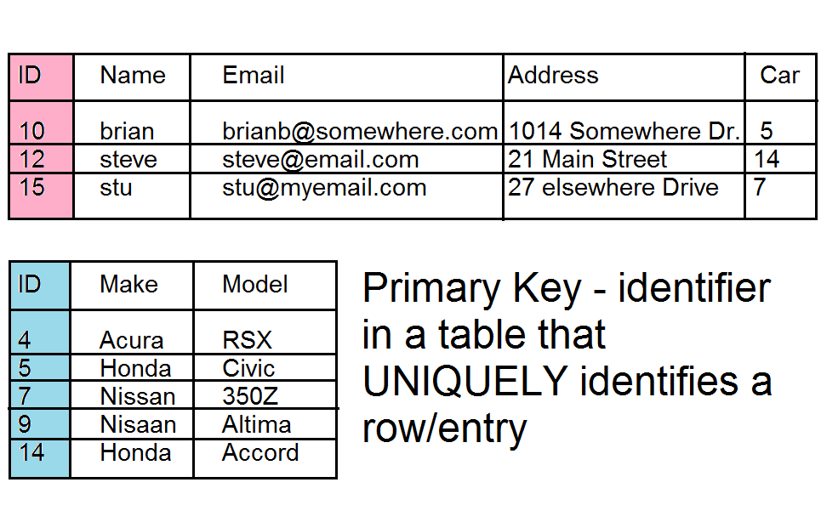
Primary Keys

Slide 20
Foreign Keys

Slide 21
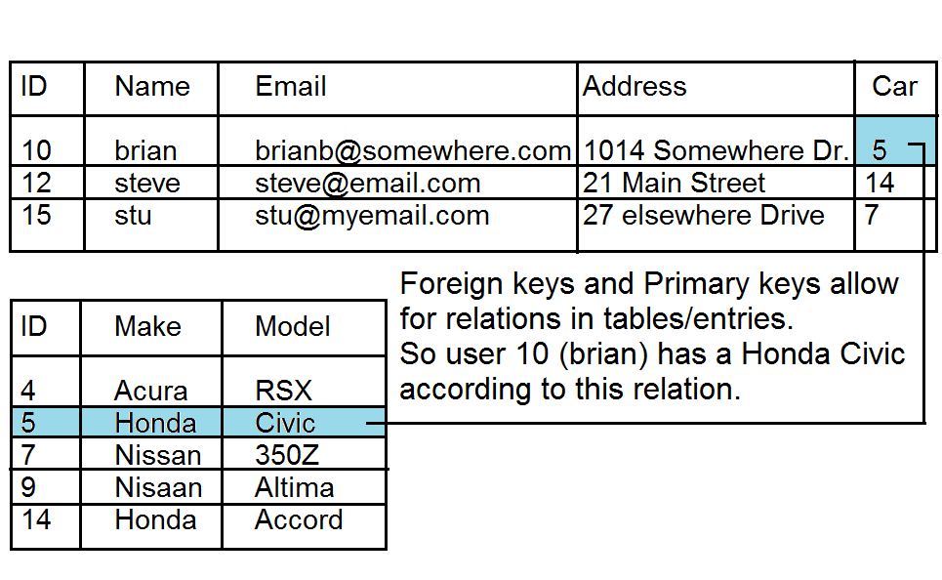
Relationship of Primary and Foreign Keys

Slide 22
Hierarchical Database (931)
Like a tree. Relationships are defined by parent, child relationships.
Some applications that use this type of database are:
DNS
LDAP / Active Directory
Windows Registry.
see visual next slide

Slide 23
Hierarchical database
.
.com
.edu
.microsoft
.paladingrp
.umbc
.stanford
www
.research
.sales
.csee
mail
www

Slide 24
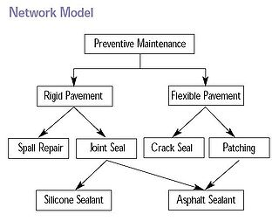
Databases, network model (931)
Similar to hierarchical, however each node in the tree may have multiple parent nodes. This forms a network or a mesh rather than a tree structure.

Slide 25
Databases Object oriented (932)
Rather than having rows and columns, OOB type databases work like object oriented programs and present data as objects, these objects can provide methods on accessing and manipulating data.
Not as common as relational databases, but used in niche markets (engineering, biology, financial sector)

Slide 26
Database Common Terms (934)
Record – a collection of related data items
Tuple – a row/record in a relational database
Attribute – a column in a relational database
Primary key – the primary identifier in a relational database
Foreign Key – an attribute in one table (RD) that links to a primary key in another table to provide a relationship between two records in a database
more

Slide 27
Database Common Terms (934)
Schema – The structure of the database (what tables exist, what data they have in them, how are tables linked together)
Data Dictionary - data about how the database is laid out, what types of data types exist and other metadata.

Slide 28
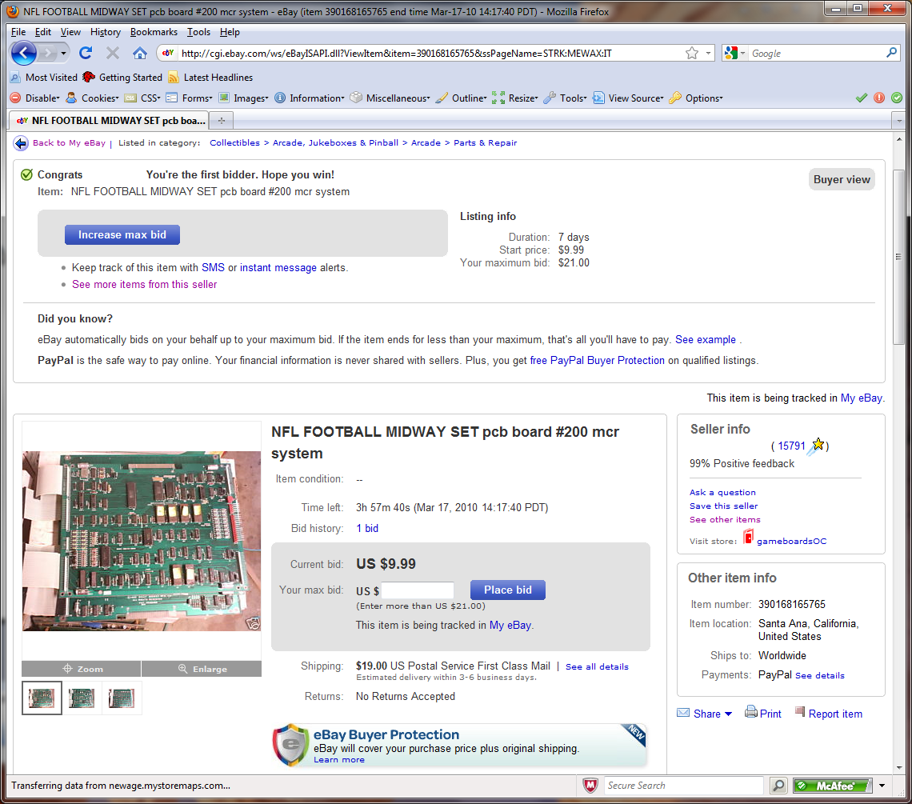
View – a window that provides a user only the data they are allowed to access

Slide 29
SQL
SQL – Structured query language - a standardized language for accessing databases, uses natural language
SQL example next page

Slide 30
SQL Example
SELECT id,email, address FROM users WHERE id=10;
Would return
10, brianb@somewhere.com, 1014 Somewhere Dr.

Slide 31
Database Integrity Concepts (940)
Transaction* – a series of database updates that are grouped together, such that all updates occur or NONE of them occur.
Example
when transferring money from accounts in a bank, a transaction MUST occur
Money is deducted from account #1
Money is added to account #2
If either of these fail the completed change should be voided, this change is called a rollback*! If the transaction succeeds we finalize it with a commit* which makes the change and lets the new contents be viewed by other queries.

Slide 32
Database Integrity Concepts (940)
Referential integrity* – assures that any foreign key has a matching primary key.
Referential integrity Example next slide

Slide 33
Referential Integrity Example
There MUST exist a entry in the car table with ID 5,14, and 7, since there is a foreign key in the users table that reference these values in the car table.

Slide 34
ACID
ACID*
Atomicity* – Database changes are atomic*, all changes in a transaction take place or none do.
Consistency* – all data is consistent within the database
Isolation* – database transactions do not interfere with each other. The results of a running transaction is not available into another process until the transaction is complete.
Durability* – Once the transaction is committed it is permanent.

Slide 35
Database Security Concerns (942)
Aggregation – combining data from multiple sources that you might have access to at one time, but not together.
Inference – the intended result of aggregation, when someone deduces something from other information.
more

Slide 36
Database security countermeasures (944)
Content dependant access control –
Context dependant access control – database looks at other stuff you are accessing to determine whether that or not you should be able to access something now.
Cell suppression – a technique used to hide specific cells that contain information that could be used in an inference attack.
more

Slide 37
Database security countermeasures
Partitioning a database – splitting the data up into multiple parts
Noise and perturbation – inserting bogus information in hopes of misdirecting an attacker.
Views – setup very specific views of data only showing the data that person or group absolutely needs to see.
more

Slide 38
Database Security Countermeasures
Polyinstantiation* – creating multiple entries into a database for a primary key, using mis-information to stop inference attacks. (see bottom of 946 with the “Oklahoma example”)
Level | Ship | Cargo | Origin | Destination
Top Secret | Oklahoma | Weapons | Delaware | Ukraine
Un-classified | Oklahoma | Food | Delaware | Africa
(more)

Slide 39
Other database related terms
Data warehousing* – combining data from multiple databases into one large database, then redundant information is removed (normalized)
Data mining* – analyzing warehoused data with automated tools to find trends, correlations, relationships etc that are not readily apparent.

Slide 40
Database Programming Interfaces
There are common interfaces created to provide programmatic access to data in databases that we will discuss on the upcoming slides.
ODBC
OLE DB
Active X Data Objects (ADO)
JDBC

Slide 41
Database Interfaces (935)
ODBC - and API that allows an application to access a local or remote database. ODBC tracks down the necessary database specific driver and translates the request into the specific database commands for that database.
Allows SQL commands
Requires a Data Source Name (DSN)*
Heavily used

Slide 42
Database Interfaces (936)
OLE DB
Used only by Microsoft as to support non-database types of data storage.
Storage types that don’t provide SQL support
Uses ActiveX data objects

Slide 43
Database Programming Interfaces (936)
Active X data Objects (ADO) – another Microsoft database technology.
High level data access programming interface
It’s a set of COM objects for accessing data sources not just databases
Doesn’t require SQL

Slide 44
Database Interfaces (936)
JDBC – An Application Programming Interface (API) that allows Java applications to communicate with a database.
Similar to ODBC, but made to be used with JAVA
Allows execution of SQL statements.
Heavily used

Slide 45
Software System Development

Slide 46
System Development (951)
Security is most effective if it is planed and designed from the beginning, not added on as an after though later.
Security should be part of the product’s lifecycle from the beginning.
Cheaper
More secure
A security plan should be included for the product and that plan should be referenced all through the software development lifecycle
more

Slide 47
System Development
There are different types of SD models however they usually break down into the following phases, each of which we will talk about.
Project initialization
Functional design analysis and planning
System design specifications
Software Development
Installation/Implementation
Operation/Maintenance
Disposal

Slide 48
SD Step 1-Project Initialization ()
Why are we building the product?
What is the scope of the product?
Conceptual definition of the product is defined, evaluate other products that will be similar.
Determine necessary resources and timeline of development
Determine security needs/objectives create security framework.
Initial risk analysis should be done this will change as the product is developed.
Get management to sign off on project development*

Slide 49
SD Step 2-Functional Design Analysis and Planning ()
In this phase a project plan is developed and security activities and checkpoints should be developed as part of that plan.
Resources should be indentified, test schedules start to form, as well as evaluation criteria (to test security functionality)
Design document is created to explain the functionality of the product. Now is the time to understand what this will or will not be able to do and add or subtract functionality.

Slide 50
SD Step 3-System Design Specification
Start to figure out HOW the product will provide the required functionality.
This is where details start to come out on what mechanisms will be used to accomplish the goals.
Specifics of how to provide the necessary functionality and security (ex. what are the details of how authentication will be accomplished, what type of encryption be used will be addressed at this stage before coding begins)
From a security standpoint, access control mechanisms will be chosen, rights and permissions defined, encryption algorithms chosen, how to handle sensitive data is determined etc.
The environment that the product will run in needs to be considered (Unix, Windows, stand alone or network access, etc)

Slide 51
SD Step 4-Software Development
Code is developed at this stage.
Developers should code in a way that does not permit software compromises. (proper secure software development training is required for this)
Input validation* should happen
Code to prevent covert channels should be included.
Everything should be clearly documented.*
Formal and informal testing should occur*
more

Slide 52
SD Step 4-Software Development
Testing should be carried out by a separate group of people (not the programmers)* (separation of duties)*
Software should be attacked to ensure it is secure.
Backdoors/maintenance hooks* should be removed
Software should be tested and fixed, and tested again, until everyone is satisfied and the product is ready to be released.*

Slide 53
Testing (963)
Obviously software needs to be thoroughly tested. There are 4 testing terms to be aware of for the exam. This happens during software development (Step 4) and before actual implementation (Step 5)
Unit Testing* – test each small component of a software system individually and thoroughly
Integration Testing – test that the components work together correctly
Acceptance Testing – Ensuring that code meets the customers requirements
Regression Testing* – retesting after any change to ensure functionality performance and protection.

Slide 54
SD Step 5-Installation/Implementation
Install the software
PROPERLY configure the software.*
Functionality and performance tests should occur, as well as security tests.
System should be certified and accredited* at this point before being put into production.
more

Slide 55
SD Step-5 Installation/Implementation
Auditing should be enabled and this software and systems should be considered as part of the Business Continuity Plan and that plan should be updated to include this new application if necessary*.

Slide 56
SD Step 6-Operation and Maintenance
Configure new system and place it into production. Ensure the security controls provided are PROPERLY configured*
Conduct vulnerability assessments/tests, patch system when required, audit system use.
If any major changes to the product occur, you might have to redo a risk analysis, re-certify and re-accredit the system.

Slide 57
SD Step 7-Disposal
When the system is to be retired, you may need to backup the data, you may also need to securely destroy the data, depending on your environment and the sensitivity of the data on your system.

Slide 58
Review
After the completion of a project the team should gather to review the project and discuss what went well, what went wrong and needs to be improved for the next project.
This should be a structured event with someone leading the meeting. People need to feel relaxed and free to speak their minds so we can learn as much as we can for the next project.

Slide 59
Software Development Methodologies

Slide 60
Software Development Methods (968)
You should probably understand the different software development methods.
Waterfall – classic method with defined phases and formal reviews and documentation before moving from one stage to another.
Spiral – builds on waterfall, but with an emphasis on risk analysis, prototype, and simulations at different phases. Periodically revisits previous stages to update and verify design requirements
more

Slide 61
Software Development Methods (969)
Joint Analysis Development – team approach in a workshop type environment
Rapid Application Development – a method of determining user requirements and developing system quickly to satisfy immediate needs
Clean room – approach that attempts to prevents errors by following structured and formal methods of developing and testing. This approach used for high-quality and critical applications that will be put though a strict certification process.

Slide 62
Computer Aided Software Engineering (969)
CASE* – is the use of tools to create and manage software. A CASE tool is aimed at supporting one or more SE tasks and activities.
development environments
version control
code analyzers
automatically code creation tools

Slide 63
Prototyping (970)
Quick code written to show the customer where the project is going to ensure that the project will satisfy the customers requirements. Prototyping does not have to be actual code, it could be a graphical walk through of displays, flowcharts, logic etc for the customer to walk through.

Slide 64
Change Control (970)
Change control is important both before production and after production. If customers are allowed to request changes (without charge) after the project is started they can make the project go over budget and the company lose money (this is a risk/threat). Change control after production focuses on how these changes will affect the configuration, functionality and security and stability of a product. The following are necessary steps for a change control process.

Slide 65
Change Control steps (971)
Make formal request for change
Analyze the request
Develop implementation strategy
Calculate the costs of the change
Review security implications
Record the change request
Submit the request for approval
Develop the change
Recode product, add/subtract functionality
Link these code change to the formal request
Submit software for testing and QA
Repeat until changes are ok
Make version changes
Report results to management
(Recertification/reaccreditation if necessary)

Slide 66
Capability Maturity Model (975)
CCM describes procedures, principles and practices to underlie software development process maturity.
The ideas is to help organizations develop standardized approaches and development practices to ensure the can consistently success with projects, and provide higher quality software at a lower cost.
The model offers a layered framework that allows a company to continuously improve their SD practices, the 5 levels are given on the next slide

Slide 67
CMM (975)
Initial – development process is ad-hoc, not structured, no effective management plans and procedures. No assurance of consistency and quality is unpredictable
Repeatable – a formal management structure, change control and QA are in place. Company can repeat processes through projects. However no formal processes exist yet.
Defined – formal procedures are in place that outline and define processes carried out in each phase. The organization has a way to allow for quantitative process improvement
(more)

Slide 68
CMM (975)
Managed – The company has formal processes in place to collect and analyze qualitative data, and metrics are defined and fed into the process improvement program
Optimizing – The company has budgeted and integrated plans for continual process improvement.

Slide 69
Software Escrow
Many companies have software that was developed by 3rd parties, and rely on that company for the code and support. This dependancy on a 3rd party is a large IRM risk .
Software Escrow attempts to mitigate this problem.

Slide 70
Application Development Methodology (976)
Code is written in a human readible high level language like C or Java (source code).
CPUs do NOT understand high level code.
High level code must be compiled into native CPU code (machine language)
Machine Language Example next page

Slide 71
Z80 Machine Language example
Machine Code | Comment
1111 0101 | Save registers A&F to stack
0011 1110 1001 1001 | Register A = 99 (BCD)
0011 0010 0101 1100 1111 1100 | Memory address 0xFC5C = Contents of Register A
1111 0001 | Reload register A&F values from stack
1100 1001 | Return from previous call
http://www.paladingrp.com/brianb/rom_hacks/ikari.html

Slide 72
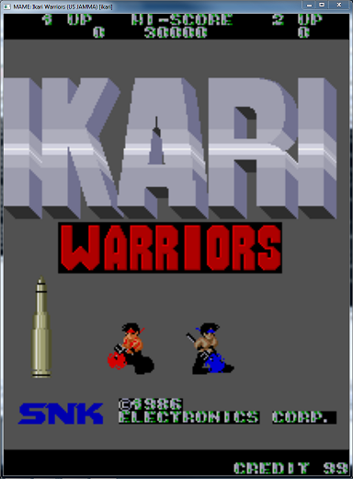
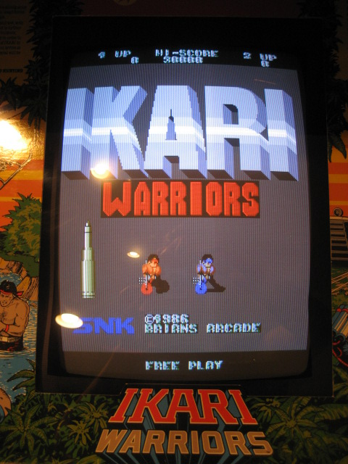
Ikari Warriors
http://www.paladingrp.com/brianb/rom_hacks/ikari.html

Slide 73
Application Development Methodology (976)
There are different type of turning source code into executable code
Assembling – turn assembly language into machine code. Assembly language code is the english equivalent of machine language, however it is not easily understood by modern humans.
Assembly language is SPECIFIC to the CPU that the machine is running on.
Assembled code is 1-1 to machine code and machine code can be disassembled and returned back to the original assembly

Slide 74
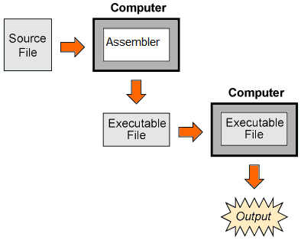
Assembly

Slide 75
Assembly (Ikari Warriors free play)
Machine Code | Assembly Representation | Comment
1111 0101 | PUSH AF | Save registers A&F to stack
0011 1110 1001 1001 | LD A 99 | Register A = 99 (BCD)
0011 0010 0101 1100 1111 1100 | LD ($FC56), A | Memory address 0xFC5C = contents of Register A
1111 0001 | POP AF | Reload register A&F values from stack
1100 1001 | RET | Return from previous call
http://www.paladingrp.com/brianb/rom_hacks/ikari.html

Slide 76
Assembly Example
leal 4(%esp), %ecx
andl $-16, %esp
pushl -4(%ecx)
pushl %ebp
movl %esp, %ebp
pushl %ecx
subl $4, %esp
movl $.LC0, (%esp)
call puts
addl $4, %esp
popl %ecx
popl %ebp
leal -4(%ecx), %esp
ret
Example Assembly Code

Slide 77
Compiled Code
Compilers - compile” languages like C or C++ into object code. Compiled languages (source code) are easier to understand, but must be converted into object code (which is NOT human readable at all). Source code is NOT specific to the CPU that the code will run on. (though can be OS dependant)
Once code is compiled there is no way to go back and get the original source code! (different from assembly)

Slide 78
Compiled Language

Slide 79
Source Code of previous assembly code
C source code
#include <stdio.h>
int main()
{
printf(“Paladin Group Rocks!\n”);
}
Resulting Assembly Code
leal 4(%esp), %ecx
andl $-16, %esp
pushl -4(%ecx)
pushl %ebp
movl %esp, %ebp
pushl %ecx
subl $4, %esp
movl $.LC0, (%esp)
call puts
addl $4, %esp
popl %ecx
popl %ebp
leal -4(%ecx), %esp
ret

Slide 80
Interpreters
Interpreters – don’t actually create object code. Instead another program reads the source code and executes the necessary instructions on behalf of the user/code. Scripting languages are usually interpreted.

Slide 81
Interpreted Language
Example
#!/usr/bin/ruby
print “Paladin Group Rocks\n”

Slide 82
Procedural Languages vs. Object Oriented Languages
In traditional (procedural) languages, a programmer must understand ALL the details of EVERYTHING he/she wants to do on the system. For example if writing code to drive someone from one point to another the programmer would need to know the details of EVERYTHING the car may need to do… example they’d need to know exactly how to parallel park…
Pull up ½ in front of car
Backup car and turn wheel while backing up
Ensure back wheel are within 12 inches of curb
Straighten wheel
Pull forward, turning wheel to straighten tires
Straighten wheel, backup till centered between car in front and car behind

Slide 83
Object Oriented Concepts
Object oriented programming tries to hide the specific details of how things work.
Object oriented programming allows programmers to be more efficient and tackle larger problems through abstraction and code reuse.
Objects provides abstraction or information hiding*

Slide 84
Object Oriented Programming
Programmers initiate objects (that others wrote)
Programmers manipulate objects through methods
Programmers do not need to know the inner working of objects*, instead they focus on how to use the object in the “big picture” and leave the details of the objects operation to the objects themselves.
Objects know how to access their own data
Objects know how to manipulate themselves
Objects pass messages to other objects

Slide 85
Object Oriented Concepts (981)
Object oriented programming tries to hide the details of how things work. (provides abstraction or information hiding). Instead programmers deal with objects that have defined methods* of how to manipulate an object. Programmers simply “instantiate”* an object they want to use, and then they can use any of the defined methods to manipulate that object, without understanding how their actions are being carried out. (give example, driving a car). Objects that need to communicate with each other use “messages passing”*
(more)

Slide 86
Object Oriented Code
Example.
If writing code to drive a car from point A to point B, the programmer would need not need to know the details of how to start the car, drive the car, or park the car.
Instead the programmers would
Instantiate the car object
Call the car.start method
Call the car.drive(location) method
Call the car.park method

Slide 87
Object Oriented Code
Whats more, if the object developer altered the internal workings of the car to alter the way the car operated or to support more types of cars (such as stick shift vs. automatic), the high level programmers would not have to change their code.

Slide 88
OOB
Object oriented programming provides the following benefits
Modularity – autonomous objects
Deferred commitment – can redefine parts of a object internally without actually affecting how other code is written
Reusability – different programs can use the same objects without re-writing code*, other objects can also inherit code from parent objects*
Naturalness – this is a more natural approach than traditional programming, where intimate details of all components need to be fully understood.

Slide 89
OOB term review
Objects – distinct entities that a programmer can create. Each object knows how manipulte itself.
Methods – specific actions an object can perform that a high level programmer can use.
Information hiding – components do not need to know how other components actually work.
Abstraction – suppress un-necessary details and lets people focus on what they are trying to accomplish.
Message passing

Slide 90
Polymorphism (984)
Two different objects can take the same input and provide different output, based on how the processing object processes the input.
Uses often for subclasses.
NEED an EXAMPLE here.

Slide 91
Cohesion and Coupling
Cohesion* - a terms that represents how many different types of tasks a module can carry out. If a module only does one tasks, that is high cohesion. If it does many tasks, that is low cohesion.
If something has high cohesion it’s easier to replace as there are not multiple dependencies on that object that you have to worry about*
If something has low cohesion, complexity is increased and it is harder to maintain and reuse.

Slide 92
Coupling
Coupling – is a measurement of how much interaction with other modules is required for one module to carry out it’s tasks.
Low or loose coupling – means an module is more independent (good)*
High coupling – means an module is dependant on other modules (more complex)*
High cohesion with low coupling* is usually preferred from a security and maintenance standpoint.

Slide 93
Distributed computing

Slide 94
Client Server Model
A model for distributed computing where a server provides some service or does some work on behalf of a client.
Web server/web browser
File server/desktop
Print Server/desktop
Database Server/Database application

Slide 95
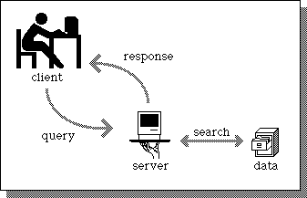
Client / Server Model

Slide 96
Distributed Computing
You need to be familiar with some of the technologies and terms in regards to distributed computing.

Slide 97
CORBA and ORBS
CORBA (Common Object Request Broker Architecture) – open object oriented standard. It provides interoperability among software, platforms, and hardware. CORBA enabled applications to communicate with one another regardless of where the objects are physically located on the network.
The standards define the API, communications protocols.
ORBs (Object Request Brokers) are the middleware that establishes the client/server relationship between objects and makes objects networkable

Slide 98
COM and DCOM ()
COM is Microsoft’s* model that allows for inter processes communication and object sharing on the same system.
DCOM enables network distributed IPC objects.

Slide 99
Enterprise JavaBeans ()
A structural design for the development and implementation of distributed applications written in Java. EJB provides interfaces and methods to allow different applications to be able to communicate across a network.

Slide 100
Object Linking and Embedding ()
OLE provides a way for objects to be shared on a computer and uses COM as the foundation. OLE enables objects (ex. Picture and spreadsheets) to be embedded into documents. (embedding)
OLE also allows linking different documents and objects. When you see a URL in a document with a blue underline and it’s clickable this is OLE (linking)

Slide 101
Distributed Computing Environment ()
DCE is a standard developed by the Open Software Foundation/Open Group. It is middleware that is available for vendors to use within their products. DCE provides RPC services, security services, directory services, time services and distributed file support.
DCE uses RPC (remote procedure calls)
DCE uses a universal unique identifier (UUID) to indentify users, resources and components*

Slide 102
More terms and concepts you need to understand

Slide 103
Expert Systems
An expert system or knowledge based system uses Artificial intelligence to solve problems. They try to emulate human logic to solve problems as if an expert human was there.
Collect knowledge into a database
Use rule-based programming* (if-then logic)
Uses an inference engine* to match facts against patterns and determine which rules are applicable.
An example of an expert system might be on that takes information about a patients medical history and current symptoms along with questions to determine which ailments a patient might be suffering from.

Slide 104
Artificial Neural Networks
Computer model based on the neural structure of the brain. Attempts to learn.
As information is used more and more connections between units grow and strengthen like how human minds work.
Fuzzy logic* is used (rather than true or false, degrees of truth or falseness/rating)
Massive trial and errors decision making is used*.

Slide 105
Web Security

Slide 106
Web Security
The web (HTTP) is the application that brought the internet out of academic and research obscurity and caused it to be the phenomenon that it is today.
The web is highly commercialized now and that brings dangers.

Slide 107
Web Security
Web dangers:
People may try to use your online presence to cause you harm.
Vandalism – deface your site, ruin your reputation
Financial fraud – attempt to steal web based goods or services
Privileged access – hack your web server to get access to something more important
Theft of personal information – access your clients information, identity theft
Theft if intellectual property – steal company secrets
Denial of service – stop you from carrying out online transaction, and cost you money!

Slide 108
Web Security ()
There are multiple vulnerabilities and threats that can be exploited to accomplish any of the previous actions. We will talk about each of these issues over the next couple slides
Information gathering
Administrative interfaces
Authentication and access control
Configuration management
Input validation
Parameter validation
Session management

Slide 109
Web Security
Information gathering – Reconnaissance, gather as much information as you can about the system you will be attacking.

Slide 110
Administrative interfaces
Administrative interfaces – often developers and administrators have back end interfaces for managing a site. These interfaces can often be attacked giving the attacker a lot of access. If you use a admin interface for management, it should be at least as secure or more secure than the app.
Disable them unless necessary
Restrict Access to only required IP addresses
Encrypt all data
Require authentication
Require authorization
Audit access
Don’t allow browsers to “remember password” for these sites in case someone steals your computer/laptops.

Slide 111
Configuration Management
Often in web development there is little configuration management, often test environments become production environments, lack of proper procedures etc.
Default passwords
Default security controls
Countermeasures:
Have official policy and procedures
Ensure security controls and configurations before going live
Remove information and feature that are not necessary.

Slide 112
Input Validation ()
Software must validate input and ensure that it is appropriate and does not pose a security risk before operating on the input.
Attackers may try to hide their actions using.
Path or directory traversal
Unicode encoding
URL encoding
Buffer Overflows
You should be aware of these and understand how they operate (pg 1008) we will explore these in the next couple slides.
(more)

Slide 113
Input Validation (Path Traversal)
Path of directory traversal tries to access data on a web server that is not intended to be shared. (data outside of the shared directories)
Web servers are configured to serve information out of the web root or document root directory which is a specific directory on the system with files for public access.

Slide 114
Path Traversal
Assume http://www.myserver.com has the document root set to /var/web/html
The request http://www.myserver.com/index.html would try to access the file /var/web/html/index.html
What would http://www.myserver.com/index.html/../../../etc/passwd try to access?

Slide 115
URL encoding
Good software should filter out request like I just showed. For example if a security product filtered out parts of the URL like “../.” One attempt to get around this is to use special URL encoded* characters
http://www.myserver.com/%2E%2E/%2E%2E/%2E%2E/etc/passwd
%2E = . so it’s the same as
http://www.myserver.com/../../../etc/passwd

Slide 116
Unicode Encoding
Similar to Unicode encoding, but uses special Unicode characters rather than URL encoding.
http://www.myserver.com/%C0AE%C0AE/%C0AE%C0AE/%C0AE%C0AE/etc/passwd
%C0AE = . so it’s the same as
http://www.myserver.com/../../../etc/passwd

Slide 117
Parameter Validation
Similar to input validation, but are specific to the environment and assume the user cannot alter them (ex. Environmental variables)

Slide 118
Session Management
HTTP is a stateless protocol* as such there must be a way of managing and passing state information between the client and the server this is usually done with cookies* which create a sessions between the user and the web application.
This session management can be attacked to hijack sessions*. The next slide discusses best practices for sessions management.

Slide 119
Session Management Best Practices
Sessions details should be stored on the server, never passed by the client*
The client should pass a session ID which the server uses to recover the state from it own database*
Session IDs should be random*
Session IDs should be encrypted*
Session IDs should have a maximum lifetime to avoid replay attack*

Slide 120
Client side security issues

Slide 121
Mobile Code
So we talked about concerns with server side applications. What about client side issues? To make the web experience more functional and friendly often code runs directly on your web browser or personal computer, this happens via mobile code that is code that your computer downloads from a server and executes on your workstation.

Slide 122
Mobile Code
Mobile Code types we will discuss
Java
Active X
Javascript

Slide 123
Java
Java - The original mobile code designed by Sun Microsystems
Purpose/idea
Byte code
Java virtual machine
Applets
Sandbox
Signed vs. unsigned applications.

Slide 124
Active X
Microsoft mobile code based on COM/DCOM*
Called active X controls
Security Level of browser determines whether or not to run active X
Active X can interact with the system. There is no sandbox
ActiveX controls can be digitally signed (authenticode)

Slide 125
Digitally Signed Software?
If mobile code is digitally signed, is it always safe to run*?
What does digitally signing code provide the end user?*

Slide 126
Javascript
Javascript (developed by Netscape) is mobile code that runs in the browser to make the web sessions more functional and interactive
Only runs in the browser
Can access browser information including cookies
Can rewrite data in the browser
Cross Site Scripting (XSS) is a common attack using Javascript to perform many undesirable actions, the most common is to steal session cookies for sessions hijacking.

Slide 127
Malware

Slide 128
Malware
Malware – You should understand what malware is and the basic types of malware and their attributes. Symptoms of malware may include
File size increase
Disk or CPU activity
Change of timestamps on files
Sudden increase of hard drive space
Strange activity by applications
Increase in network activity
Slow computer
Now to look at the types of Malware

Slide 129
Malware
The types of malware we will discuss in the next couple slides are
Viruses
Trojans
Worms
Logic Bombs
SPAM -not malware, but a method of malware distribution

Slide 130
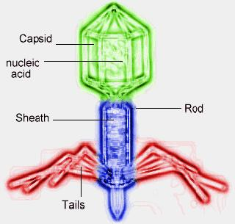
Viruses

Slide 131
Viruses
The original malware.
Operation
Requires human intervention to spread and attack
Types
Program Virus
Boot sector virus
Multipart virus – (infects both boot sector and executables)
Macro virus
Stealth virus – tries to hide itself from anti-virus software
Polymorphic virus – creates multiple different copies of itself in different ways to defeat detection
Self-garbling virus – like polymorphic, but alters itself with each generation.
MEME virus – not real virus, but chain letters, hoaxes etc

Slide 132
Virus Countermeasures
Countermeasures
Never run code if you don’t know what or where that executable has been.
Run anti-virus software on all workstations and major servers that accept incoming data to users (email, instant messaging, web proxies)

Slide 133
Anti-Virus Software
Anti-virus software tries to detect and stop viruses.
Types
Signature based
Heuristic
Strengths and weaknesses of each
which can possibly stop a 0day?

Slide 134
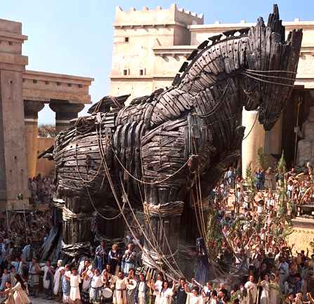
Trojan (horse)

Slide 135
Trojan
Like the Trojan Horse, a Trojan program seems like a gift. Pretends to be some useful program, and it even might do something useful initially. Howver it’s purpose is to deliver it’s malware payload.
Countermeasures
User Education
Don’t run software that you are not familiar with and that you don’t have original distribution media for.
Beware of email attachments that want to be run.
Software Signing
Anti-virus software to detect known Trojans

Slide 136
Worms
A worm has the ability to actively spread on it’s own unlike a virus that simply copies itself into other executables.
self-propagates*
It might try to scan networks for known security weaknesses and “hack” machines as a method of spreading.
May email itself to others

Slide 137
Famous Worm Attacks
Morris Worm – First known worm
Simply spread didn’t do anything else
Did eat up a lot of CPU and network bandwidth, brought internet to a halt in 1988.
Did password guessing and auto-hacking
Code Red
Attacked IIS, using a buffer overflow, targeted other IIS servers
Nimba
5 methods of propagation
Email, network shares, compromised web sites, IIS holes, and backdoors from other worms.

Slide 138
Worm Countermeasures
Counter measures
Remove un-necessary services
Patch OS and applications
Beware of email attachments that want to be run.

Slide 139
Logic Bombs
Logic Bomb
Countermeasures
Inventory all software and keep checksums (File Integrity Verification Software*)
(tripwire)

Slide 140
Anti-malware best practices
Install anti-virus on all computers
Have an automated method of updating virus signatures
Do not allow users to disable anti-virus scanning
External disks should be immediately scanned.
Disable “auto play” on USB and CDroms
Backup files should be scanned
Use network antivirus filters (email servers, proxy servers)
Make virus scanning a scheduled task on all computers
Use dynamic anti-virus scanning (real time file access)
Users should not be able to install software (especially on servers or critical systems)

Slide 141
SPAM
SPAM is annoying.
Spam wastes time and resources.
Spam can spread viri, trojans and worms.
SPAM can cause HR problems (nude images etc)
Spam filtering concepts
False positives
False negatives
Rules
Bayesian filtering* – predicting probability via mathematical analysis.

Slide 142
Malware
For the exam you should be able to
define what malware is
what symptoms of malware are
be able to understand and discriminate between the types of malware their characteristics and countermeasures.
Understand the relationship between malware and SPAM

Slide 143
Patch Management

Slide 144
Patch management
Systems must be constantly updated/patched. There should be a process to handle applying patches and system updates. This is called a “Patch management process” and the goal is to introduce patches in a controlled and tested fashion and to have a rollback plan. Patch management follows a 6 step methodology.

Slide 145
Patch Management
Infrastructure
Create a strategy and a team
Research
Research a patch, check digital signature, verify the appropriateness of the patch to the system*
Assess and test
Test the patch on a test system*
Integrate patch into change management *
Mitigation (rollback)
Have a plan and steps required if a patch must be undone*
more

Slide 146
Patch management
Deployment (rollout)
Use a pilot group of less critical systems*
Use automated scripts or deployment tools
Have a “patch window”*
Validation, reporting and logging.
log what was done, where and the results*
Retest / asses vulnerabilities to ensure patch has addressed them*
Confirm systems actually received patches*
Archive logs/reports

Slide 147
Chapter 11 - Review
Q. What is a logic bomb?
Q. What is the final stage in the change control process. Report changes to ___________.
Q. What is the difference between a virus and a worm?
Q. What is a important practice in signature based anti-virus scanning?

Slide 148
Chapter 11 - Review
Q. What is a primary key in a relational database?
Q. what is the purpose of polyinstantiation?
Q. how does a buffer overflow work?
Q. what is a transaction?

