Slide 1
Chapter 12: Operations Security
Brian E. Brzezicki

Slide 2
Operations security
Most of this chapter is review

Slide 3
Overview
Operations Security
Day to day tasks, once network is deployed/operational
Ensuring people have necessary access controls
Ensures monitoring and auditing
Ensures systems, networks and environments are properly secured and updated
Lots of overlap with all the other topics. This is the day to day implementation of other concepts.

Slide 4
Goal
To implement due care.
To ensure that people, applications, equipment and overall environment is properly secured.
This includes physical concerns such as ensuring humidity controls, secure media reuse and destruction, and utilities are provided in a reliable and secure fashion.
This also includes verification methods to ensure that standard and compliance requirements are met.

Slide 5
Administrative management ()
Operationally important administrative concepts
Separation of duty
Job rotation
Mandatory vacations
Least privilege

Slide 6
Security Administrator 1031
Day to day responsibly for implementation and administrating the security controls.
The security admin should not report to the network administrator.
Responsibilities
Implement and MAINTAIN security devices and software
Security assessments
Set initial passwords for users.
Implement and maintain access controls
Configure security labels on MAC systems
does not actually classify data or authorize access
Review audit logs

Slide 7
Accountability 1032
Auditing needs to take place in a routine manner
Access attempts MUST have the user id included.
Someone MUST actually read over the logs
There are automated tools to analyze logs
Ask yourself 3 questions when reading logs
Are users accessing stuff that they don’t need to access in order to do their job (secure perms better)
Are repetitive mistakes begin made (require re-training)
Do too many users have rights to restrictive info? (need to analyze/re-evaluate data access rights)

Slide 8
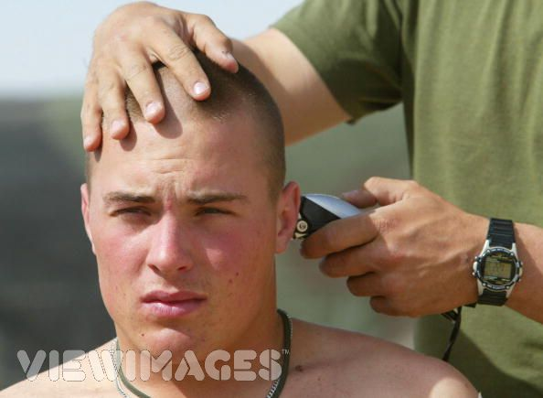
Clipping Level

Slide 9
Clipping Level*
The threshold of violations attempts that should be considered normal and not logged.
Example:
A system may be configured to only log login failures after a user has failed 3 times.
Why use clipping levels
avoid to many false positives, avoid overwhelming the analyst
Clipping level thresholds should NOT be known to end-users

Slide 10
IPL* ()
Initial Program Load – a mainframe term for loading the OS into the computers main memory.
Same concern exists with booting a workstation or server.
Concerns of securely booting on next slide

Slide 11
Concerns for security booting*
Boot up sequence should not be available for normal users to re-configure?
System logging should not be able to be bypassed
Log output should not be able to be redirected
Users should not be able to initiate a shutdown

Slide 12
Trusted Recovery* – ()
When an OS or app crashes, it should not put the system in an insecure state! An OS’es response to a failure can be one of the following*
System reboot – a controlled shutdown and restart in response to a TCB failure. This restores the system to a stable secure state
Emergency system restart – when the system detects an activity that cannot be recovered without restarting.
a system reboot is a clean restart. An emergency restart, is a shutdown with a restart.
Cold start – when an unexpected kernel or medial failure happens and the regular recovery procedure cannot recover the system to a consistent state, human intervention may be required to actually bring the system back online. Until then the system is shutdown. The steps to bring the system back online are on the next slide

Slide 13
Crash steps ()
Enter single user mode – usually require direct access to system (console)
Fix issue
Validate critical files - might use something like tripwire.

Slide 14
Input/Output – ()
I/O security needs to be concerned with ensuring input and output to a system happens securely.
That users cannot put in false info
Input is validated
Transactions should be recording and time stamped
Non-repudiation issues
Encryption of data

Slide 15
System Hardening ()
What is system hardening
Remove disable accounts
Remove disable services/software
Remove compilers
Run services as restricted accounts
Configure services for maximum security
Configure OS setting for max security
Install host based firewall and IDS
Install access controls, TCPwrappers, auditing
Keep machine and services patched and up to date.
(more)

Slide 16
System Hardening ()
Restrict physical access
Lock network equipment and access
Secure removable media access
Secure console
use a physically different server (or VM) for each service

Slide 17
Remote Access Security ()
More mobile/virtual workforces now a days. Need to secure Remote Access
Strong authentication of users
Proper cataloging and auditing of media
Look at labeling on 1053
Encrypting data
Critical systems should not be adminstrated remotely.

Slide 18
Configuration Management ()
Important in actually running a network or business, especially when subject to regulation (ex. SOX)
There should be a change control policy and process (next slide)
Important during operational use
Important during the whole lifecycle of a product
service packs etc are types of changes!

Slide 19
Change control process
Operational changes happen a lot. So make sure your familiar with the change control process from chapter 11
Request a change take place
Approve change
Document the change
Test and present the change
Implement the change
Report change to MANAGEMENT*

Slide 20
Media Control ()
Day to day media must reflect the companies security policy and enforce Confidentiality, Integrity and proper access controls (same as Confidentiality)
Backup media need to be protected from people and the environment.
Auditing of media access must be done
Company may have media librarian
Media reuse issues
Media destruction (next slide)

Slide 21
Media destruction ()
Sanitization – process of destroying media when it is no longer used.
Data reminence – residual information left on a computer after being erased. (object re-use)
Purging – making information unrecoverable even through extraordinary measures
Zeroization – overwriting, don’t use simple all zeros or all ones. Do multiple passes
Degaussing – magnetically scramble data

Slide 22
Network and resource availability

Slide 23
Network and resource availability ()
Availability is often overlooked but is of fundamental importance.
Redundant hardware – ready to hot or cold swap
Fault Tolerant technology
Service Level Agreements (both from providers and what SLA you provide internally to departments)
Solid operational procedures
Documented procedures
Practice of recovering from issues!

Slide 24
MTBF ()
Mean (average) Time Before Failure – all equipment (especially moving equipment) will eventually fail. MBTF is the average expected life time of a device
What does this mean to you? How do you use MTBF?

Slide 25
MTTR ()
Mean Time To Repair – expected time to get a device fixed and back into production.
If MTTR is too high, you might want to have redundant systems or spare parts.

Slide 26
Single Point of Failure – ()
What does this mean?
What are some examples.
What are some technologies to control this
HSRP
Alternate routing vs. diverse routing*
RAID
RAIT
Clusters / Load balancers
Virtualization
Grid computing – example DES challenge / SETI@home
SANs and NAS

Slide 27
RAID

Slide 28
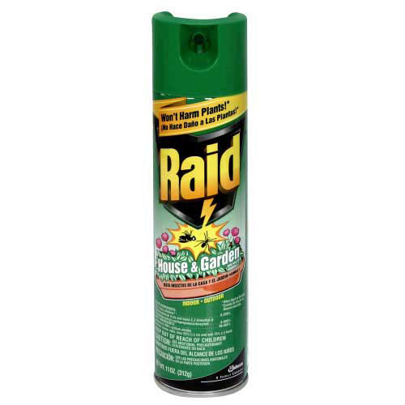
RAID
Kills Bugs… dead!

Slide 29
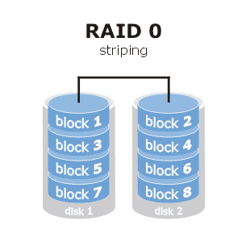
RAID 0 - 1061
Raid 0 – striping (see visual)
Fast access
No redundancy
Actually increases probability of failure

Slide 30
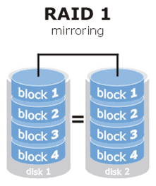
RAID 1
Raid 1 – mirroring (see visual)
Identical copies of data
Expensive
Faster than a single disk for reading
Can lose a disk
What is disk duplexing

Slide 31
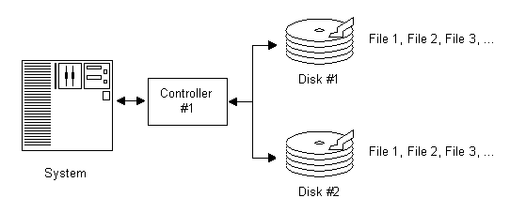
Normal RAID 1

Slide 32
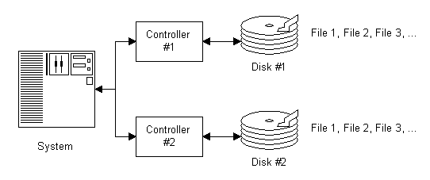
RAID 1 - Disk Duplexing

Slide 33
Parity
If I have an even number of 1s set the 4th bit to 1, if odd, set to 0
Disk1 Disk2 Disk3 Disk4 (P)
0 1 1 1
If I lose a disk… I can determine the lost information!

Slide 34
Parity
If I have an even number of 1s set the 4th bit to 1, if odd, set to 0
Disk1 XXXX Disk3 Disk4 (P)
0 ? 1 1
What does disk 2’s data HAVE to be, in order for the parity bit to be 1?

Slide 35
RAID 1061
RAID 5 – Striped sets with parity (see visual)
At least 3 disks
Can lose single disk
Capacity of one disk is lost
The more disks the less waste
Fast reads
Writes can be slower, especially small writes
If disk lost you are in critical mode
Another disk, total failure
Slow operation while in critical mode

Slide 36
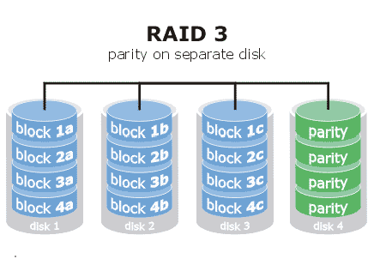
RAID 3 (similar to 5, easier to explain)

Slide 37
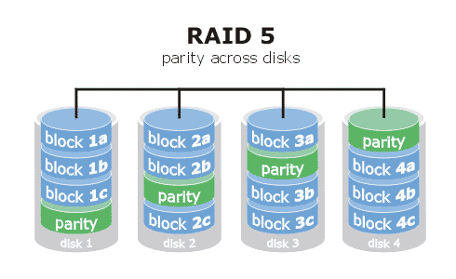
RAID 5

Slide 38
NAS
Network Attached Storage
Traditional model of a file server sharing files on a file based level*
Multi-station remote access
Can be a windows or Unix file server or a stand alone device like NetApp. However all file sharing is via a network file system like NFS or CIFS
Used to share FILES* to end users desktops

Slide 39
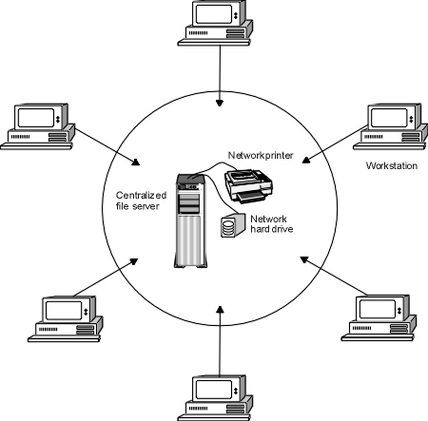
NAS

Slide 40
SAN
Storage Area Network – disk/block level sharing
Hard drives are not in servers, instead attached to a network.
Dedicated storage network
Shares sections/blocks of a disk rather than files.
Generally only to one machine at a time, though used in clusters to make access available to stand by machines*
Used to share LUNS to SERVERS (not desktops)*
Can optimize equipment use (share a tape drive)
Can support advanced storage and backup concepts.
If computers need multi-station remote access, a server will then share out the file system (via NFS or CIFS) such becoming a NAS server using a SAN!
Used for clustering
Used for virtualization
Can be used for normal server disk access

Slide 41
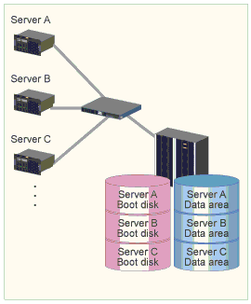
SAN

Slide 42
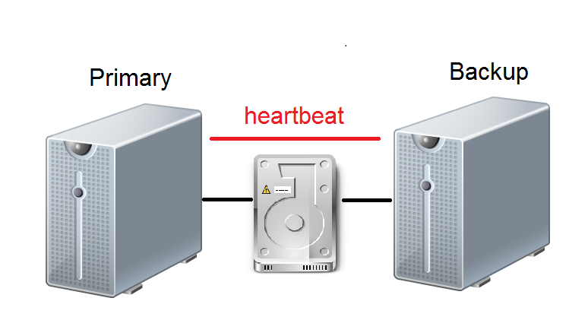
Clustering (Active/Passive)

Slide 43
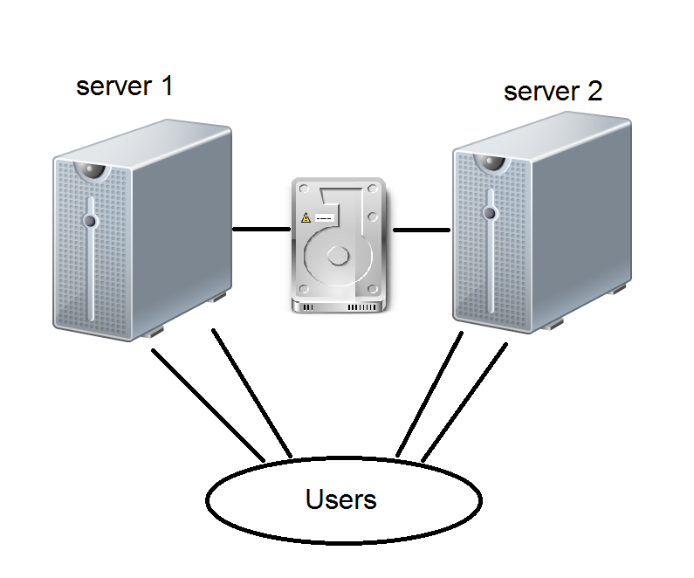
Clustering (Active/Active)

Slide 44
Virtualization
Virtualization is KEY to network security, availability and maintenance/ease of operation.
What does it allow you to accomplish
How does it make your life as an admin easier
How does it increase availability
How does it allow you to make servers more modular?
How does it increase security and integrity?

Slide 45
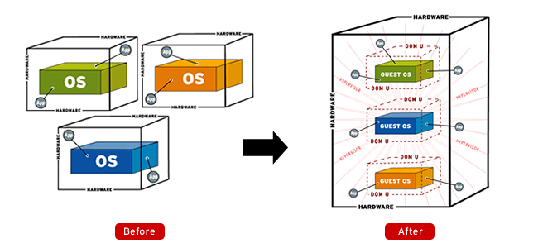
Virtualization

Slide 46
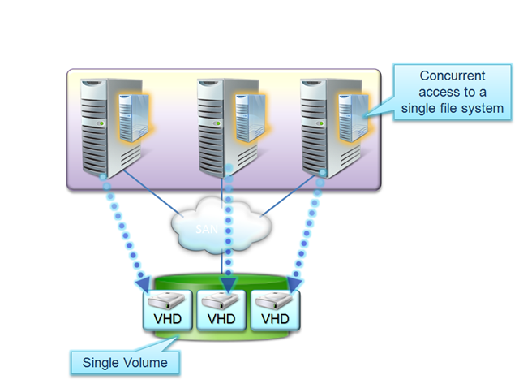
Virtualization migration

Slide 47
Backups – ()
Backups and Data Archiving
RAID does not make backups un-necessary!*
Backps should be done regularly
All needed information is backed up
Backups must be verified
Restores must be tested
Store offsite / and onsite
Archive backups for permanent storage

Slide 48
Email Security - 1072
Email is relied upon every day
SMTP (TCP/25) to send mail
No true security
No user authentication (spoofing)
No encryption
Problems with relaying*
SPAM/Virus/Trojans/Phishing
Sending and Receiving
POP TCP/110
Downloads all mail
No encryption
IMAP TCP/143
Leaves mail on server, more incremental
No encryption
Use SSL or VPNs when using POP/IMAP

Slide 49
Hacking Terms 1078
White Hats – good hackers
Black Hats – bad hackers
Grey Hats – in between, should not be trusted*
Ethical Hacking is often called penetration testing (later)
Script kiddie
Port scanning (visualization next)
Os fingerprinting
Password Cracking
Crack
John the Ripper
L0phtcrack
Backdoors
Sniffing

Slide 50
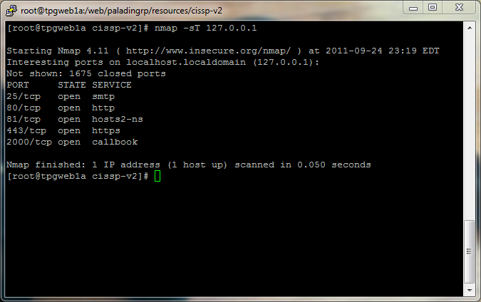
Port scan

Slide 51
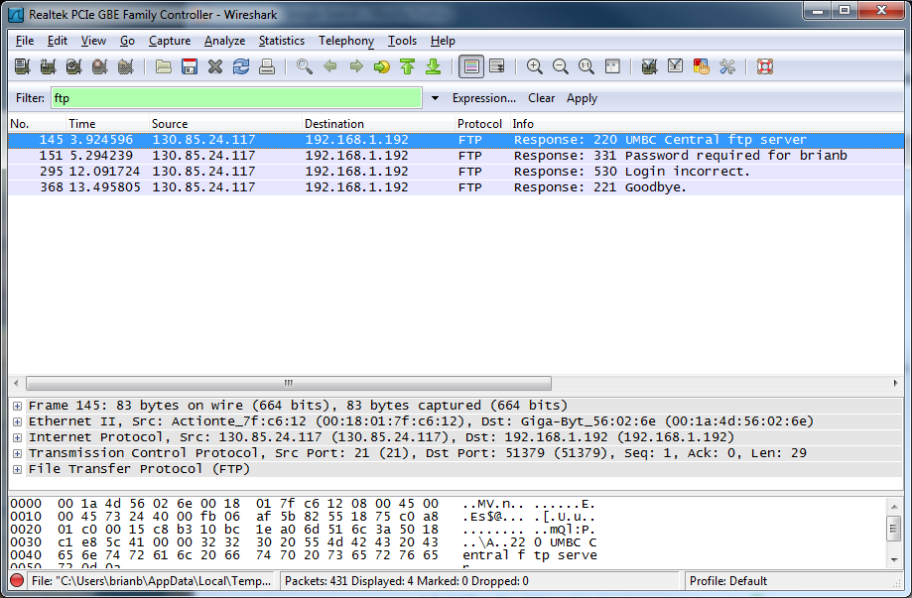

Slide 52
Hacking 1078
You should be familiar with the attacks from the end of chapter 7! You probably will see each one of them!
Buffer Overflow
Ping of Death
Smurf
Fraggle
LAND
Tear drop
LOKI
DDoS
Zombies / Botnets

Slide 53
Penetration Testing 1092
Idea of simulating attacks on networks
Steps
discovery – gathering info about target
Enumeration – port scanning and resource identification
Vulnerability mapping – identifying potential vulnerabilities
Exploitation – try to break in
Report to management

Slide 54
Penetration Testing – ()
Types
Zero Knowledge
Partial Knowledge
Full Knowledge
Methods
Blind – zero knowledge, but defenders know it will occur
Double blind – zero knowledge, defenders are unaware of the impending penetration test
Targeted – specifically targeted penetration tests
When penetration testing, be aware you can cause damage to the systems being tested, this is more aggressive than simple vulnerability assessment and is a separate concept.*

Slide 55
Chapter 12 - Review
Q. What is the difference between a SAN and a NAS? Would you export a LUN to simultaneous disks to many stations with a SAN?
Q. What is RAID 0, RAID 1, RAID 5?
Q. What is MTBF?
Q. What is MTTR?
Q. How can virtualization help with keeping your IT resources running with little to know downtime?

