Slide 1
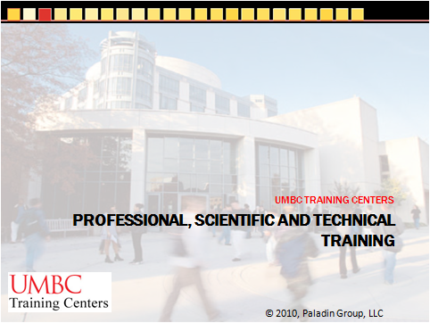

Professional, Scientific and Technical Training
Certified Information System Security Professional (CISSP)
UMBC TRAINING CENTERS
© 2010, Paladin Group, LLC

Slide 2

Certified Information System Security Professional (CISSP)
Developed and presented by :

Slide 3
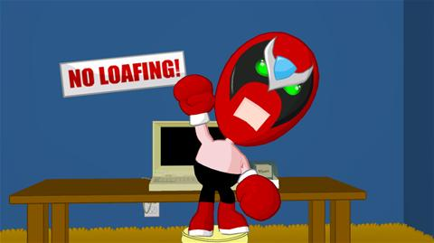
About the Instructor

Slide 4
About the Instructor
Brian E. Brzezicki
email: brianb@paladingrp.com
bbrzezicki@keywcorp.com
  Bachelor of Science, Computer Science
  Masters of Science, Computer Science
  ISC2 CISSP
  EC-Council Certified Ethical Hacker (CEH)
  CompTIA Security+
  Red Hat Certified Technician (RHCT), Certified Engineer (RHCE)
  Sun Solaris Network Administrator, Sun Solaris Systems Administrator
  Microsoft MCSE (NT 4.0) / Microsoft Certified Trainer

Slide 5
About the Instructor
Strengths
  Technical Security (hacking and defending)
    Access Control
    Telecommunication and Network Security
    Security Architecture and Design
    Applications Security
    Operations Security
  Unix/Linux
  TCP/IP
  Internet Services

Slide 6
About the Instructor
Weaknesses
  Non-technical Areas
    Business Continuity Planning and Disaster Recovery Planning
    Legal Regulation and Compliance
  Windows: I simply don’t like it and I avoid deploying it.
Note on the areas of the CBK that I’m not an expert in, I will do my best to find you the correct answers to your questions if I don’t have them already.

Slide 7
What about each of you
Yes It’s that time where you all have to say a few words about yourself
  Name
  What you do (if you can/want to tell)
  What your strengths and weaknesses in security are
  Why are you taking this class?

Slide 8
About this Class
This class is NOT about hacking

Slide 9
About this Class
You will NOT be a hacker when you leave this class

Slide 10
About this Class
Some subjects will be very boring

Slide 11
About this Class
I mean VERY boring

Slide 12
About this Class
You may have the urge to fall asleep

Slide 13

But seriously guys…

Slide 14
About this Class
At the end of this class you will have a good understanding of the wide range of different business security concerns

Slide 15
About this Class
By obtaining this certification you will be very valuable to many organizations

Slide 16
How to be successful in this class…

Slide 17
How to be successful in this class
…Avoid the urge to check your email or surf during class…

Slide 18
How to be successful in this class
Seriously… I won’t stop you… but it’s WAY too easy to get distracted.

Slide 19
How to be successful in this class
… Also try not to fall asleep…

Slide 20
How to be successful in this class
…Besides that…

Slide 21
How to be successful in this class
Relax! There is nothing to prove to anyone but yourself and ISC2 ☺
There is A LOT of material to cover! “a mile wide, an inch deep”
Focus on the main concepts and understanding them
Try to keep on topic. For situation specific questions see me during breaks.
Please read chapters AHEAD of time
STOP me if you don’t understand something!
Ask questions of what you have read and need clarification on!

Slide 22
How to be successful in this class
Don’t believe EVERYTHING you read, whether that be in this book, or what I tell you. (I’ve seen incorrect answers on exams!) Sometimes I will transpose my thoughts or be thinking of something else.. I may even say something blatantly wrong just to see who is awake! ;)
Moral of the story is ALWAYS think for yourself.
Watch for * in the notes… pay special attention to these items for the exam.

Slide 23
CISSP Common Body of Knowledge Domains
10 Domains
  Access Control
  Telecommunications and Network Security
  Information Security and Risk Management
  Applications Security
  Cryptography
  Security Architecture and Design
  Operations Security
  Business Continuity Planning and Disaster Recovery Planning
  Legal Regulation and Compliance *
  Physical (Environmental Security)
  * This chapter will probably be left as a reading assignment for you.

Slide 24
Becoming a CISSP
Prerequisites
5 years of PROFESSIONAL experience in TWO or more of the domains
  Or
4 years of experience (2+ domains) AND 4 year college degree or masters degree in Information Security from a National Center of Excellence
  Or
3 years experience (2+ CBK), AND a 4 year college degree AND approved security exam (see ISC page)

Slide 25
Not Enough Experience?
You can take the exam, if you pass you will be an “CISSP Associate”.
An Annual Maintenance Fee (AMF) of US$35 applies, and
Continuing Professional Education (CPE) units must be earned each year (20 towards the CISSP)
You have 6 years to get the required on the job experience to become a CISSP

Slide 26
CISSP Exam
250 multiple choice questions
  4 possible choices, 1 correct answer
  Different difficulty, different values
  225 questions are graded, 25 are NOT
  Minimum passing score 700 out of 1000
  Usually 2 answers are easily removed
  2 remaining answers are very similar
  Some questions are “word problems”
6 Hours to complete exam
Most people DO NOT pass their first time!

Slide 27
CISSP Exam Techniques
Before you attempt the exam, ensure that you have read every page in the book and understand the points discussed in the “Quick hints” of each chapter.
Relax! Don’t stress yourself out.
THINK! Rather than memorize.
Internatlize important ideas/concepts and use them to derive the correct answers
Immediately remove 2 of the answers
Knock out the ones you know right away
Skip a problem and come back if your not at least 90% sure of your answer

Slide 28
Exam Resources
CISSP practice tests
  http://www.freepracticetests.org
  Do These after EACH chapter at home. Use this to figure out what you need work on.
  Do one CBK at a time
  Put the settings on PRO
  Choose 25 questions at a time
  If you can consistanty get 85% or better… you should feel comfortable with that CBK for the CISSP
I will post my slides/notes online at http://www.paladingrp.com/resources.shtml

Slide 29
After the Exam
Must provide resume
Must state which 2+ domains you have experience in, at which jobs and for how many years.
Must be sponsored by a current CISSP (preferred) or have a past manager vouch for your experience

Slide 30
Maintaining your CISSP
120 credit hours worth of extra-curricular activities. (classes, reading books, conferences etc) every 3 years.
80 must be directly related to security
40 can be generic IT related
Minimum 20 credits a year
  Or
Retake the exam every 3 years

Slide 31
Lets Begin!

